Slide 1



Sharing your science
Name
Date
Notes:
This final session is all about communicating your science!

Slide 2







Minds on
How would you know if there was a big scientific discovery?
2
Notes:
FACILITATION IDEA: Have students discuss with each other how they would know if there was a big scientific discovery. Then, choose some answers from the class to share. What are some common themes?

Slide 3


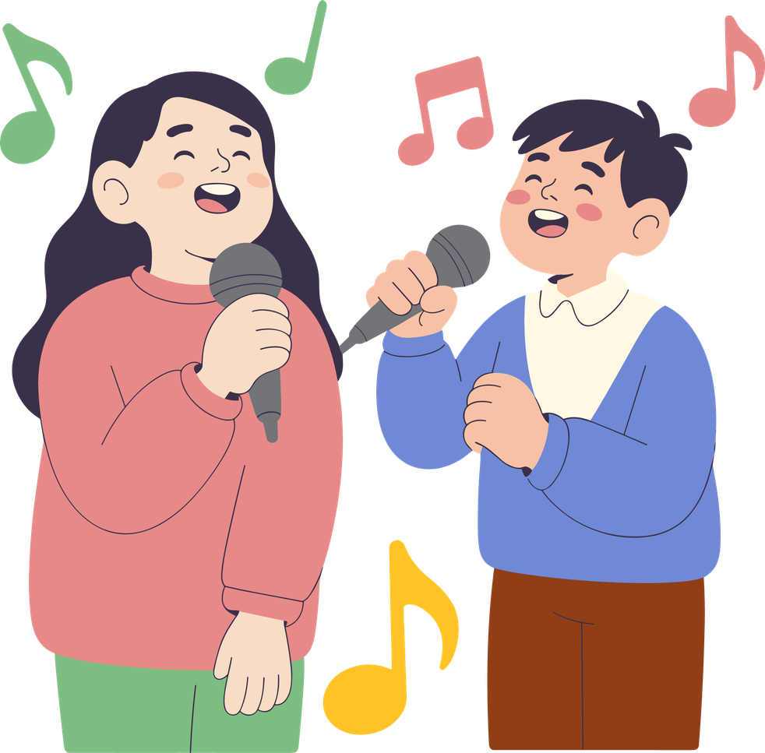




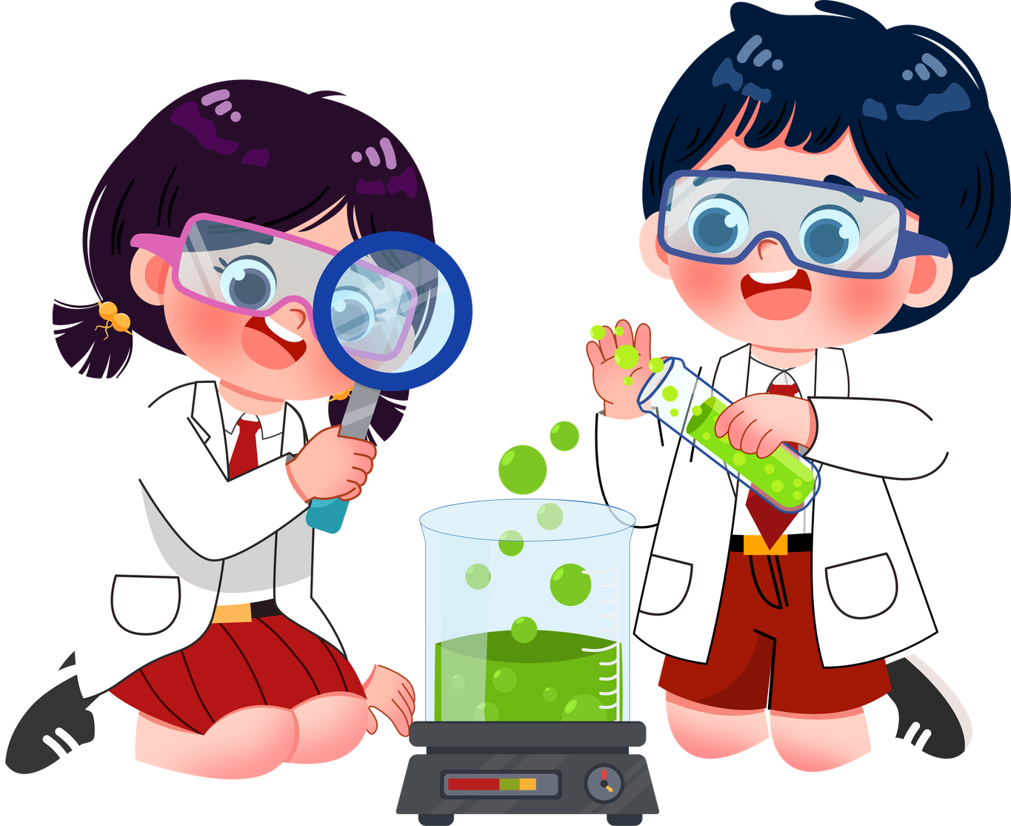
Ways to share science
Can you think of any other ways science is shared?
3
Notes:
There are so many ways that science is shared! It is not limited to what most people think, like the news. Sometimes we learn about science through pictures, magazines, books, songs, and videos! We also learn by doing or recreating experiments.

Slide 4

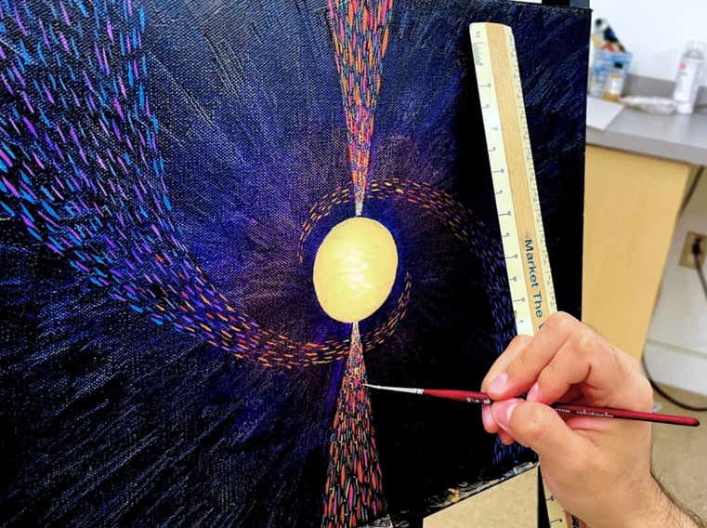
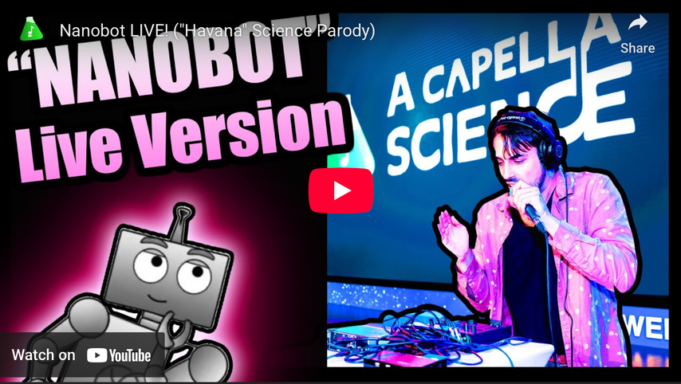
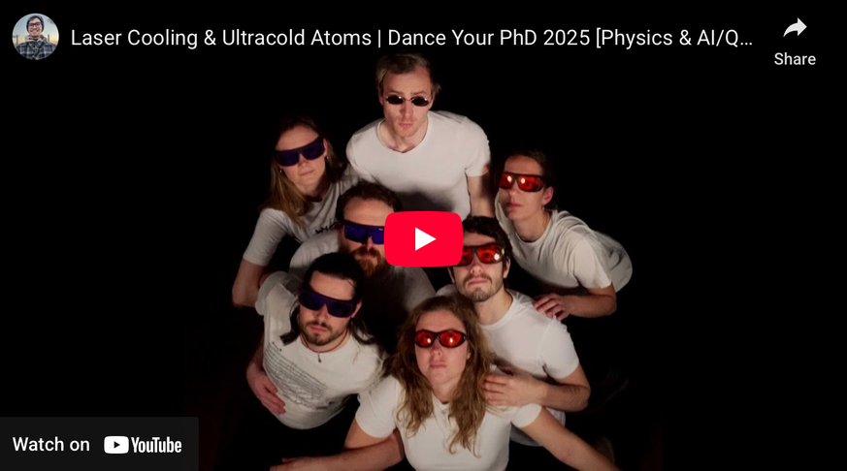
More Ways to share science
4
Notes:
Check out some of these creative ways science is shared! The arts, including singing, dancing, and painting or drawing are all important ways that science can be shared in a fun way.

Slide 5

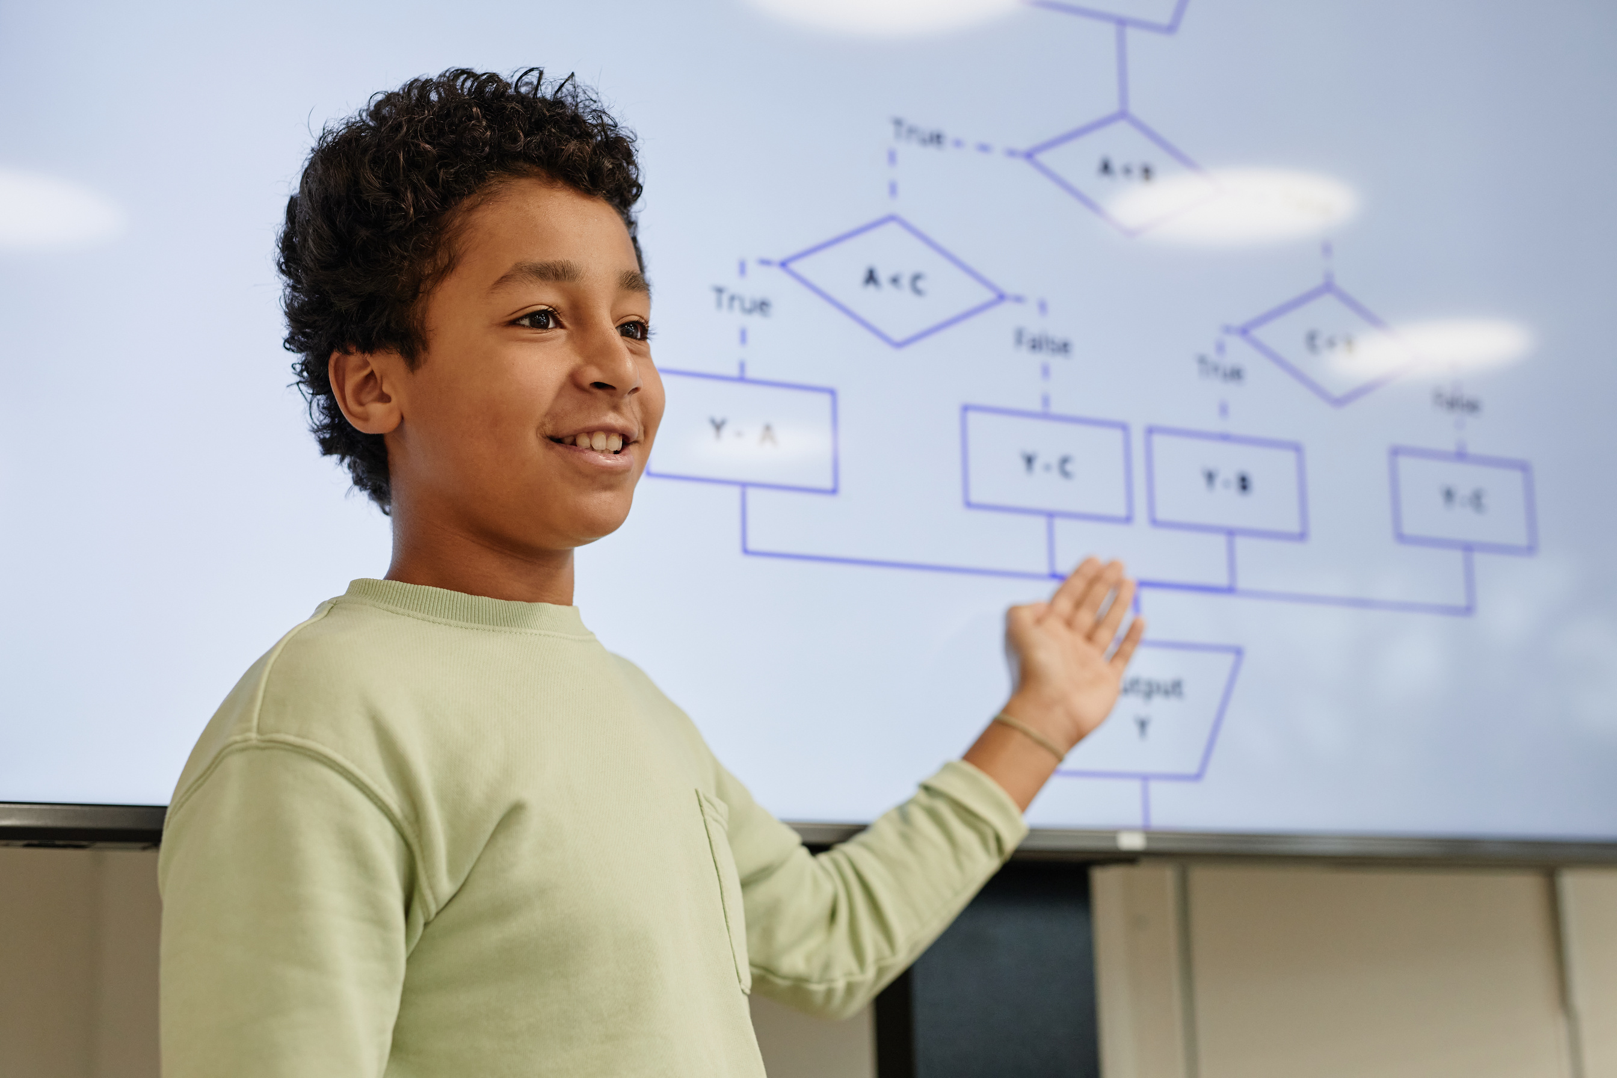
Talking about science
Part of doing science is telling people about your experiments and their results!
We talk about our results so we can:
Learn
Share
Compare
5
Notes:
A big part of doing science is telling people about your experiments and the results that you get!
We do this so that we can learn, compare, and share!

Slide 6





Sharing your science!
However you share your science, make sure to answer these three questions:
What did you want to find out?
How did you find it out?
What did you discover?
6
Notes:
Regardless of how your science is shared, you should answer the three questions on the slide. This helps to tell a story that people can understand and gives good motivation.

Slide 7

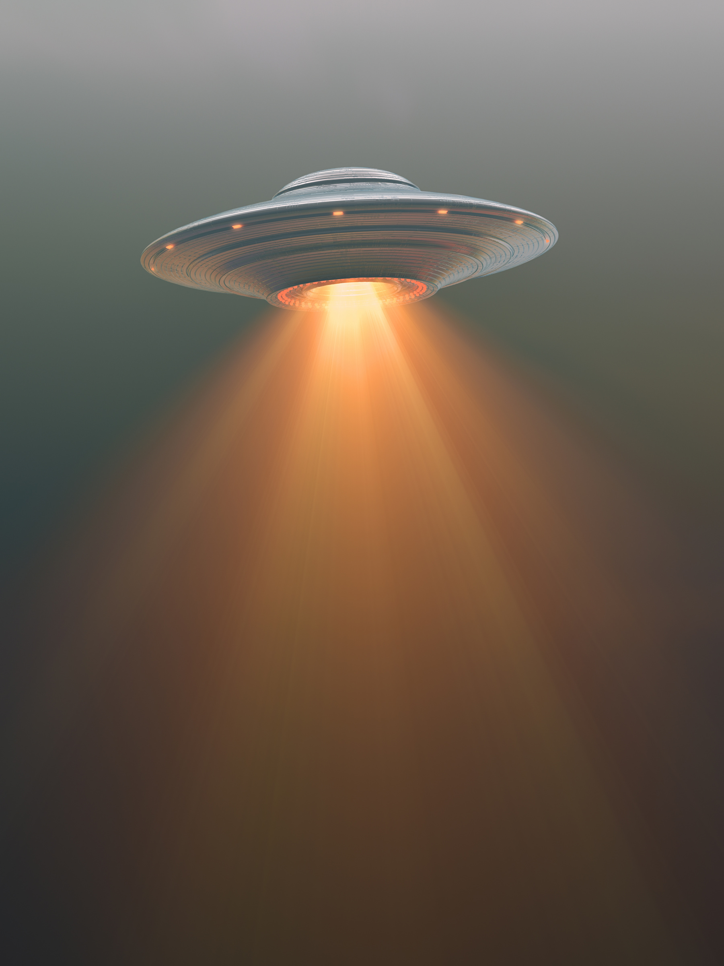
Let’s practice
In groups of 3-4, randomly pick a fun science fact. Prepare one of the following ways to explain it to an alien visiting Earth!
  Write it
  Draw it
  Act it
  Sculpt it
7
Notes:
In groups of 3-4 people, randomly have students choose from the list of science facts that are in the Educator Guide. Have students decide how they want to explain their fun fact like they are explaining it to an alien visiting Earth! Then, give everyone some time (15 minutes or so) to work on their science share.
Invite students to come to the front of the class and present their share as a group giving them a couple of minutes to do so.

Slide 8

Reflect
Why is it important to share science with other people?
8
Notes:
Take ideas from the class about why it is important to share science with other people.

Slide 9
Any questions?
We will be in touch about your experiment ideas!
9
Notes:
Any questions? Reach out to outreach@snolab.ca if you have any!

Slide 10
Please complete our survey
Let us know what you thought of the program and how we can improve it!
10
Notes:
Please complete our close-out survey to tell us where we did well and how we can improve it! Reach out to outreach@snolab.ca for the form!

