Slide 1



Snolab & the scientific method
Name
Date
Notes:
This session is tying in a small experiment that aligns with S.M.A.R.T. goals and SNOLAB to be able to demonstrate a type of question that a student may be able to ask.

Slide 2



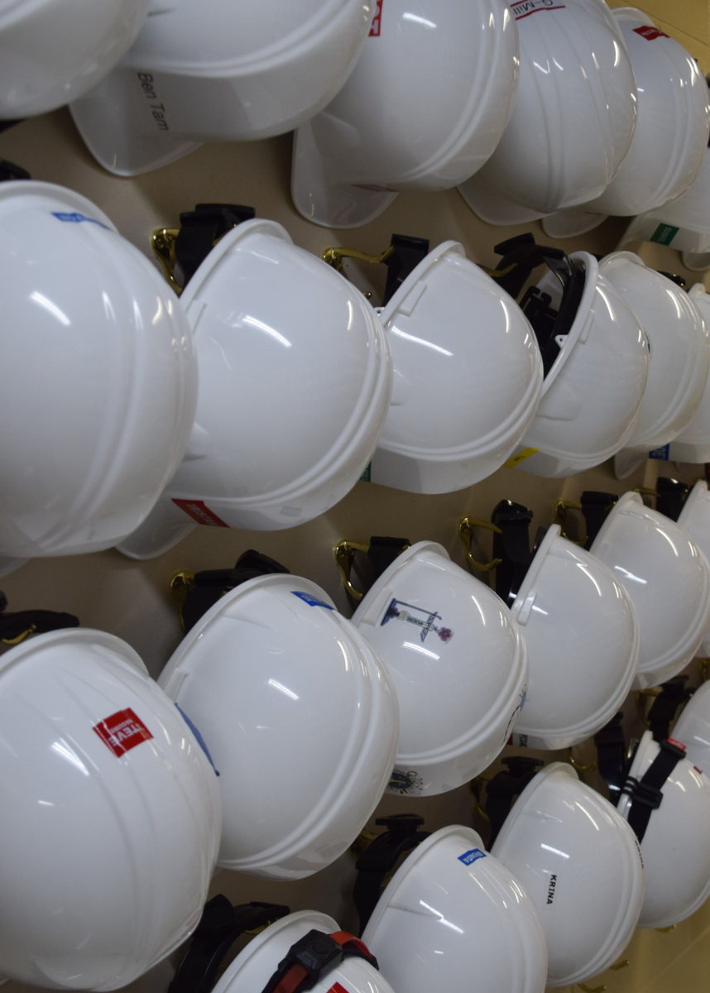
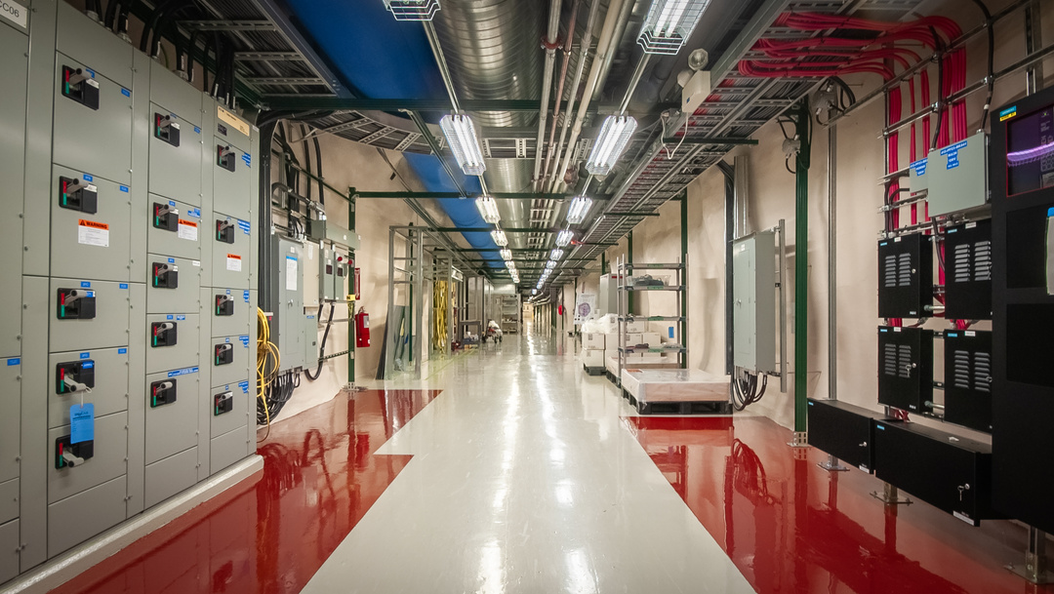

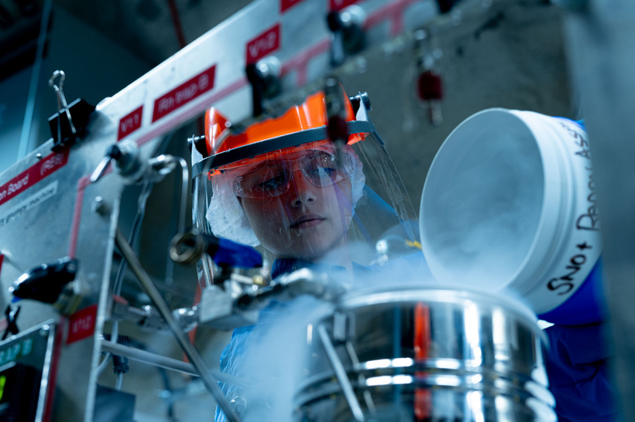
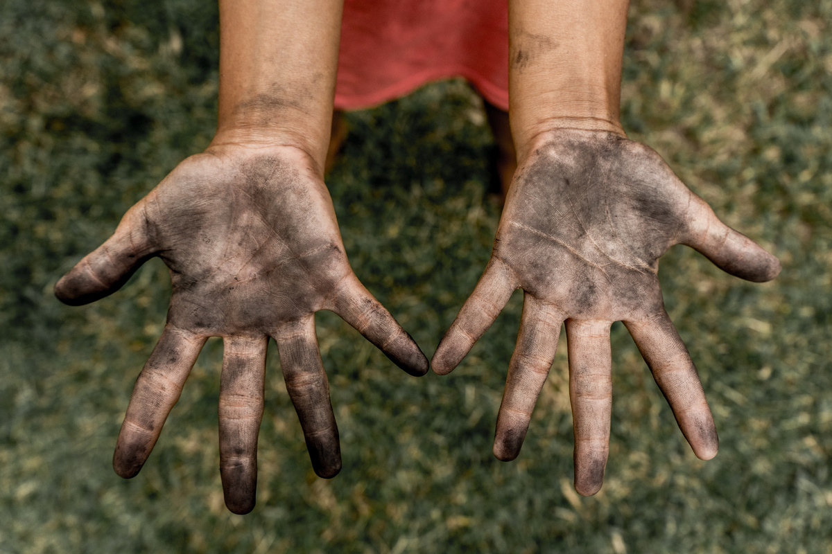

Minds on
What doesn’t belong?
2
Notes:
Ask students to look at the four images on the screen. Using their knowledge of SNOLAB from the last session of Wonderground, determine which image does not belong. Take answers from the class about which image and why they think it does not belong.
Image 1: Shows clean hardhats that we wear in the lab.
Image 2: Shows a scientist pouring very cold liquid nitrogen to perform a science experiment.
Image 3: Shows dirty hands, something that would absolutely not be okay in the lab. This is the image that is not allowed.
Imaged 4: Shows the view down one of our hallways in the underground laboratory.

Slide 3



Do you remember some of the unique conditions at snolab?
3
Notes:
Ask students if they remember some of the unique conditions from the lab! Hint: you can also encourage them to look at the handout provided that outlines the unique conditions.

Slide 4

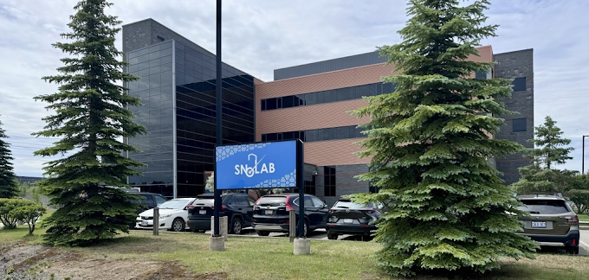
Unique conditions at snolab
SNOLAB’s unique location has some neat characteristics – one being how deep underground it is!
4
Notes:
We have so many unique conditions, but the biggest one is how deep underground we are. You may remember that being so far underground comes with a higher pressure!

Slide 5
Unique conditions at snolab
SNOLAB’s unique location has some neat characteristics – one being how deep underground it is!
So, we wondered what happens when they try to boil water so deep underground?
5
Notes:
SNOLAB was curious about boiling water underground and how the high pressure impacted that process.

Slide 6
Unique conditions at snolab
SNOLAB’s unique location has some neat characteristics – one being how deep underground it is!
So, we wondered what happens when they try to boil water so deep underground?
SNOLAB performed an experiment to test this, and they want YOUR help!
6
Notes:
We want your classes help with testing this experiment!

Slide 7
Scientific question
How does increasing depth (underground) change the time it takes for water to boil?
7
Notes:
So, we asked how does increasing depth by going underground change the time it takes for water to boil?

Slide 8
How does increasing pressure change the time it takes for water to boil?
What do you think the variables we need to think about are for this experiment?
Independent
Dependent
Control
(what we change)
(what we measure)
(what stays the same)
8
Notes:
Ask students to identify each of the variables. The answers are on the next three slides.

Slide 9
How does increasing pressure change the time it takes for water to boil?
What do you think the variables we need to think about are for this experiment?
Independent
Dependent
Control
(what we change)
(what we measure)
(what stays the same)
The pressure increasing as we go underground
9
Notes:
We are changing the depth, and by doing so, we change the pressure as we go underground.

Slide 10
How does increasing pressure change the time it takes for water to boil?
What do you think the variables we need to think about are for this experiment?
Independent
Dependent
Control
(what we change)
(what we measure)
(what stays the same)
The pressure increasing as we go underground
The time it takes for water to boil
10
Notes:
We are measuring the time it takes to boil. In this case we are going to measure the time it takes for the kettle to turn off, we will talk about this interesting fact later.

Slide 11
How does increasing pressure change the time it takes for water to boil?
What do you think the variables we need to think about are for this experiment?
Independent
Dependent
Control
(what we change)
(what we measure)
(what stays the same)
Amount of water
The pressure increasing as we go underground
Starting temperature of water
The time it takes for water to boil
Thermometer
Timer
11
Notes:
Controls that stay the same may vary when you ask students and are certainly not limited to what is written on the slides! Other answers might include the kettle and if we measure the water with a beaker.

Slide 12
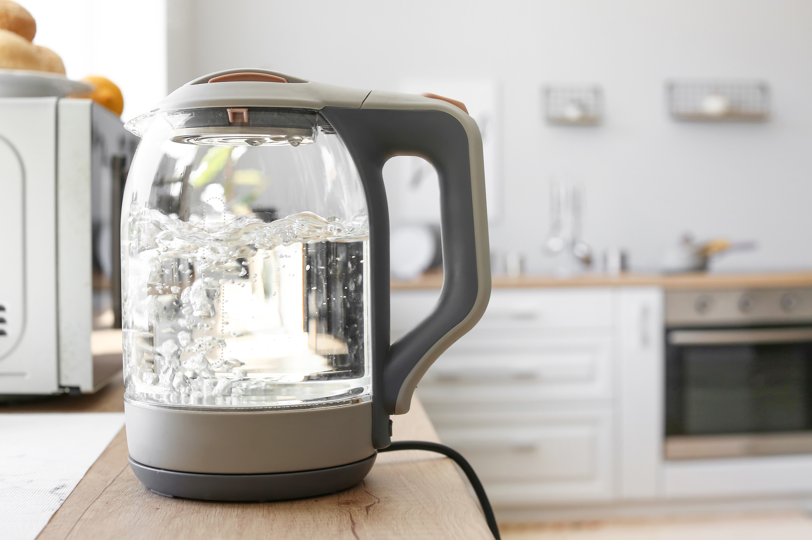
Performing the surface control experiment
We are going to perform the surface (control) experiment together. We will need:
  Kettle
  1 L of tap water
  Timer
  Thermometer
12
Notes:
Get a student to fill the kettle with 1L of water.

Slide 13

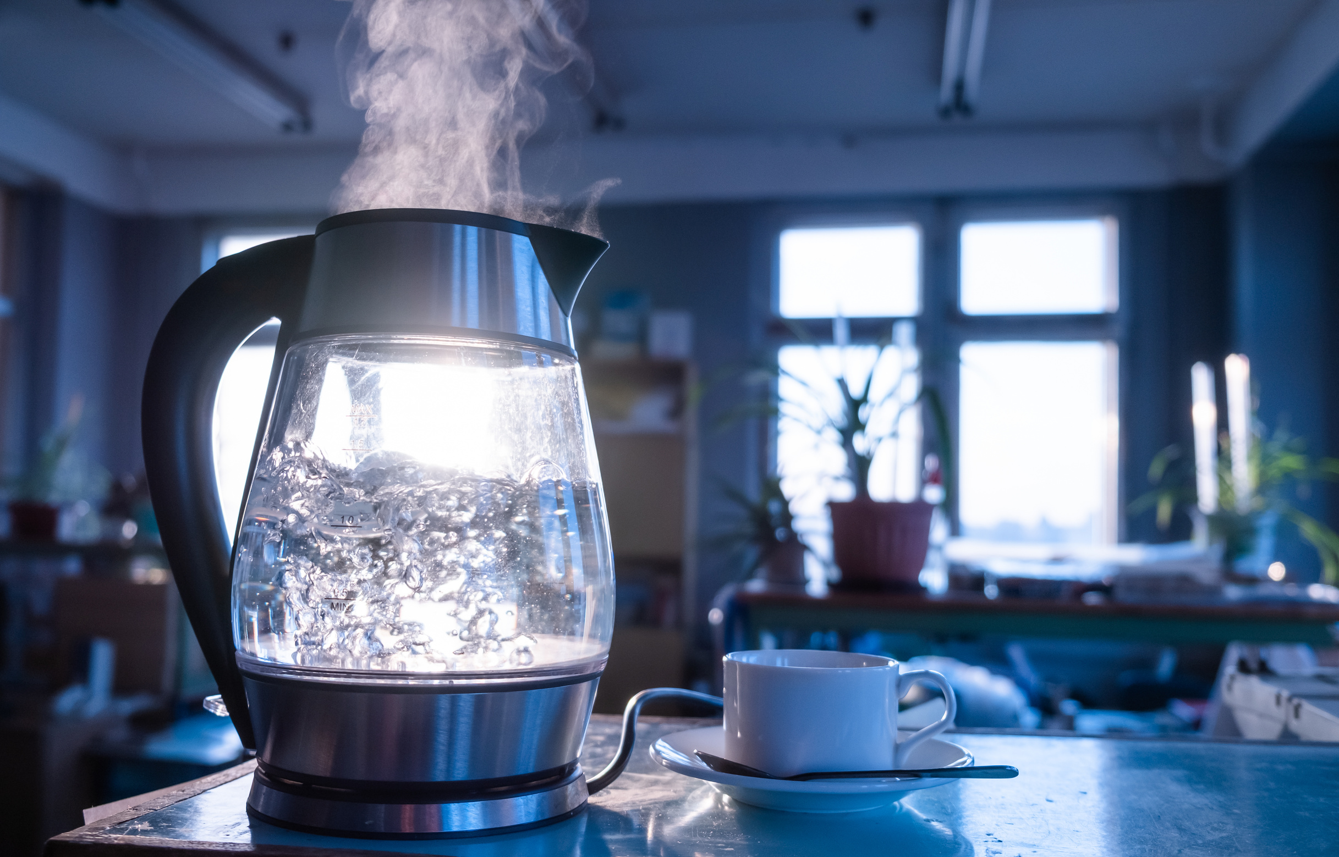
Performing the Surface control experiment
Steps:
  Fill the kettle to the 1 L mark with tap water
  Measure the temperature of tap water in the kettle
  Turn on kettle AND start timer at the exact same time
  Stop timer once kettle boils and turns off and immediately measure temperature
13
Notes:
Did you know SNOLAB followed this exact procedure the underground laboratory!
Get students to do each step! Assign each step to a student. The last step involves very hot temperatures, so take extreme caution if allowing a student to measure the temperature.

Slide 14


What did you measure?
Starting temperature of the water:
Final temperature of the water:
Time it took to boil:
14
Notes:
Have the class record each of these measurements listed.

Slide 15
Let’s go back underground!
SNOLAB measured the time it took to boil water just like we did, but underground! Here’s what they saw:
10.9 C
Starting temperature of the water:
Final temperature of the water:
Time it took to boil:
105.1 C
15
Notes:
SNOLAB's results might look a little bit different than what you saw in your class! Why do you think this might be? What temperature does water usually boil at?
Most surprisingly, how long do you think it took for the water to boil underground? The answer is on the next slide!

Slide 16
Let’s go back underground!
SNOLAB measured the time it took to boil water just like we did, but underground! Here’s what they saw:
10.9 C
Starting temperature of the water:
Final temperature of the water:
Time it took to boil:
105.1 C
10:50
16
Notes:
The water took 10 minutes and 50 seconds to boil fully underground! How does this compare to what you saw in your class? Was it longer or shorter?

Slide 17
Reflect
Why do you think it takes longer to boil water underground?
17
Notes:
Why do you think it took longer to boil underground?
Have students discuss with a partner why they thought that. You can prompt them to think of the unique conditions of SNOLAB that they learned about.

Slide 18

SNOLAB’s Answer
The higher pressure made the water take longer to boil because the particles are closer together!
Surface
Underground
18
Notes:
The unique condition that would best explain the difference in our result would be the higher pressure underground! It takes more energy for the particles to change phases and begin the boiling process, and that also happens at a higher temperature.

Slide 19
Start to think:
If you could design an experiment at SNOLAB, what would you do?
Some guidelines:
  Be S.M.A.R.T. (from Session 2)
  Be clean (unless you want it in the mine)
  Take ~2 weeks to complete
  Use materials that are available/purchased (within reason)
  No use of animals or people
  Take up no more than the space of a desk
  Be safe!
19
Notes:
Start to think of what experiment you might want to perform at SNOLAB! Here are some general guidelines for what your experiment should align with.

Slide 20
Any questions?
Next session: Experiment submission
20
Notes:
Any questions? Reach out to outreach@snolab.ca

