Slide 1







Request a virtual tour!
Notes:
Want to request a virtual tour or need help facilitating this session? Reach out to outreach@snolab.ca. SNOLAB can deliver Session 3 of Wonderground. These slides are available for teacher facilitation if a virtual tour cannot be done and otherwise cannot be presented by SNOLAB.

Slide 2




Introduction to SNOLAB
Name
Date
Notes:
This session talks all about SNOLAB, Canada's deep underground science lab!

Slide 3

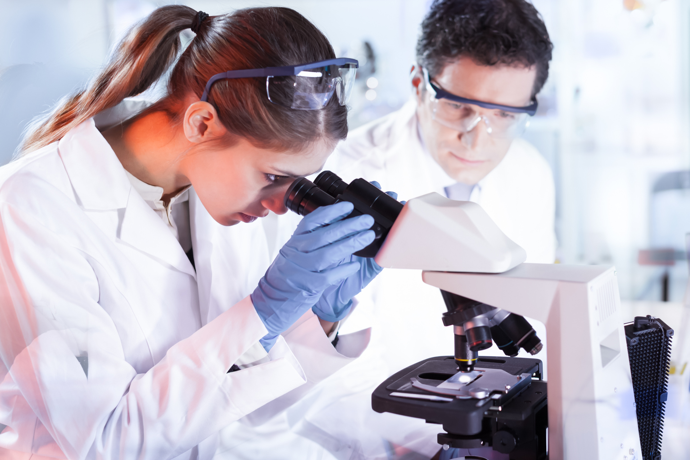
Making science happen
Now that we know what a scientific question is, some people answer those questions as their job!
Let’s look at one of the places where people work to answer big scientific questions.
2
Notes:
There are a lot of people in the world who get to answer big scientific questions as part of their job! Let's dive deep into a place that actually explores these questions.

Slide 4
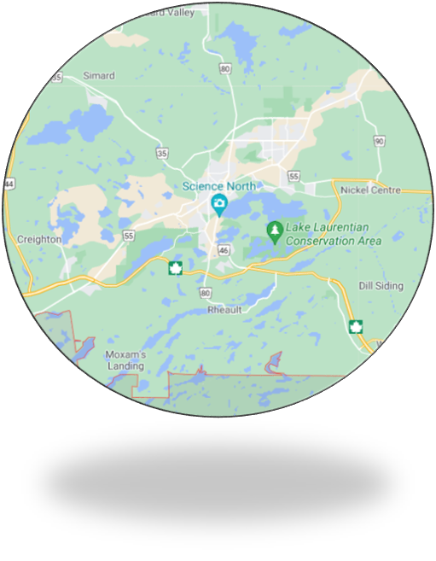
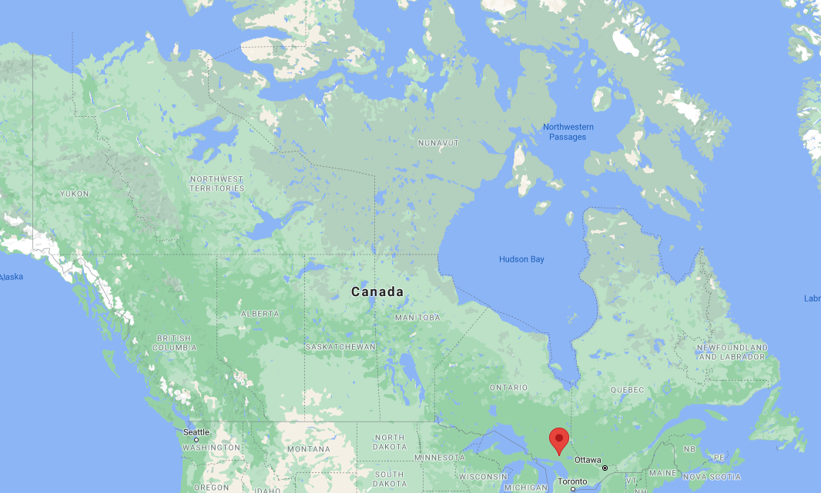
Location
SNOLAB
Sudbury
3
Notes:
About 4 hours north of Toronto, there is a city called Sudbury. One of the communities is located about 20 minutes outside of Downtown Sudbury and within that community, Lively, is an underground laboratory called SNOLAB!
Have students come up and point to where they are located on the map of Canada OR pre-add a pin of where your class is so that students can see where we are in relation to them!

Slide 5

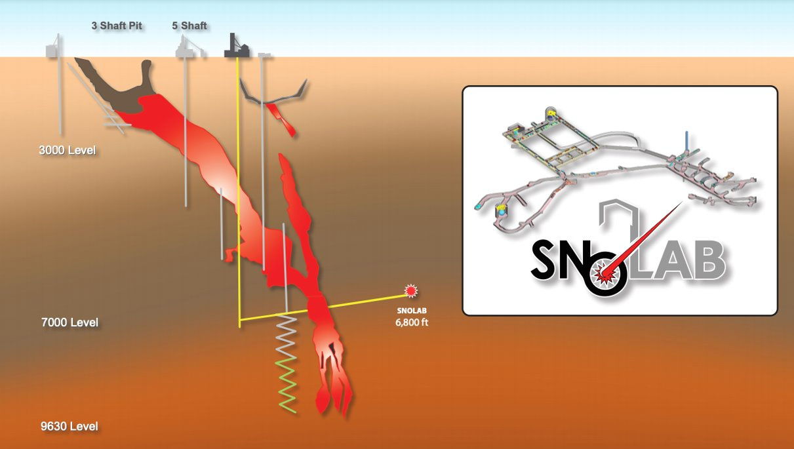
4
Notes:
SNOLAB is located 2 kilometres underground in an active mine called Creighton Mine. That is 4 CN towers deep underground or 34 hockey rinks end to end.
Sudbury is a very important mining community! We have around 10 active mines. SNOLAB is one of a dozen labs like this around the world.
Find the tallest structure in your community (in metres)! Divide that by 2000 metres to find out how many of those structures we are underground. If your community does not have very tall structures, things like width of rivers or lengths of local runways work great! Google Earth is a good tool to get these measurements.

Slide 6
Why do we need to be located underground?
5
Notes:
But why does a science lab like SNOLAB need to be located so far underground?

Slide 7

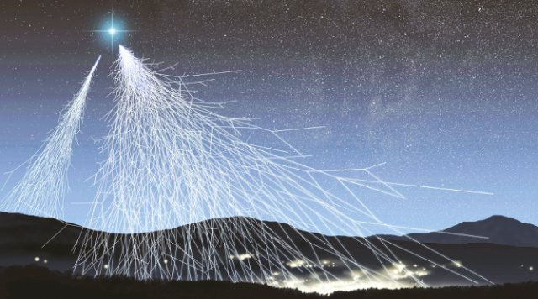
6
Notes:
On the surface of the Earth, where we are, we are always interacting with something called cosmic radiation, or cosmic rays for short!
These cosmic rays come from outer space from things like stars and other processes that happen. This photo is an artists rendition of what cosmic rays would look like if we could see them with our eyes, which we cannot!

Slide 8
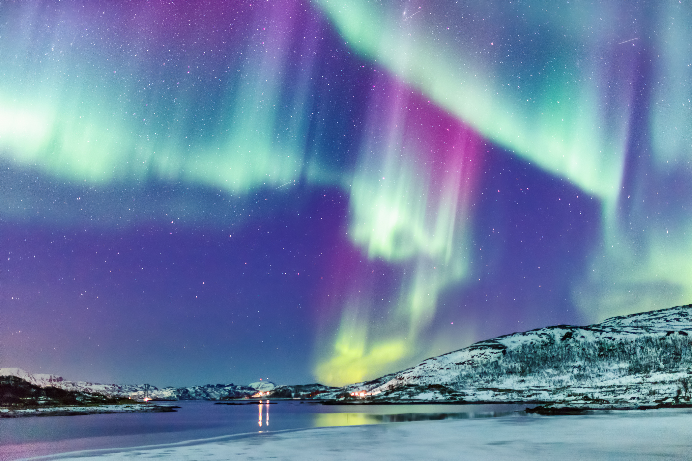
Unique conditions: Less cosmic rays
Cosmic radiation (particles from space) that constantly bombard the Earth’s surface is reduced by a factor of 50 million when we go underground.
Fun fact: When cosmic rays interact with our atmosphere, they produce the Northern Lights!
7
Notes:
By going 2 kilometres underground, we reduce the cosmic rays by a factor of 50 million. Without the rock that is overhead, we would never be able to see what we are looking for! Cosmic rays would light up our experiments and block out the signals that we want to see.
Fun fact, if you have ever seen the Northern Lights - that is actually cosmic rays interacting with our atmosphere and making beautiful colours that light up the night sky!
Have students hold out their hands, flat, palm-side up. Every second, we have one cosmic ray pass through our hand on the surface of the Earth but by going deep underground, it would take several months for one particle to pass through our hand.

Slide 9

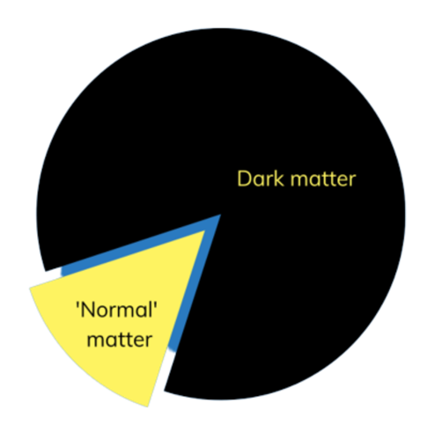
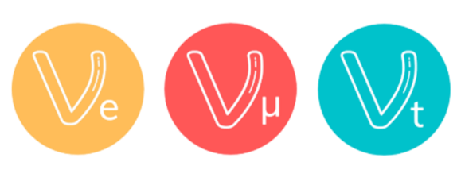
The Science of SNOLAB
8
Notes:
SNOLAB does a lot of different science in the underground lab and we will touch on that in the next few slides.
Very briefly, SNOLAB does a small amount of biology, neutrino science, and dark matter science!

Slide 10
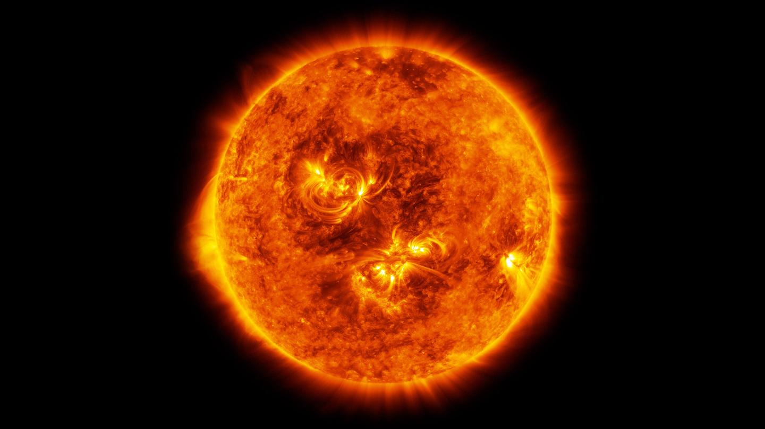
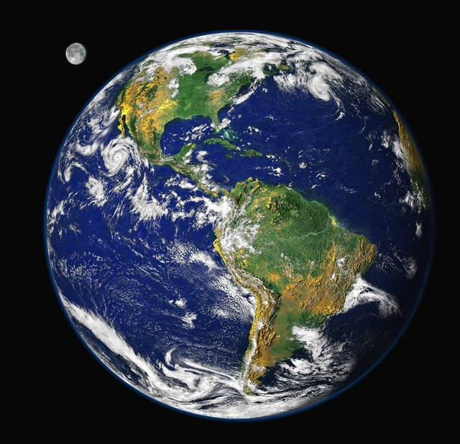
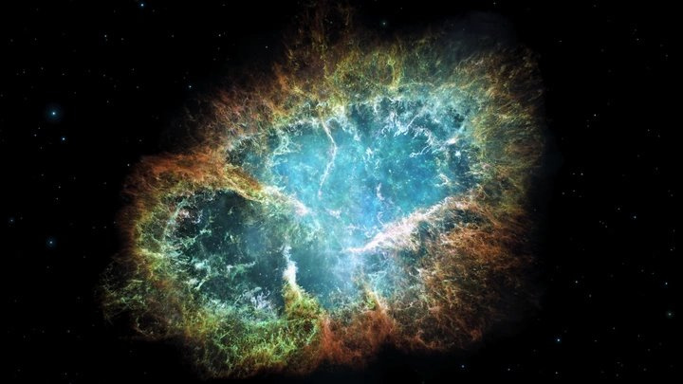
9
Notes:
First, let's talk about neutrinos! Neutrinos are the second most abundant particle in our Universe, meaning that aside of particles of light (photons), neutrinos are the second most found particle. Yet they rarely interact with other matter! This means that they can travel across solar systems and straight through Earth and still not even stop.
They come from dying stars (supernovae), the Sun, the centre of our Earth, and many other places!
We go deep underground where we are more likely to see them interact and to avoid cosmic rays blocking out the signal that we want.

Slide 11

Dark matter
10
Notes:
Dark matter is a hypothetical particle that believe makes up 85% of our Universe, yet we have not been able to directly see it!
There are many experiments around the world that are looking to directly see a dark matter particle.

Slide 12
Let’s check out the effects of dark matter!
11
Notes:
But how do we know something exists that we haven't seen?

Slide 13
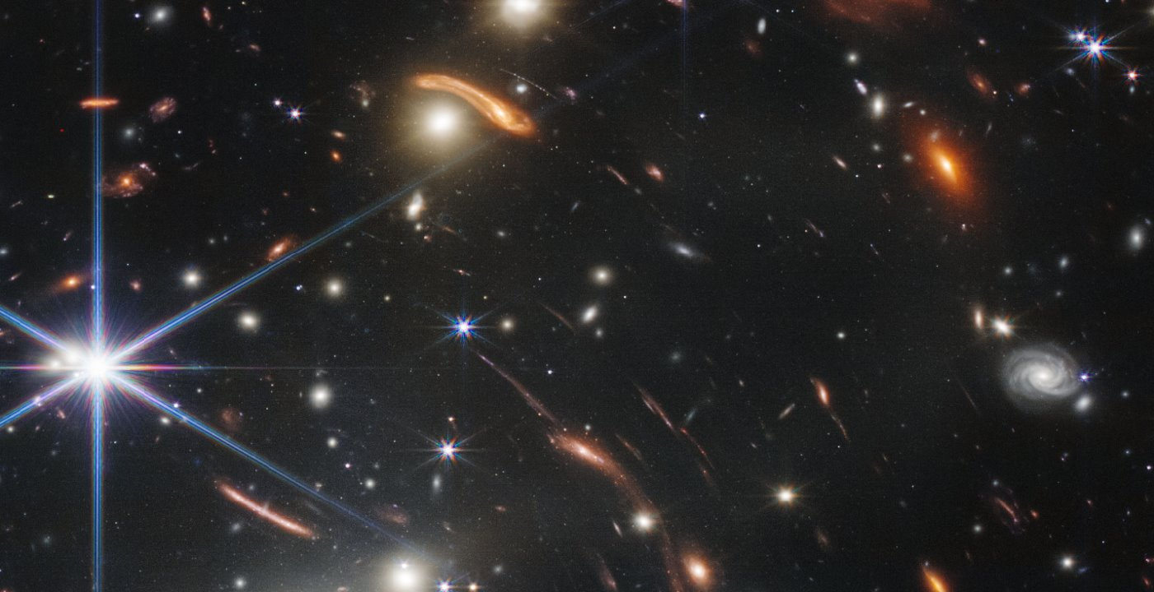
12
Notes:
Well, there are impacts that we see all around our Universe when we observe the stars and galaxies.
We see an effect called gravitational lensing, which means that as light travels all the way from distant galaxies, it actually stretches and smears. This means that there is something there that is affecting the way the light travels.
This image shows very well the galaxies light being impacted by something that we haven't directly observed before!

Slide 14
journey to snolab
13
Notes:
Phew! That was a lot of big science questions that scientists around the world are trying to solve! What does the journey to the lab look like?

Slide 15
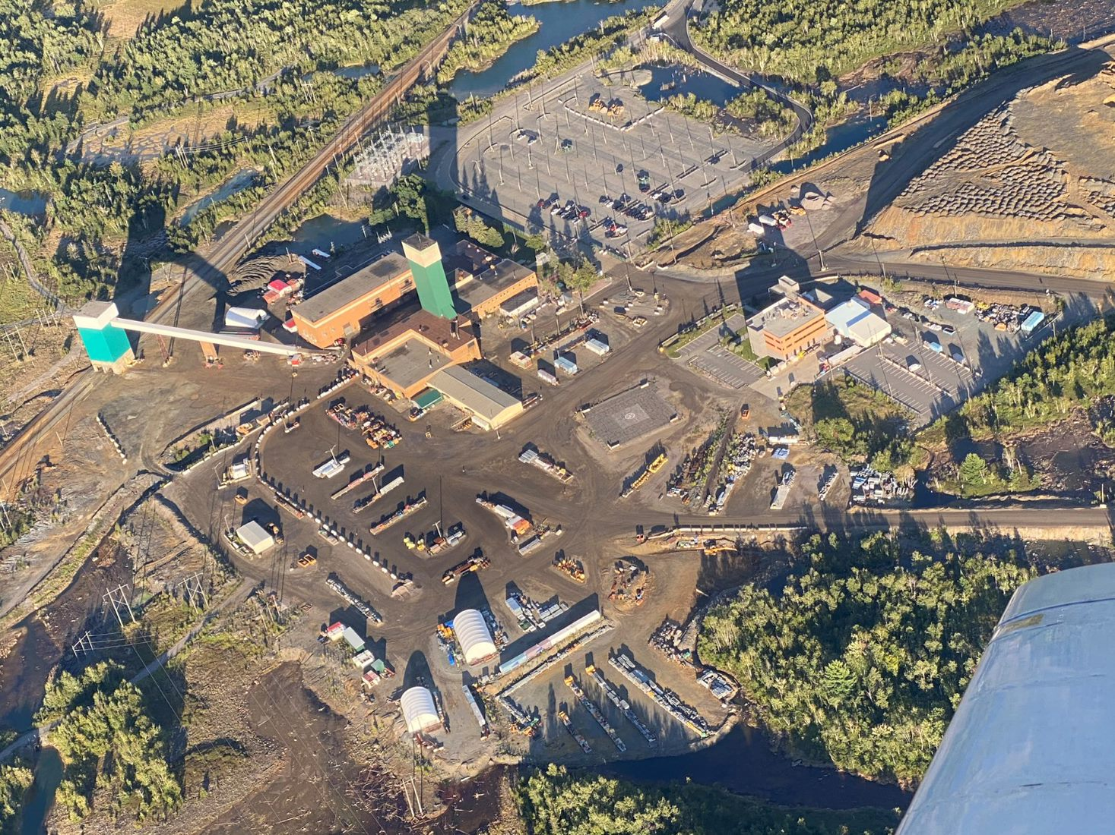
Vale Creighton mine
14
Notes:
Their day starts at Creighton Mine, an active mine site! The blue star is where the SNOLAB surface building is. We have offices, a surface clean lab, and a space to get ready to go underground, among many other spaces!
The red star is where the mining operations happen! There is an elevator to go underground and places and people to support the work within the mine.

Slide 16
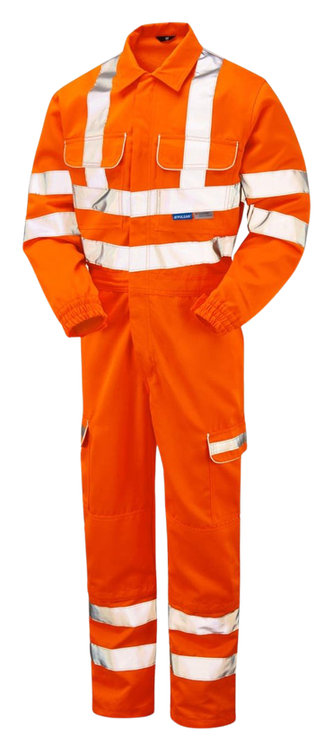
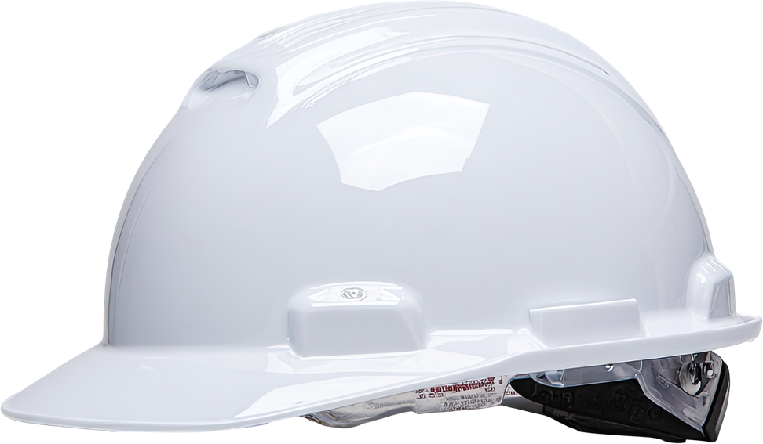
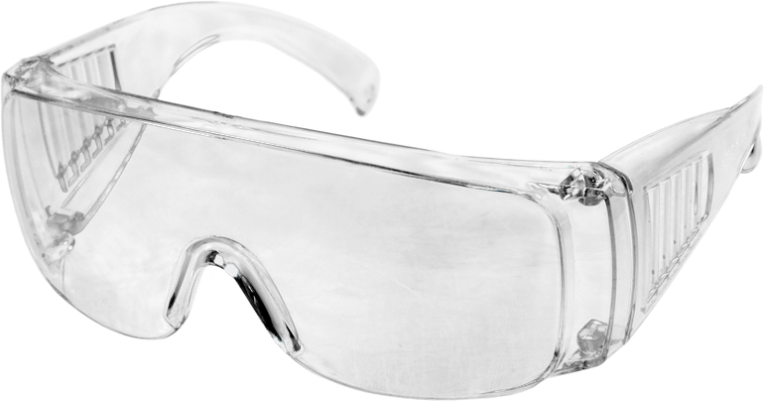
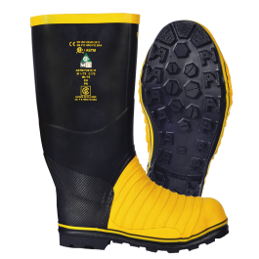
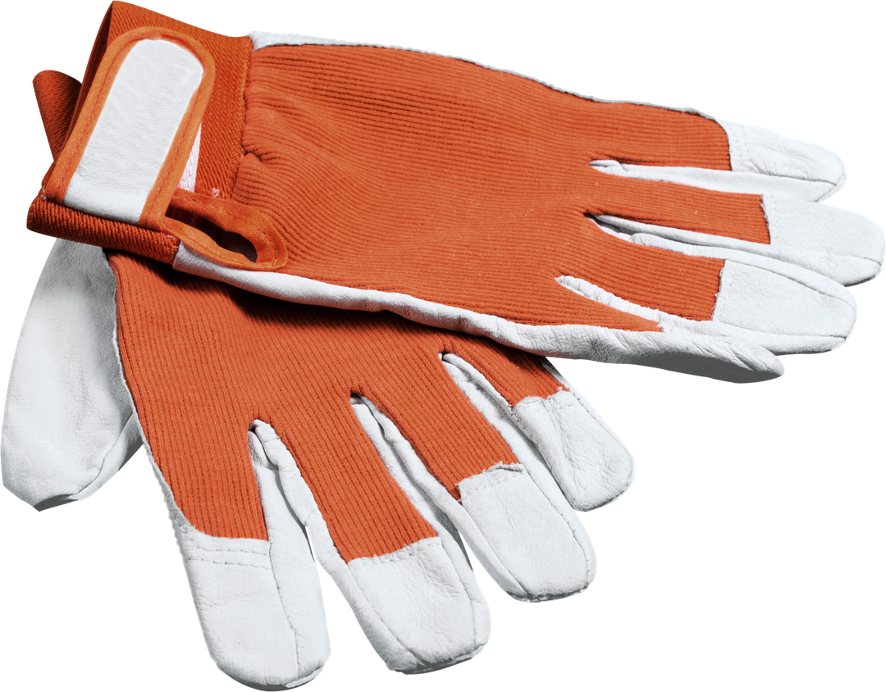
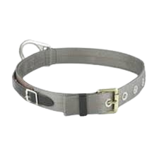
Personal protective equipment (PPe)
15
Notes:
Since we are in an active mine, to go underground we need to be dressed up in full Personal Protective Equipment (PPE)! This includes a full set of bright orange coveralls (visitors wear yellow!), a hardhat, a cap lamp, which is basically just a flashlight that attaches to your hardhat, heavy steel-toed boots, gloves, safety glasses, and a belt!
This is all to keep us safe while in the mining environment.

Slide 17
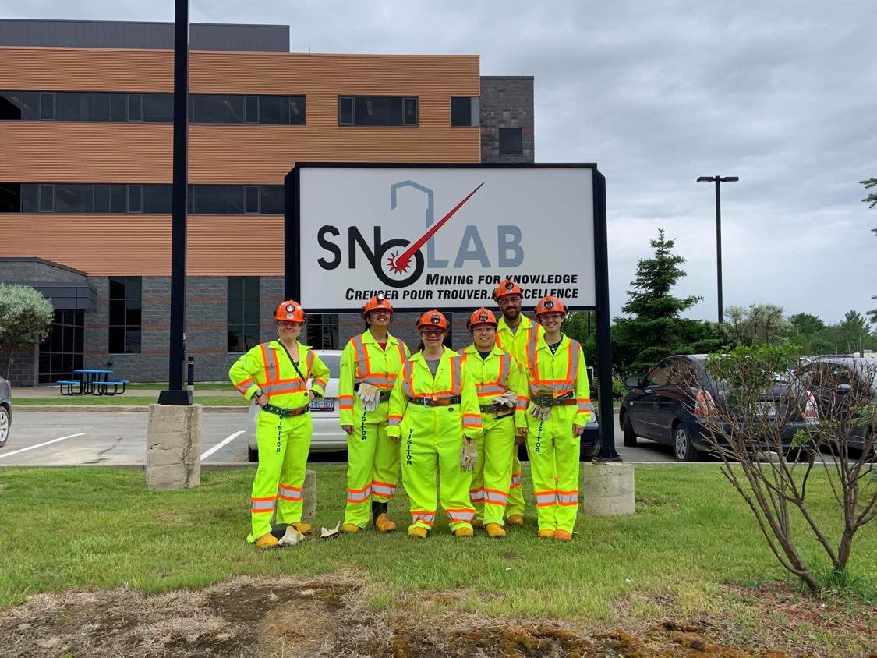
16
Notes:
And this is what a person who is going underground would look like when they are all ready to go!

Slide 18
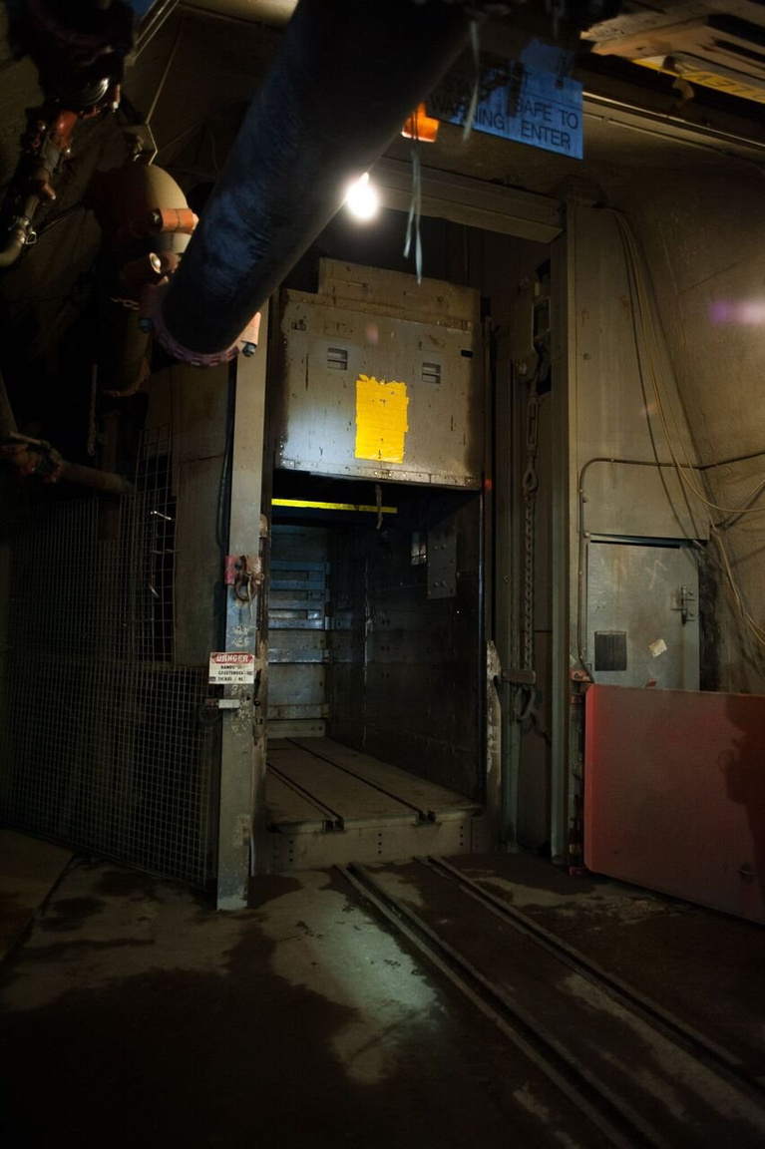
The Cage
17
Notes:
Then we need to take something called the cage. The cage is a mining term for a large, industrial elevator. This is the elevator that takes both people and material underground!
The cage has two levels and each level can fit around 44 adults. The total time it takes to get underground 2 kilometres is only about 3 and a half minutes!
FACILITATION IDEA:
The cage measure 4.5 feet by 12.5 feet. You can take the time to measure out the dimensions of the cage, and have all the students try and fit inside the square! It is a fun challenge.

Slide 19
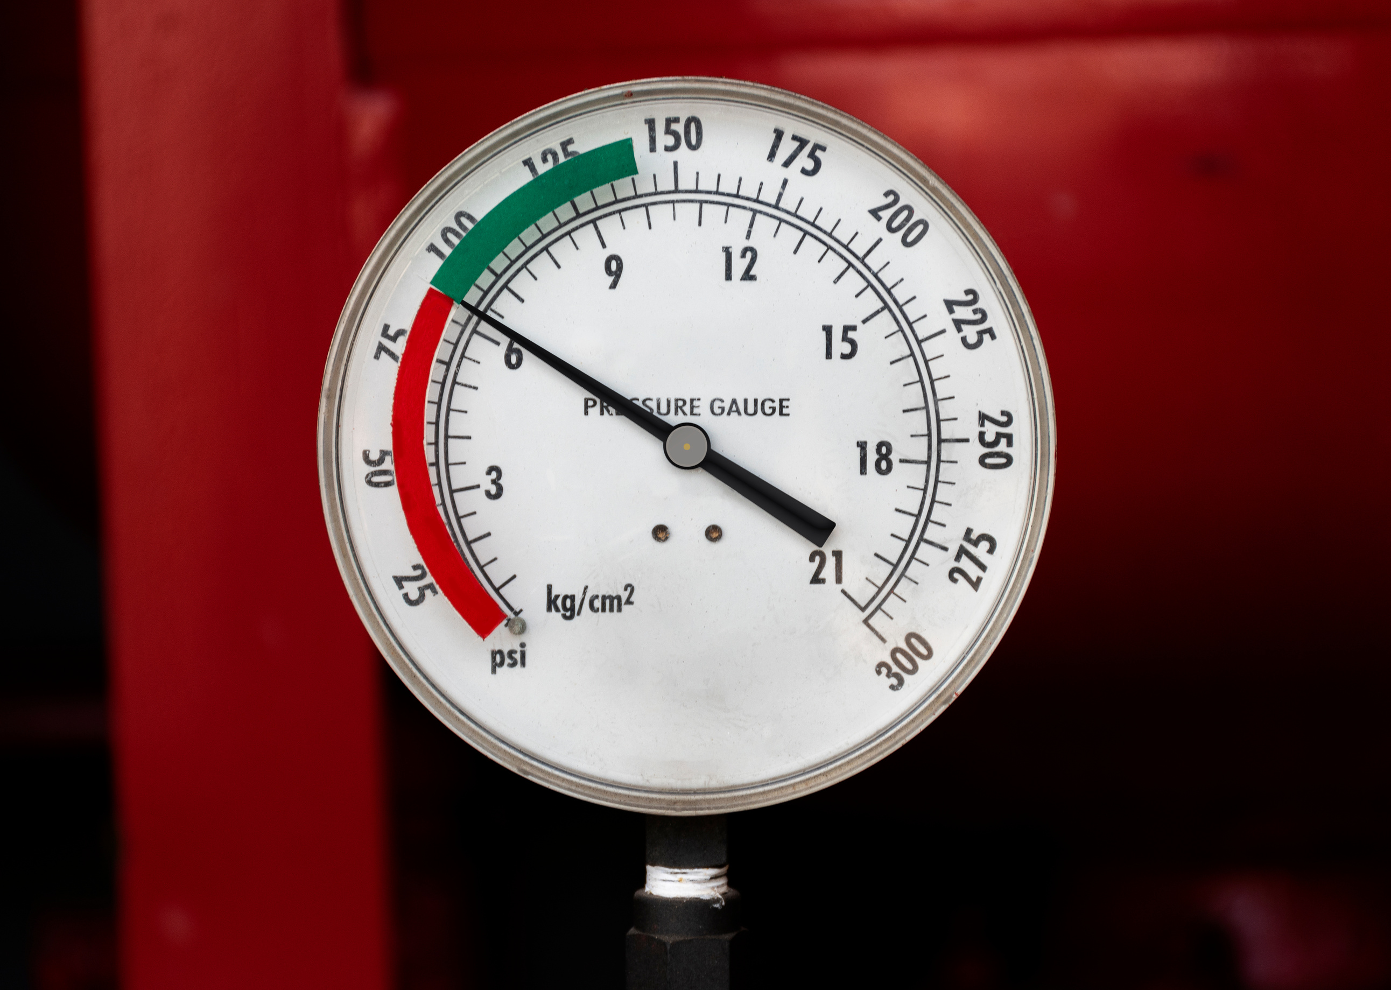
Unique conditions: Higher pressure
Going deep underground causes an increase in air pressure! The air can be 20% to 30% higher in pressure.
This condition results from the 2 km of rock above the lab!
18
Notes:
Going so deep underground actually causes an increase in air pressure! This means that the air pressure can be around 20% to 30% higher than on the surface of the Earth!
It can impact many things going underground, even your ears, much like flying in an airplane!

Slide 20
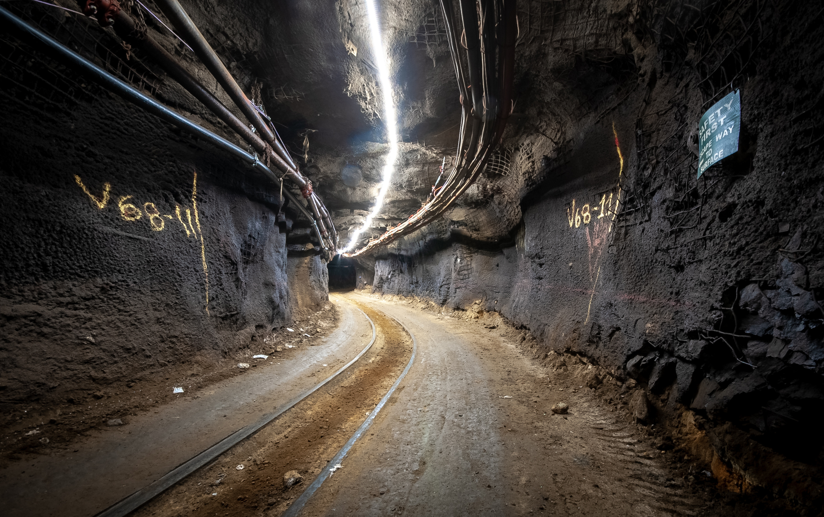
1.4 km walk to SNOLAB
19
Notes:
Once we get underground, we have to walk 1.4 kilometres to the underground lab. This walk takes place in a dusty, dirty mine in our full mining gear! It is also very hot! The walk to the lab is sometimes around 30 degrees Celsius.

Slide 21

Unique conditions: No sunlight
Sunshine cannot travel through the 2 kilometres of rock surrounding the mine, meaning some areas have no light at all and the rest are artificially lit.
20
Notes:
But, being so far underground means that we never see real sunlight in the mine! All the light that is underground is artificial and the some areas have no light at all.

Slide 22

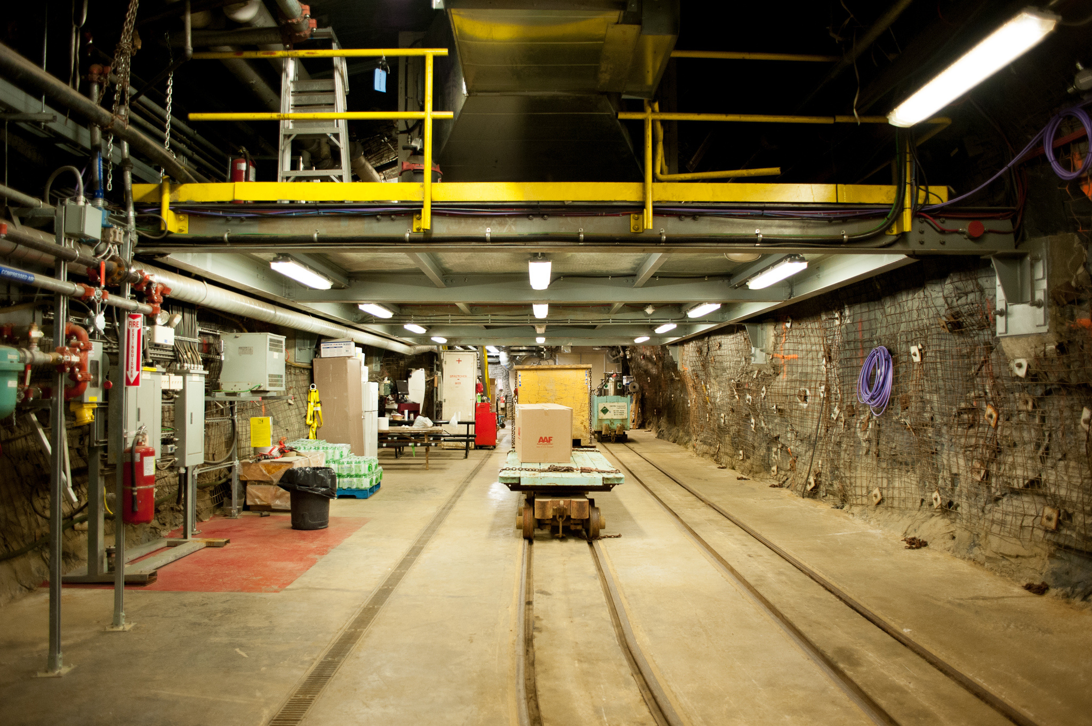
Underground entrance to SNOLAB
21
Notes:
Once we get to the front doors of the lab, you can already tell it is starting to look cleaner and more pristine.
The first step in our cleanliness journey is washing our boots. We wash our boots to get rid of any dust that might be in the mine dust that we just walked through.

Slide 23
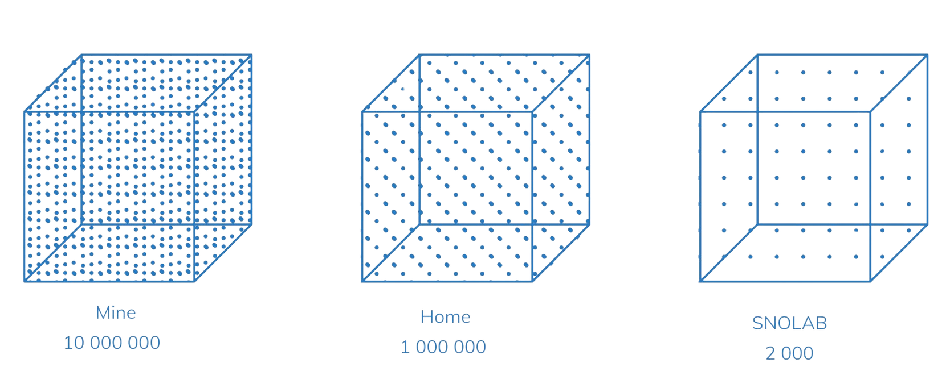
Unique condition: Cleanliness
Being a class 2,000 clean lab means that less than 2,000 particles per ft³ can enter the lab.
22
Notes:
And maybe most shockingly, our underground lab is a class-2000 clean lab! This means that in one cubic foot of air, the size of about 2 shoe boxes put together, we have less than 2000 particles of dust. In your classroom right now or in your home, you may have around 1,000,000 particles of the same size in that space, but in the mine that we walk through to get to work, there are around 10,000,000 particles!
We care a lot about dust as the dust can block out signals that we are looking for and can even mimic those signals, so we are very careful about cleaning.

Slide 24
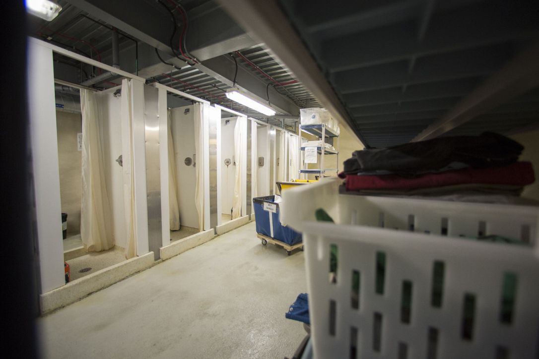
Underground showers
23
Notes:
So careful that we even take a full shower once we get to the lab! Yes, a real shower with water. We have a full team of cleaners that take very special care of our lab and make sure things like the laundry that we wear is done and that we are bringing only clean items into the lab.

Slide 25

Unique condition: ultra-pure water
Ultra-pure water is so pure that you can’t even drink it! This water is made underground and is used to protect experiments and for cleaning.
24
Notes:
One of our other unique conditions is the ability to produce something called Ultra-pure water (UPW). Ultra-pure water is so clean that you can't drink it or even shower in it! It is used to help clean items that are coming into the lab and to shield the outside of our experiments from unwanted particles - sort of like putting the experiments in a big pool!

Slide 26
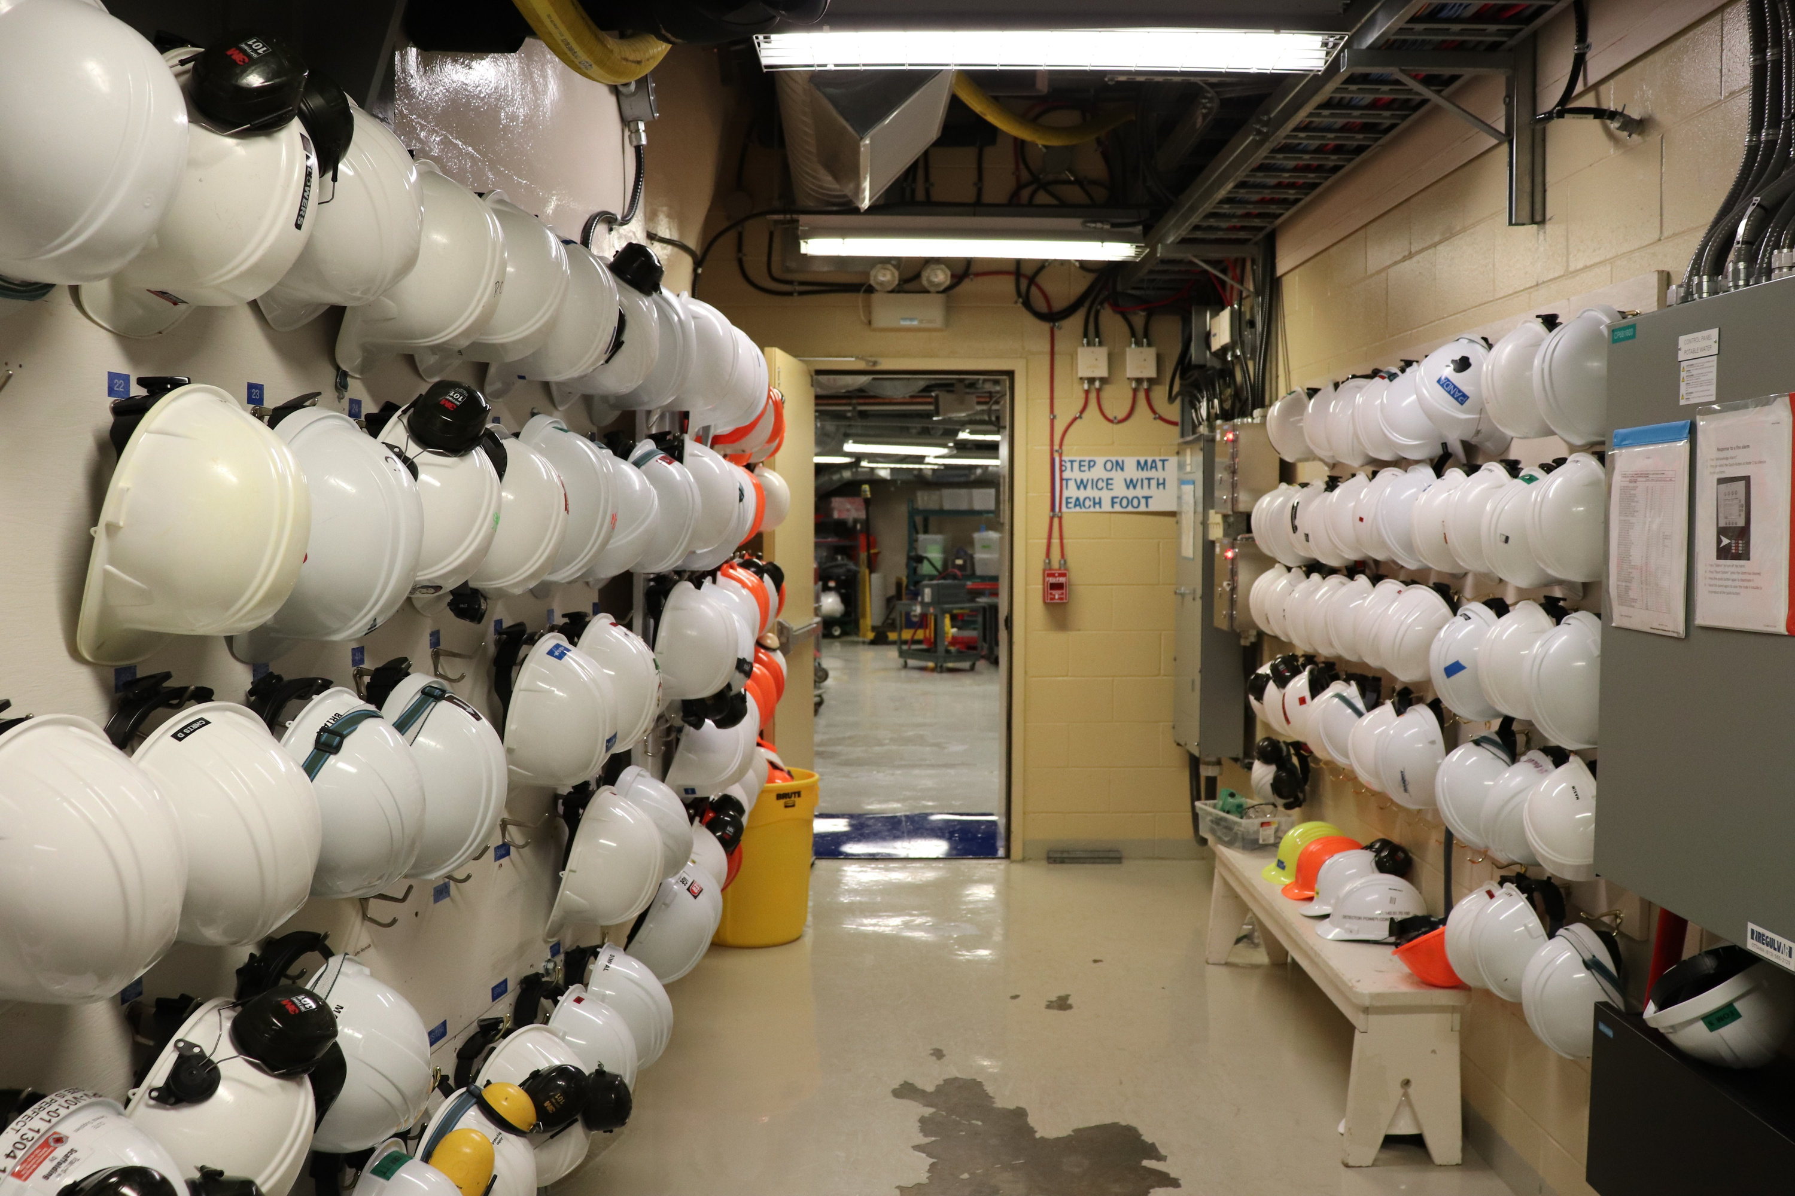
Refuge station
25
Notes:
And once we do that whole journey, we are finally ready to go into the lab! We end up in a special place in the mine that is called the refuge. The refuge is where we gather in the case of an emergency, but it is also where our lunch room is!

Slide 27
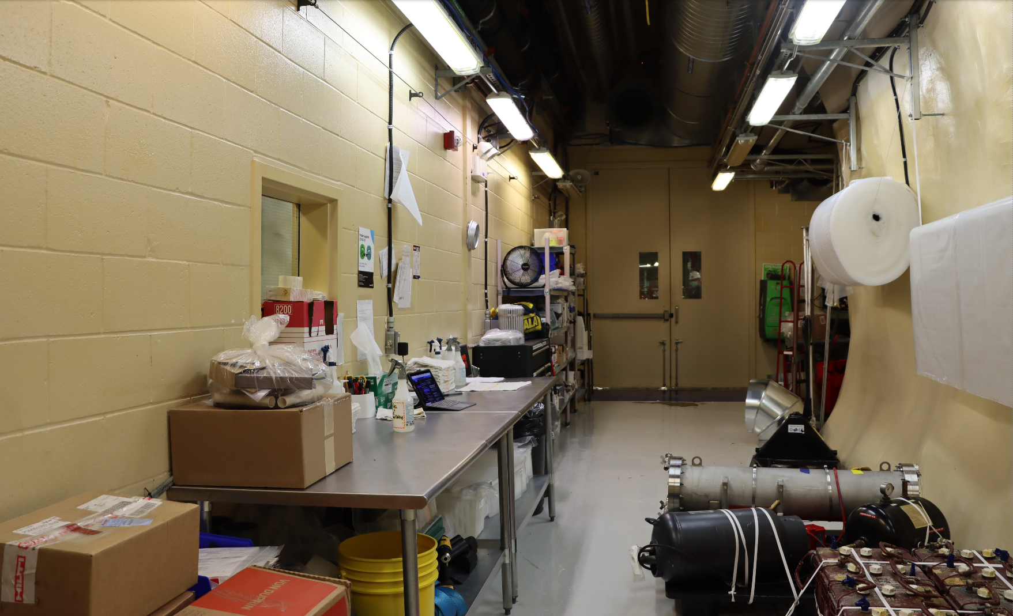
Car wash
26
Notes:
Everyone that comes into SNOLAB must go through the shower process, but all materials that come into the lab must be carefully cleaned.
This is done in what is called the car wash. It's named this because it can fit one whole rail car in the space. There are two sides to the car wash, separated by large doors. One side is where materials are hosed off to get off large pieces of dirt and dust. The second side is what is shown in the photo. This side is where items are cleaned very carefully and checked to make sure no dirt enters the lab.

Slide 28
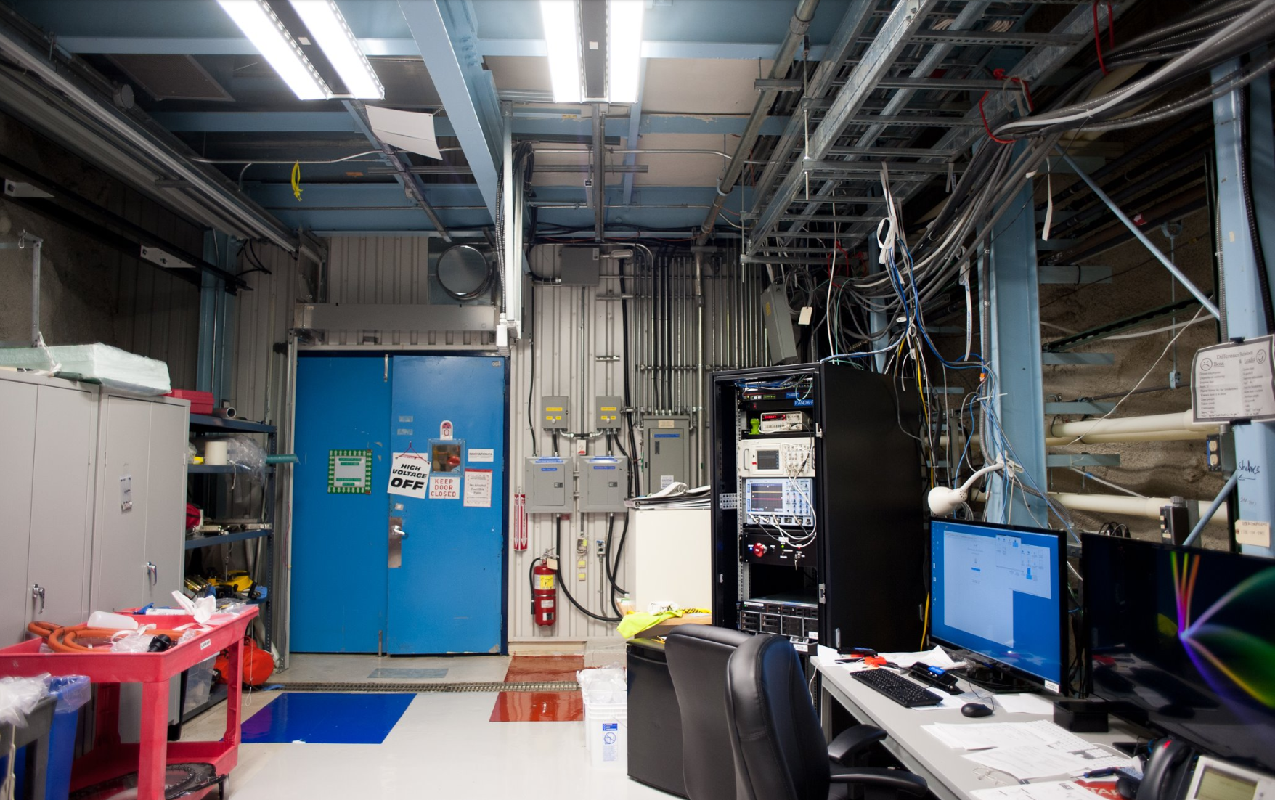
SNO+ control room
27
Notes:
Moving into the lab space, we visit the older part of the lab. Our first stop in the tour is the SNO+ control room. The SNO+ control acts as the space where the SNO+ experiment can be monitored and worked on without having to physically interact with the experiment.

Slide 29
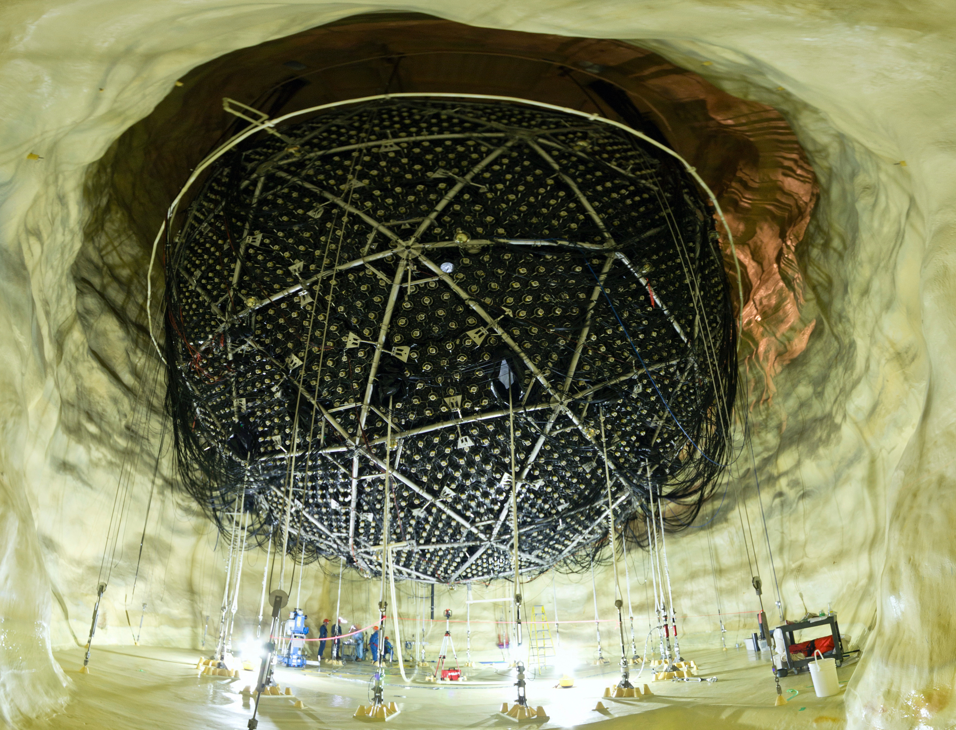
SNO+ experiment
28
Notes:
But what is SNO+? SNO+ is an experiment that studies neutrinos. You might recall from earlier in the session that neutrinos are the second most abundant particle in our universe.
This experiment uses many of the original parts that the Sudbury Neutrino Observatory used - the first experiment that helped build the path for what is now SNOLAB. This experiment is huge! It sits in a 10 storey tall cavern. Can you see the people with the orange hard hats in the bottom of the photo?

Slide 30

The Nobel Prize
29
Notes:
The Sudbury Neutrino Observatory actually won the Nobel Prize in Physics in 2015 for it's work on neutrinos. It made a groundbreaking discovery that helped to determine that neutrinos have a very small amount of mass when we thought that neutrinos didn't have any mass at all!

Slide 31
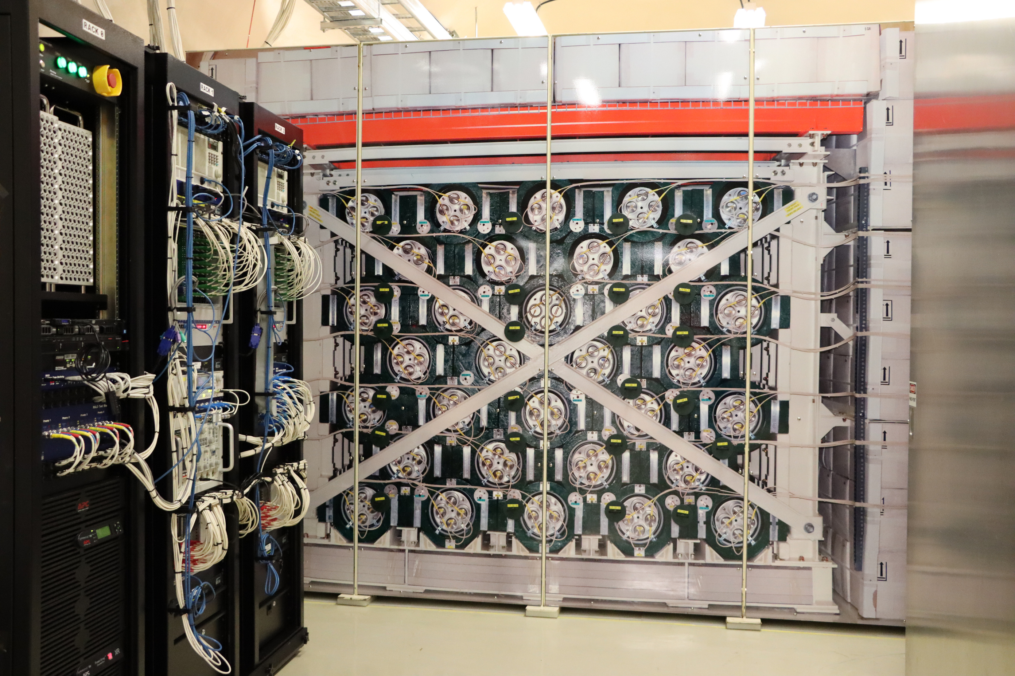
HALO
30
Notes:
Moving on to the new part of the lab. The lab was expanded and formally opened in 2012 after the success of the Sudbury Neutrino Observatory.
The Helium And Lead Observatory (HALO) is our second neutrino experiment underground. This experiment is special in that it is looking for a supernova. A supernova is what might happen when a star dies. When a supernova happens, it release many neutrinos and we see those neutrinos before the light from a supernova. HALO is part of a global network of experiments looking and waiting for a supernova to happen so that we can can tell telescopes all around the world to point at the supernova and watch it happen! This is something we have never observed before.
Want to sign up to know if there is a supernova happening? Go here: https://snews2.org/

Slide 32
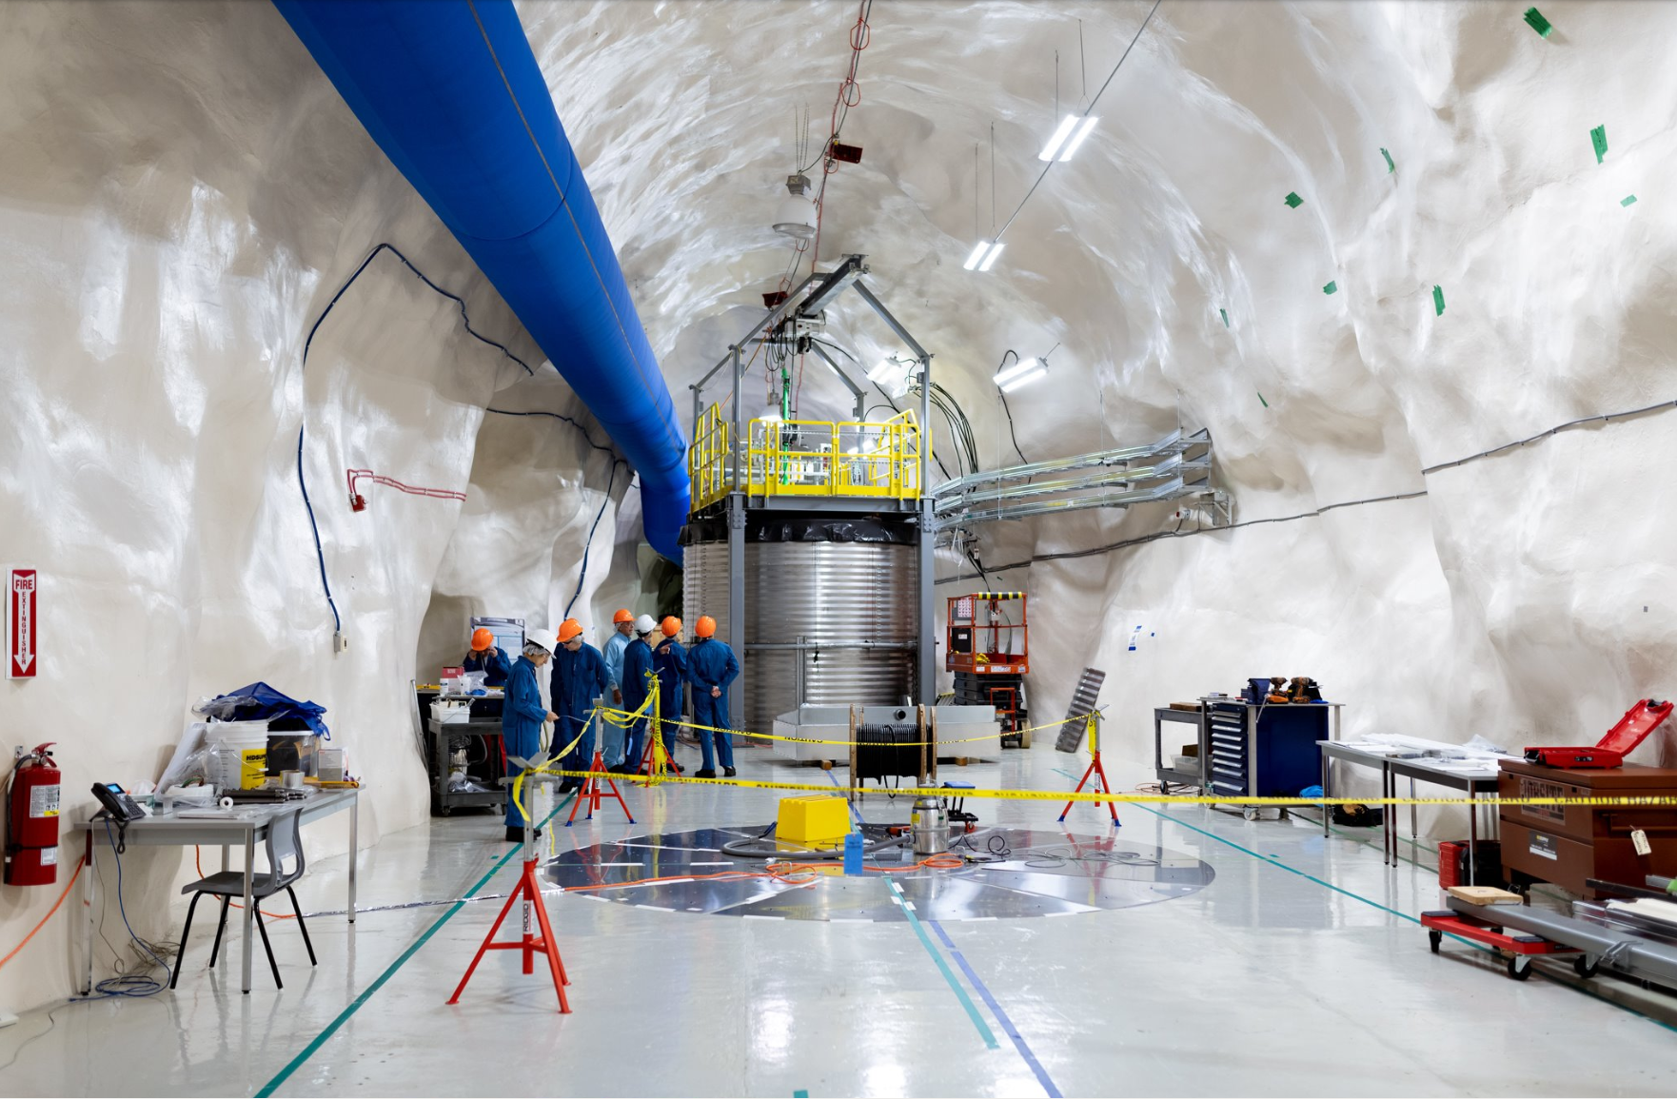
CUTE
31
Notes:
CUTE, or the Cryogenic Underground TEsting facility is a testing facility that helps to test components of underground dark matter experiments.
Cryogenic means that something is very cold. In this case, the experiment gets to below -273 degrees Celsius! This is even colder than outer space. It needs to be this cold to get rid of signals that we are not interested in to make sure that the parts of these experiments work well!
This experiment is also now testing quantum sensors!

Slide 33
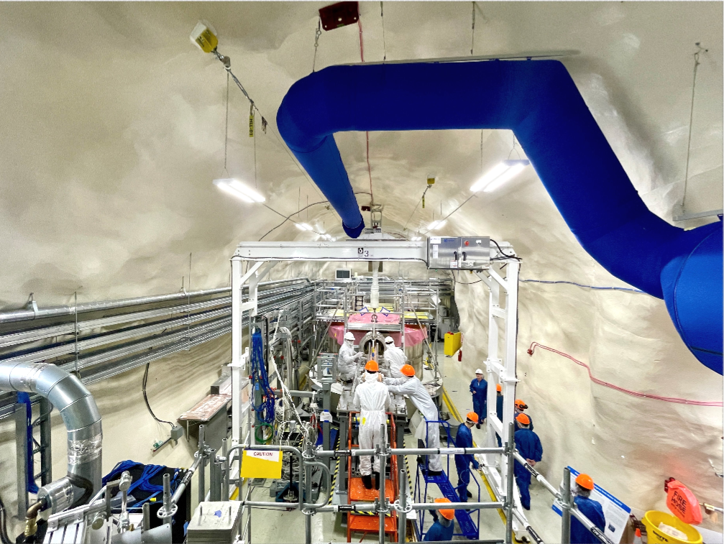
SuperCDMS
32
Notes:
SuperCDMS, the Super Cryogenic Dark Matter Search, is searching for dark matter using tiny vibrations that are produced in ultra-cold crystals. In this case, the silicon and germanium crystals are cooled to colder than outer space as well! By cooling the crystals to these extreme temperatures, any tiny vibrations that usually happen at warmer temperatures, disappear. When a particle comes in and interacts it will create a tiny vibration, called a phonon, that can be measured and observed.

Slide 34
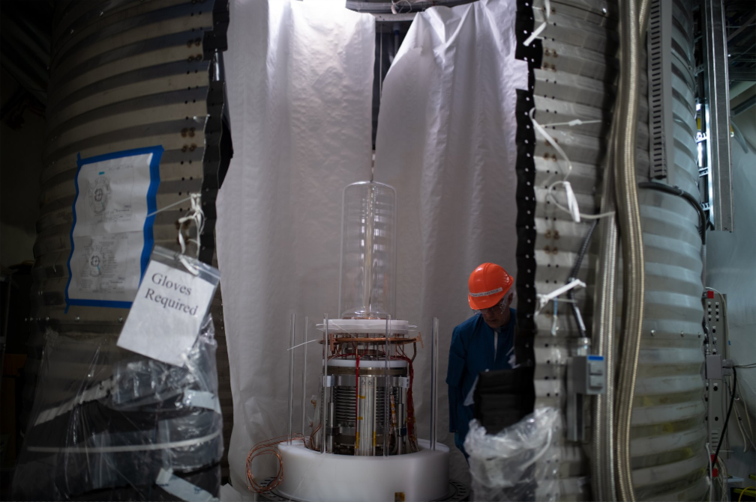
PICO
33
Notes:
PICO is a dark matter experiment that is using bubbles. These bubbles are produced in a liquid that is similar to what used to be used in household refrigerators to keep them cold! This liquid is kept at a temperature that is warm enough that it wants to boil, but the pressure inside of the container doesn't let that happen. So, when a particle comes in to interact it will create a bubble that can be photographed and even listened to!

Slide 35
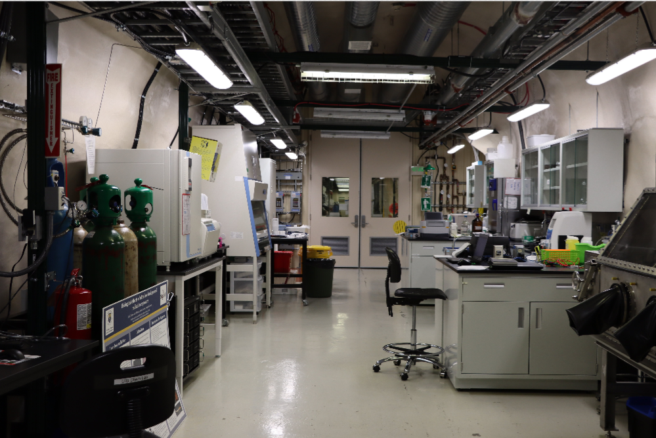
Life sciences & chemistry lab
34
Notes:
The Life sciences and chemistry lab helps to support the science that is happening underground! We can perform sensitive chemical testing that is used in our experiments.
SNOLAB even has a biology experiment underground that is studying the effects of a lack of certain particles, called radiation, on different living cells such as yeast.

Slide 36
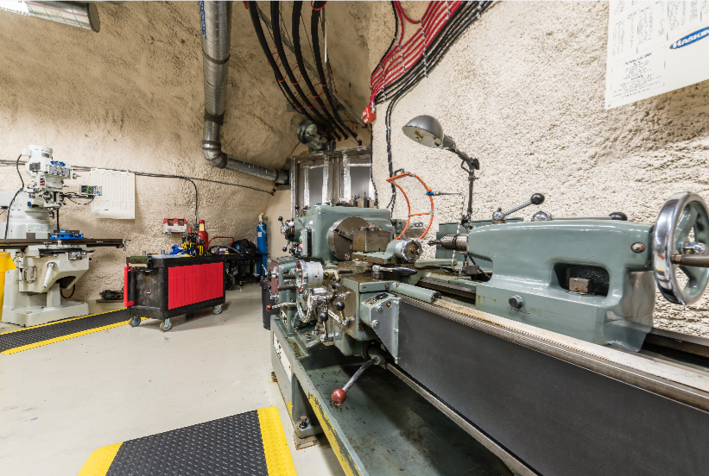
Machine shop
35
Notes:
The machine shop underground helps to support the lab by machining different parts for experiments and the lab as a whole. It is a very clean machine shop as it is part of the clean lab, meaning there can't be any dust or particles.

Slide 37
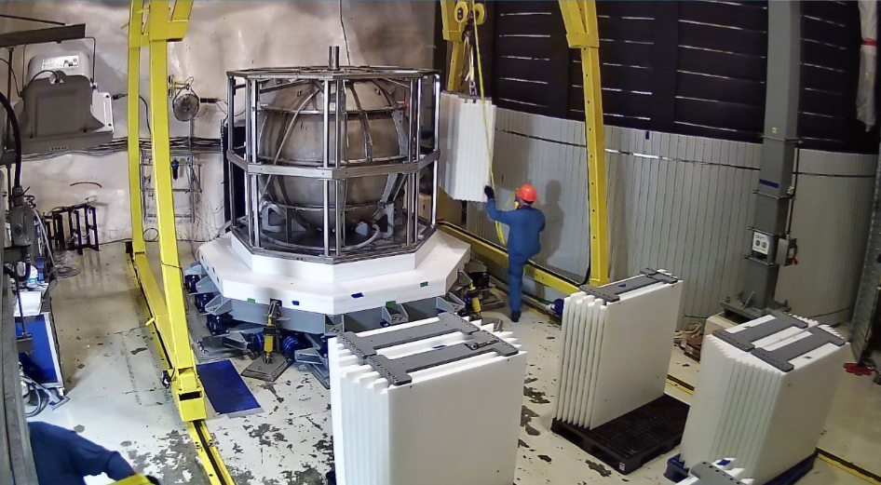
NEWS-G
36
Notes:
NEWS-G, or New Experiments With Spheres - Gas, is a dark matter experiment that searches for dark matter using large amounts of gas. There is a large copper sphere that is 1.4m in diameter with a small sensor that is held at a high voltage. It can collect electrons within the gas mixture.

Slide 38
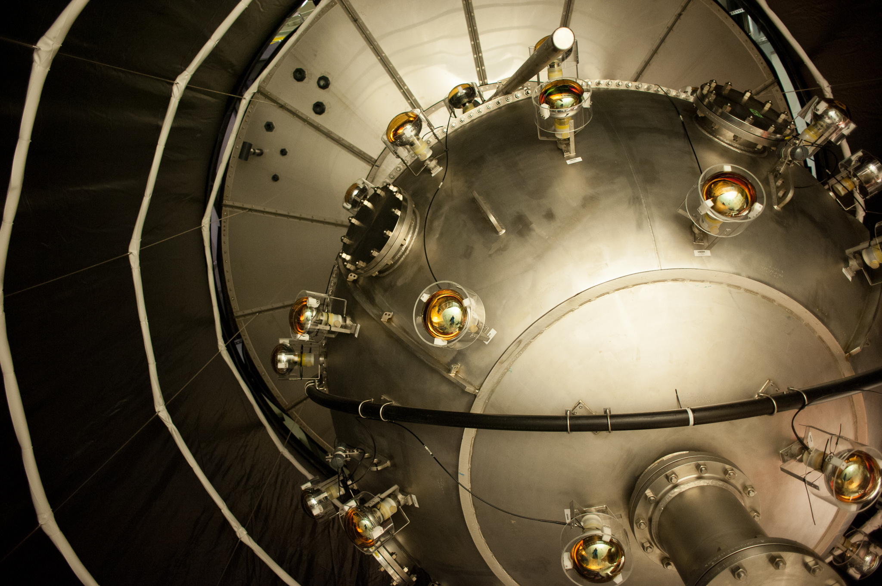
DEAP-3600
37
Notes:
DEAP-3600 is a dark matter experiment that uses large amounts of liquid argon, which is -186 degrees celsius for its search. When a particle interacts with this very cold liquid, it will create a small amount of light, called a photon. This light can be read by very sensitive light sensors.

Slide 39
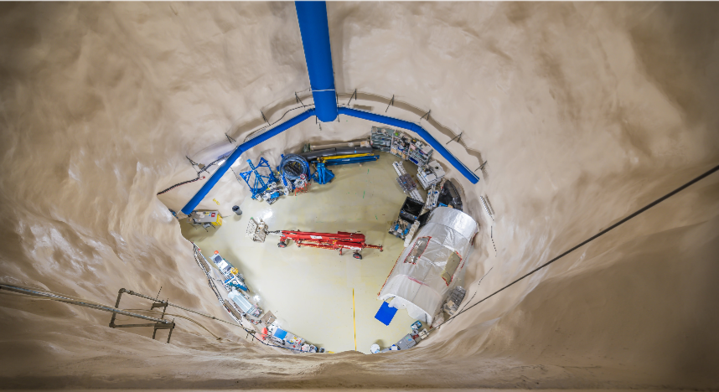
Cryopit
38
Notes:
The Cryopit at SNOLAB is one of our three large caverns. It is hoping to be home to a new, very large scale physics experiment that will push forward our understanding of the Universe even further.

Slide 40
Any questions?
Next session: SNOLAB & the scientific method
39
Notes:
Any questions or hope for a virtual tour? Reach out to outreach@snolab.ca

