Slide 1




Asking scientific questions
Name
Date
Notes:
Session 2 is all about asking scientific questions.

Slide 2







Minds on
What is something in science that you wonder about?
2
Notes:
Let's open this session with a thinking activity. This session is all about asking scientific questions so we can start early on to get them in that thinking mindset.
Invite a couple of students to share with the group something in science they are curious about! This does not have to be specific to physics and can relate to anything!

Slide 3


Mystery Box Activity
Let’s investigate why we only want one variable to change at a time!
3
Notes:
Prepare the small boxes (this can be an old cereal box or shoe box). In one box, add only one item in it, such as a paperclip. In the other box, add one of the same item as the other box and a small assortment (3-5) other small items. The goal is to add more variables so that students will realize that having more than one variable can add a layer of uncertainty.

Slide 4
Mystery Box Activity
Let’s investigate why we only want one variable to change at a time!
  Try a box with one mystery item in it
4
Notes:
Show the students the box with item concealed in it. Give the box a shake, have students guess what it is and ask questions that may help such as "How heavy is the box?" and "What if I slide it slowly left and right, what sorts of noises does it make?"
Allow students to make a few observations and inferences based on what they notice.

Slide 5
Mystery Box Activity
Let’s investigate why we only want one variable to change at a time!
  Try a box with one mystery item in it
  Now, try a box with multiple mystery items in it
5
Notes:
Take out your second box with several items in it. At this point, give it a shake and have students make inferences and observations what they notice. Just like with one item in the box, they can also ask more questions to help identify what is in it.

Slide 6
Reflect
How did the difficulty change with more items?
6
Notes:
Take answers from students about what they found from each of of the boxes. Was it easier to guess what the item was when it was alone in the box?
Having too many variables can impact how well we can identify the different questions and come up with an answer.

Slide 7

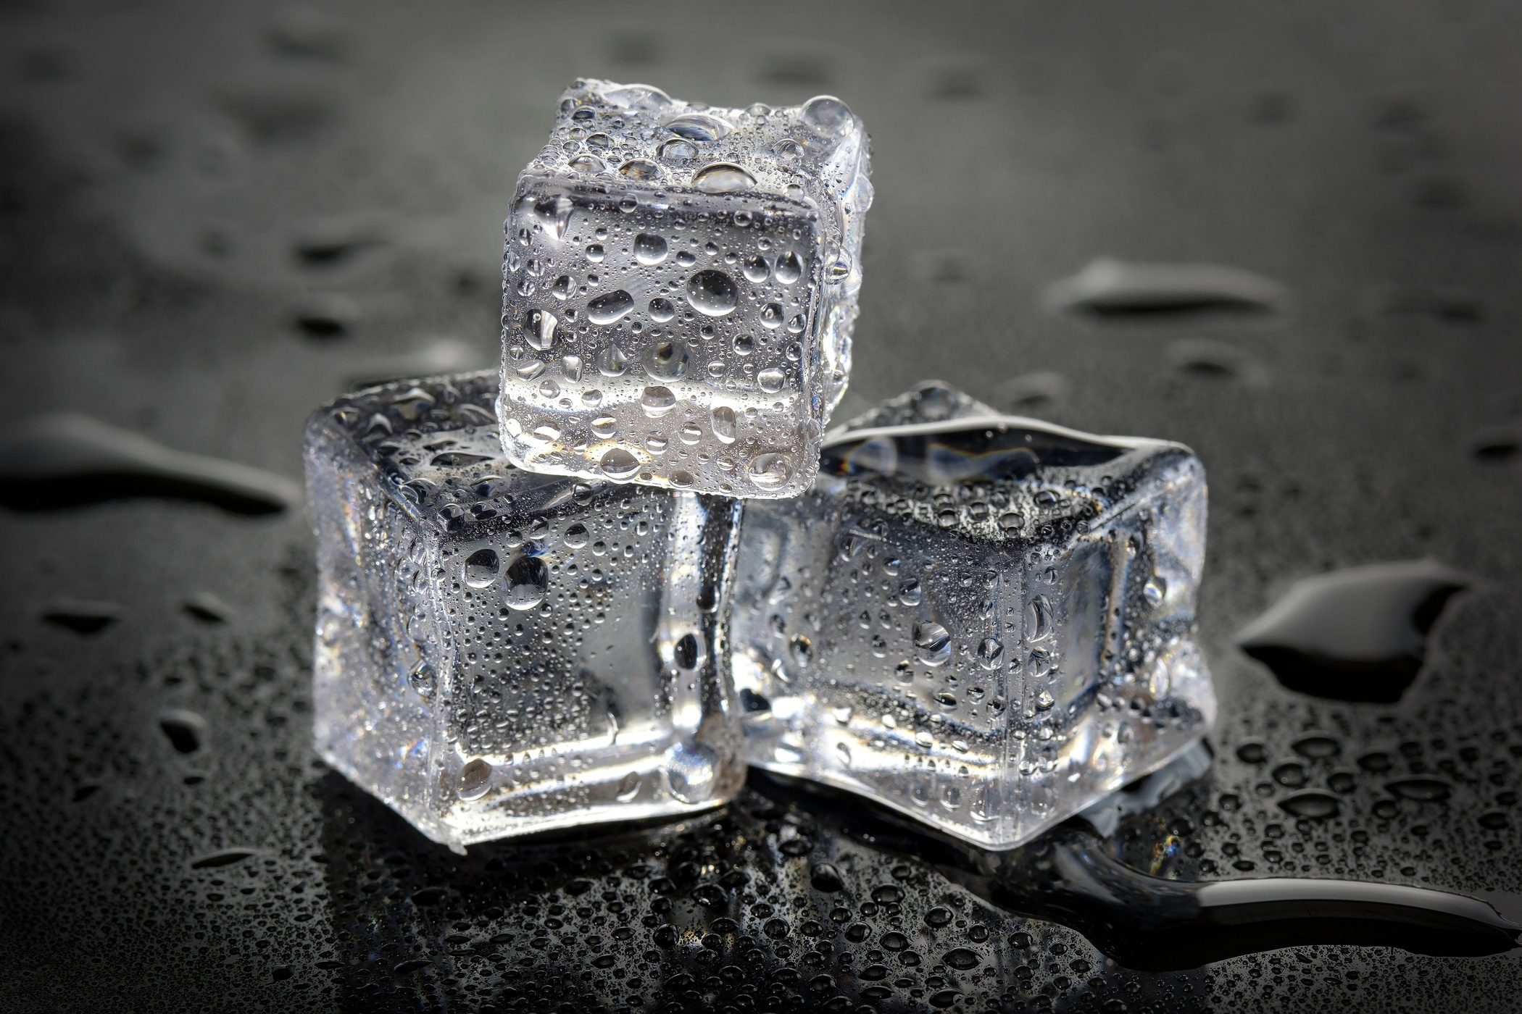
independent variable
The independent variable is the variable that you can change in your question or experiment to see what the effect might be.
This is something that YOU should be changing.
Example: Changing temperature to see if an ice cube will melt faster.
7
Notes:
Giving examples of different variables can help to reinforce some of the concepts that are presented.
If you have time, ask the students to come up with independent variables. This can also be left until the end of this section. There will be a small workshop and activity on identifying different variables.

Slide 8
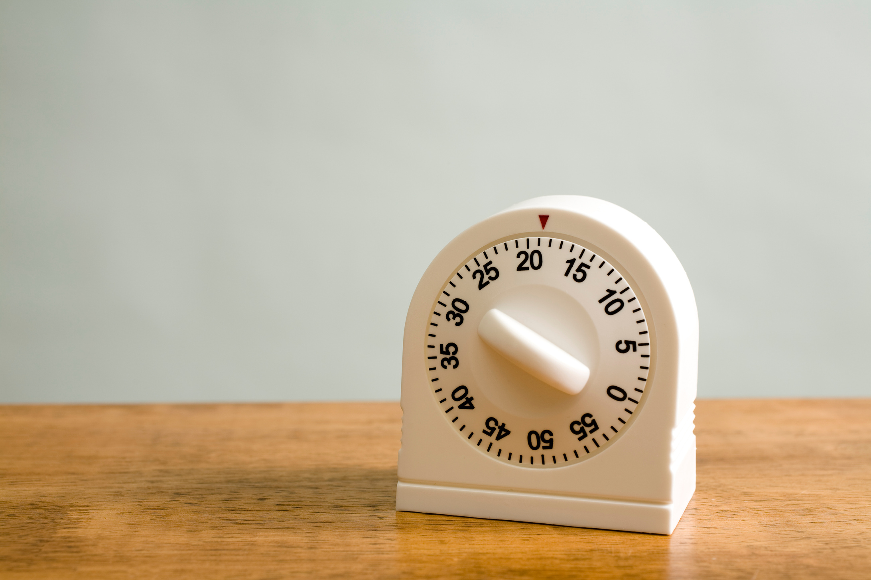
Dependent variable
The dependent variable is the change that you will measure in your experiment.
This is what YOU are observing or measuring.
EXAMPLE: Measuring how long it takes for an ice cube to melt in different temperatures.
8
Notes:
If you have time, ask the students to come up with dependent variables. This can also be left until the end of this section. There will be a small workshop and activity on identifying different variables.

Slide 9

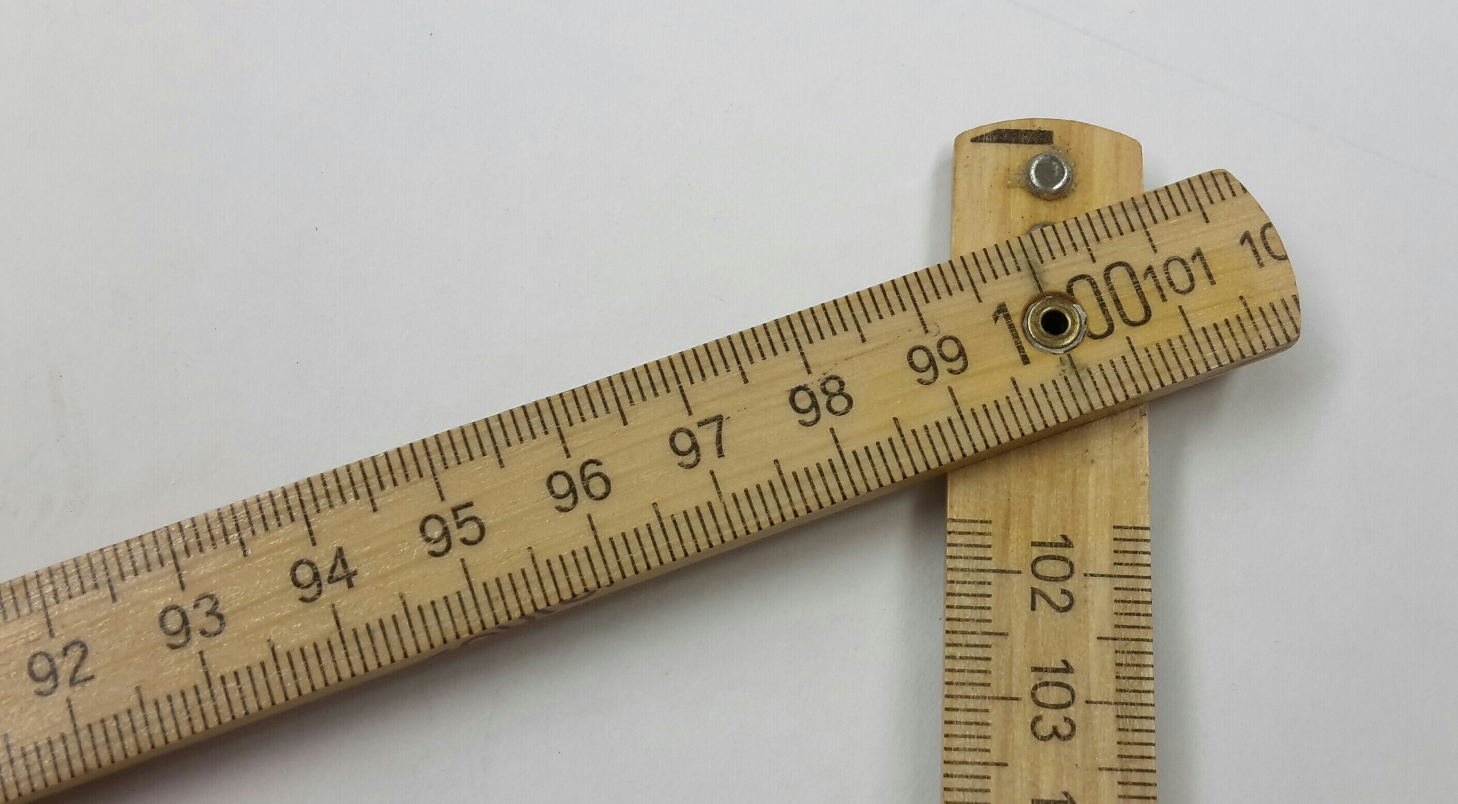
Control variable(S)
A control variable is something that remains constant or stays the same in your experiment.
Having control variables ensures that everything EXCEPT for the independent variable stays the same.
EXAMPLE: Making sure all the ice cubes are the same size before melting them.
9
Notes:
If you have time, ask the students to come up with control variables. This can also be left until the end of this section. There will be a small workshop and activity on identifying different variables.

Slide 10
Your turn
How does the steepness of a ramp affect how far a toy car will travel?
10
Notes:
This will be a pause for a short activity for students to explore different types of variables.

Slide 11
Your turn
How does the steepness of a ramp affect how far a toy car will travel?
Trial 1
Shallow Ramp
Trial 2
Steep Ramp
Ramp angle (estimate):
Ramp angle (estimate):
Distance travelled:
Distance travelled:
11
Notes:
Have students work together in small groups or as a class to determine different variables. For this, the students must:
1. Use their small plank of cardboard as a ramp.
2. Using a shallow ramp and starting from the top of the ramp, let the car go. Make note of where the car was when the car was let go.
3. Measure distance that the car traveled on the floor.
4. Repeat 2 more times for the shallow ramp, being sure to recreate the test as close to the beginning as possible, such as angle of the ramp and point at which the car was let go at.
5. Recreate the above steps but for a steeper ramp.

Slide 12

Your turn
How does the steepness of a ramp affect how far a toy car will travel?
What are the different variables for this question?
Independent
(what we change)
Dependent
(what we measure)
Control
(what stays the same)
12
Notes:
Have students come up with answers on what they believe to be the different types of variables. The answers on the next 3 slides.
You can guide the students by giving the prompts that are written alongside each column.

Slide 13
Your turn
How does the steepness of a ramp affect how far a toy car will travel?
What are the different variables for this question?
Independent
(what we change)
Dependent
(what we measure)
Control
(what stays the same)
The steepness of the ramp (angle)
13

Slide 14
Your turn
How does the steepness of a ramp affect how far a toy car will travel?
What are the different variables for this question?
Independent
(what we change)
Dependent
(what we measure)
Control
(what stays the same)
The steepness of the ramp (angle)
The distance the toy car travelled
14

Slide 15
Your turn
How does the steepness of a ramp affect how far a toy car will travel?
What are the different variables for this question?
Independent
(what we change)
Dependent
(what we measure)
Control
(what stays the same)
Toy car used
The steepness of the ramp (angle)
The distance the toy car travelled
Starting point
Ramp material
15

Slide 16

What is a testable question?
A testable question is a question that can be answered through experimenting and observations.
Questions that need opinions are NOT testable.
16
Notes:
There are examples of testable questions on the next slides.

Slide 17
What is a testable question?
A testable question is a question that can be answered through experimenting and observations.
Questions that need opinions are NOT testable.
Testable:
How does the steepness of a ramp affect how far a toy car wilL travel?
Not testable:
17
Is Chocolate the best kind of ice cream?
Notes:
An example of a testable question is the hands-on example that we just did!
Non-testable questions are ones that have opinions. Examples of this would be:
"Is chocolate the best kind of ice-cream?" and "What is the best colour?"

Slide 18
S
Pecific
M
easurable
To make sure we create testable scientific questions, we want to make they’re S.M.A.R.T.!
A
chievable
R
elevant
T
imely
18
Notes:
To decide if our questions are testable, we can use the acronym S.M.A.R.T.! We will go through what each of these mean and some examples in the next few slides.

Slide 19

SMart qUESTIONS
Asking a more specific question often leads to an easier experimental set-up.
Adding a more specific variable can help to make the question more specific!
sPECIFIC
19
Notes:
S is for specific.
Having specific questions helps to lead us to narrow our variables and can make designing experiments more easy!

Slide 20
SMart qUESTIONS
Asking a more specific question often leads to an easier experimental set-up.
Adding a more specific variable can help to make the question more specific!
Non-specific:
How long does it take to boil something?
Specific:
How long does it take to boil water?
sPECIFIC
20
Notes:
An example of this would be "How long does it take something to boil?" vs. "How long does it take water to boil?". To test how long it takes something to boil, we would need to test every single liquid in the world! That would take much longer than what we have.

Slide 21


SMart qUESTIONS
How will you know when your question is answered? This can be done by thinking about what tools you will use!
A measurable question is one that can be answered by measuring something.
Measurable
21
Notes:
M is for measurable.
Measurable questions will get us thinking about what tools will we use in our experiment! Maybe we need a ruler or a calculator.

Slide 22
SMart qUESTIONS
How will you know when your question is answered? This can be done by thinking about what tools you will use!
A measurable question is one that can be answered by measuring something.
Non-measurable:
Are plants happy?
Measurable:
How does sunlight affect how tall a plant grows?
Measurable
22
Notes:
An example of a non-measurable question would be "Are plants happy?" vs. "How does sunlight affect how tall a plant grows?"
To measure the happiness of a plant, we would need a happy-meter, and that doesn't really exist. We can measure the height of a plant based on how much sunlight it gets easily by putting the plants in dark spots or sunnier spots and take regular measurements of the height of the plant!

Slide 23
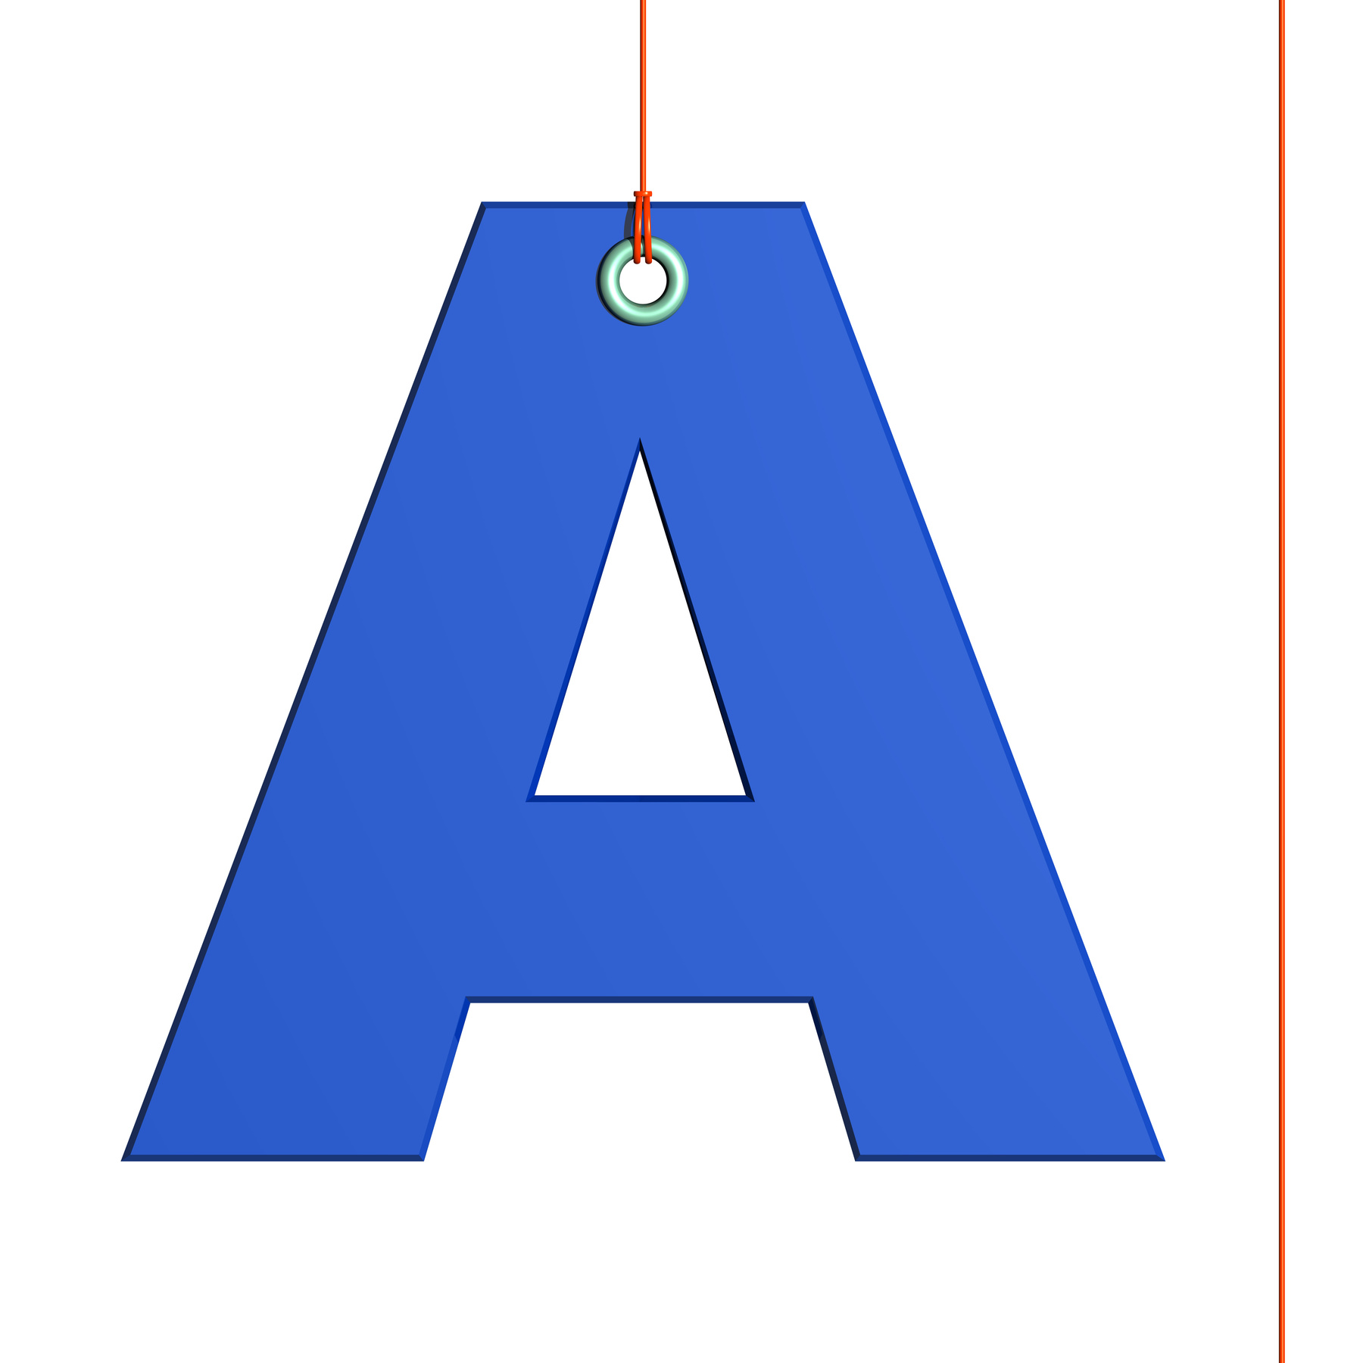
SMart qUESTIONS
When asking your question, it should take a reasonable amount of time and be done with the resources that are available to you.
Attainable questions are doable questions!
Attainable
23
Notes:
A is for attainable.
Attainable questions are questions that can be done in a reasonable amount of time and can be done with resources that are available to us.

Slide 24
SMart qUESTIONS
When asking your question, it should take a reasonable amount of time and be done with the resources that are available to you.
Attainable questions are doable questions!
Non-attainable:
What happens if i teleport back in time using a time machine?
Attainable:
Attainable
How tall can a plant grow?
24
Notes:
An example of attainable questions would be "What happens if I teleport back in time using a time machine?" vs. "How tall can I grow a plant?"
It would take a lot of money and a lot time the build a time machine (if it were even possible!). Growing a plant can take a few months and doesn't cost very much money compared to trying to build a time machine!

Slide 25

SMart qUESTIONS
Does this question increase your knowledge? Making sure your question is relevant is a way to make sure your results will be interesting!
Relevant questions are interesting for others to learn about!
relevant
25
Notes:
R is for relevant.
Does this question increase your knowledge or is something that has already been done before? Relevant questions make it interesting for everyone to learn about!

Slide 26
SMart qUESTIONS
Does this question increase your knowledge? Making sure your question is relevant is a way to make sure your results will be interesting!
Relevant questions are interesting for others to learn about!
Non-relevant:
Can i make a paper airplane?
Relevant:
relevant
Which style of paper airplane flies the farthest?
26
Notes:
Asking a question like "Can I make a paper airplane?" vs. "Which style of paper airplane flies the farthest?", the second is a much more relevant question!
Many people can make paper airplanes, but it's the style that would be more interesting to everyone.

Slide 27

SMart qUESTIONS
Make sure your question can be answered in a reasonable amount of time. While some experiments take years, we want one that is much quicker.
Timely questions can be completed in ~2 weeks!
Timely
27
Notes:
T is for timely.
Timely questions are questions that can be answered in a reasonable amount of time. For the purpose of this experiment, we would be looking for questions that can be complete in ~2-3 weeks.

Slide 28
SMart qUESTIONS
Make sure your question can be answered in a reasonable amount of time. While some experiments take years, we want one that is much quicker.
Timely questions can be completed in ~2 weeks!
Non-timely:
How long will the sun last?
Timely:
timely
How long does it take an ice cube to melt?
28
Notes:
An example of a non-timely question would be "How long will the Sun last?" but a timely question would be "How long does it take for an ice-cube to melt?"
We could be waiting for billions of years for the Sun to fizzle out but an ice cube will melt after only about 20 minutes!

Slide 29
Let’s Review!
Looking back at the wonderings we had at the start of the lesson, do they fit within our SMART acronym?
29
Notes:
Invite the students to look back at their questions from the beginning of the session.
Encourage students to reframe their question to fit in within the S.M.A.R.T. acronym and share with their partner!

Slide 30
Any questions?
Next session: Intro to SNOLAB
30
Notes:
Any questions? Reach out to outreach@snolab.ca

