Slide 1




The Scientific method
Name
Date
Notes:
This session introduces students to the scientific method. As it is the first session in Wonderground, it is a fairly broad session.
We are thankful NSERC PromoScience for funding this program.

Slide 2



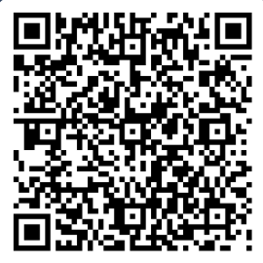


Survey time!
2
Notes:
This survey is completely anonymous. Its purpose is to gauge how students feel towards science at the beginning of the program and at the end of the program. This helps to inform SNOLAB on the successes and improvements needed to the program. It is also a reporting requirement through our funders for the program.
The link for the survey can also be found here: [Insert link]

Slide 3
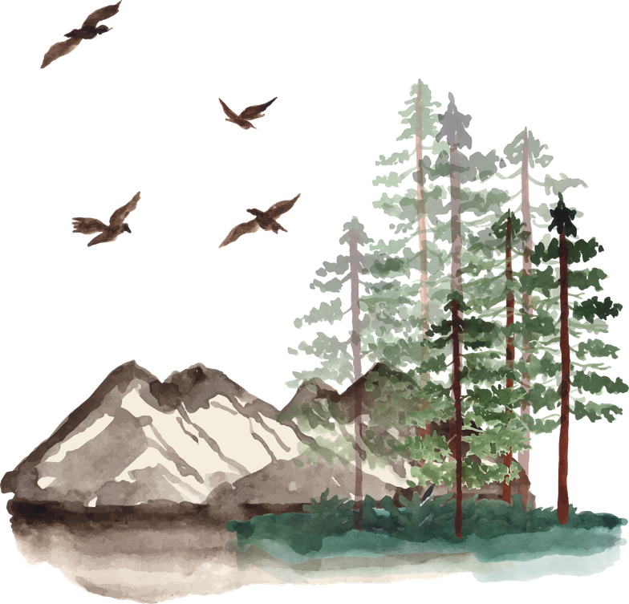

Traditional knowledge
Science is a way to understand the world around us. There are many ways to learn about the world and much to learn from traditional knowledge.
3
Notes:
Traditional knowledge has helped us to learn about the world. Ask students if they can think of any traditional ways of knowing that have impacted science!
These are some great resources to explore with students!
https://www.canada.ca/en/environment-climate-change/services/science-technology/indigenous-science.html
https://wearefire.ca/using/indigenous-science

Slide 4


Minds on
How do you find answers to things you’re curious about?
4
Notes:
Ask students how they find answers to the things they are curious about!

Slide 5

Curiosity leads to discovery
Observations can make us curious and lead to asking questions that can help us learn more.
We can test our questions by following
the scientific method!
5
Notes:
Curiosity is the first step in discovery! Asking questions is what happens when you are curious and that kickstarts the scientific method!

Slide 6

The Scientific method
Step 1: Ask a question
Step 2: Make a prediction
Step 3: Test the prediction
Step 4: Look at the results
Step 5: Share your results
6
Notes:
This is a very basic outline of what the scientific method is and generally what all experiments follow as they do the scientific method!
There is a printable version of this for your students and/or classroom available on our website.

Slide 7


Step 1: Observe & Ask a Question
Look at what you’re curious about and write down any questions that may come to mind.
As you observe, try asking yourself these questions:
Who?
What?
Why?
Where?
When?
7
Notes:
This is where students can start to brainstorm very broadly what makes them curious. There are no guidelines on this!
You can give them things you are curious about like:
"Where do bugs go in the winter?", or "How does the Sun burn?", or even simpler like: "Why is it cloudy (or not) today?"

Slide 8

Step 2: Make a guess or prediction
This is what scientists call a hypothesis
What you expect to see based on what you already know. In other words, it’s an educated guess!
Your hypothesis might follow this outline:
“If
, Then
will happen.”
8
Notes:
Get them to choose one question from what they wrote in the last slide, and make a prediction about what they think is the reason for their question!
Making an educated guess is what scientists call a hypothesis! This often follows the format "If ______, then _______ will happen."
For example: "If it is cold out, then the bugs will hide in the ground."

Slide 9
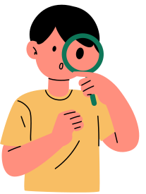
Step 3: Test the prediction
This is where the fun really happens!
You develop an experiment to test your hypothesis. Usually, you repeat your test many times to be sure of your results.
9
Notes:
Some hypotheses are a little bit harder to test with the things we have available to us, but we will get to testing in just a few slides!

Slide 10
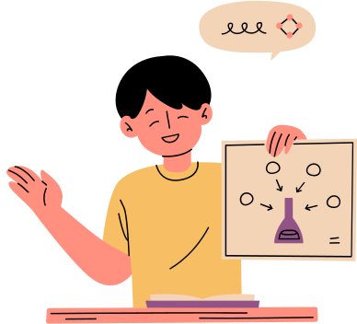
Step 4: Look at the results
Once you have some results, it’s time to compare them to your original hypothesis. Are they what you expected? Why or why not?
Don’t worry if your hypothesis and experiment results are different, that is an important result, too!
10
Notes:
Looking at results is where you get to compare your results to your original hypothesis! Are they what you expected?
It is completely okay if they are not! These results are important too, and sometimes even lead to big discoveries.

Slide 11
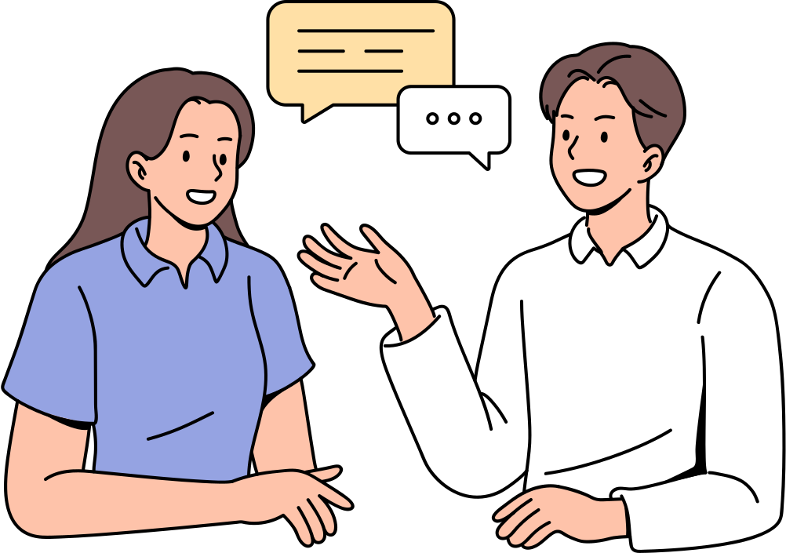
Step 5: Communicate the results
Now, it’s time to share what you’ve done!
When sharing your results, being thorough is important. You should share your thought process from beginning to the end. You can try to answer questions like:
What were you curious about?
Why did you set up your experiment the way you did?
11
What did your results show?
Notes:
It is important to have good science communication so that everyone can learn about science! This makes science accessible for everyone. We will learn in a future session about ways to communicate science and the scientific method in experiments from beginning to end.
Have students share ways that they communicate science or ways that they learn about science!

Slide 12
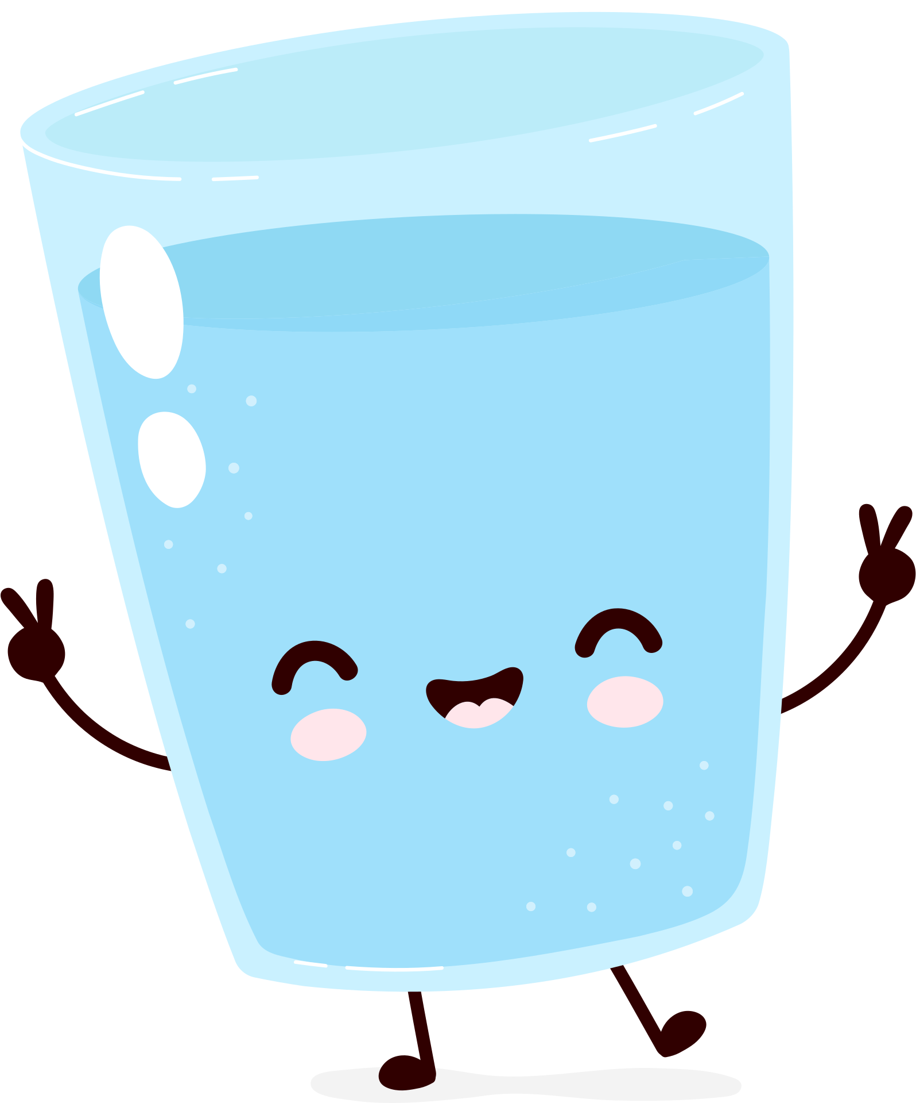
Will it float or will it sink?
Let’s try the scientific method together!
12
Notes:
Time to do a small experiment! This experiment encourages students to work their way through the scientific method from beginning to end.

Slide 13
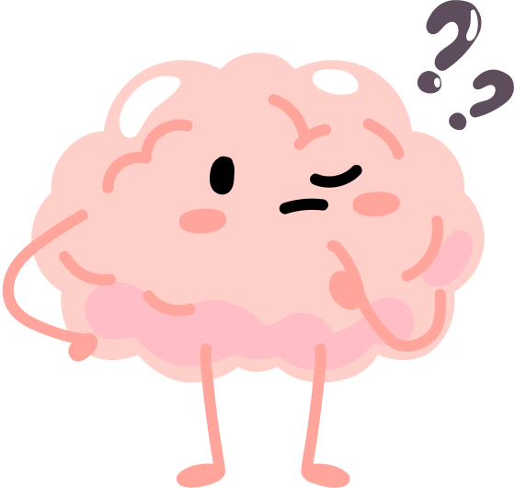
Step 1: Observe & Ask a question
We are going to observe some things getting put into water, and will predict if it will sink or float!
This will let us wonder what makes certain things float or sink, such as a pencil.
13
Notes:
The first step is to observe something that makes us curious and as a question.
We noticed that some things float and some things sink in water - but does a common classroom object such as a pencil float or sink? That is our question.

Slide 14
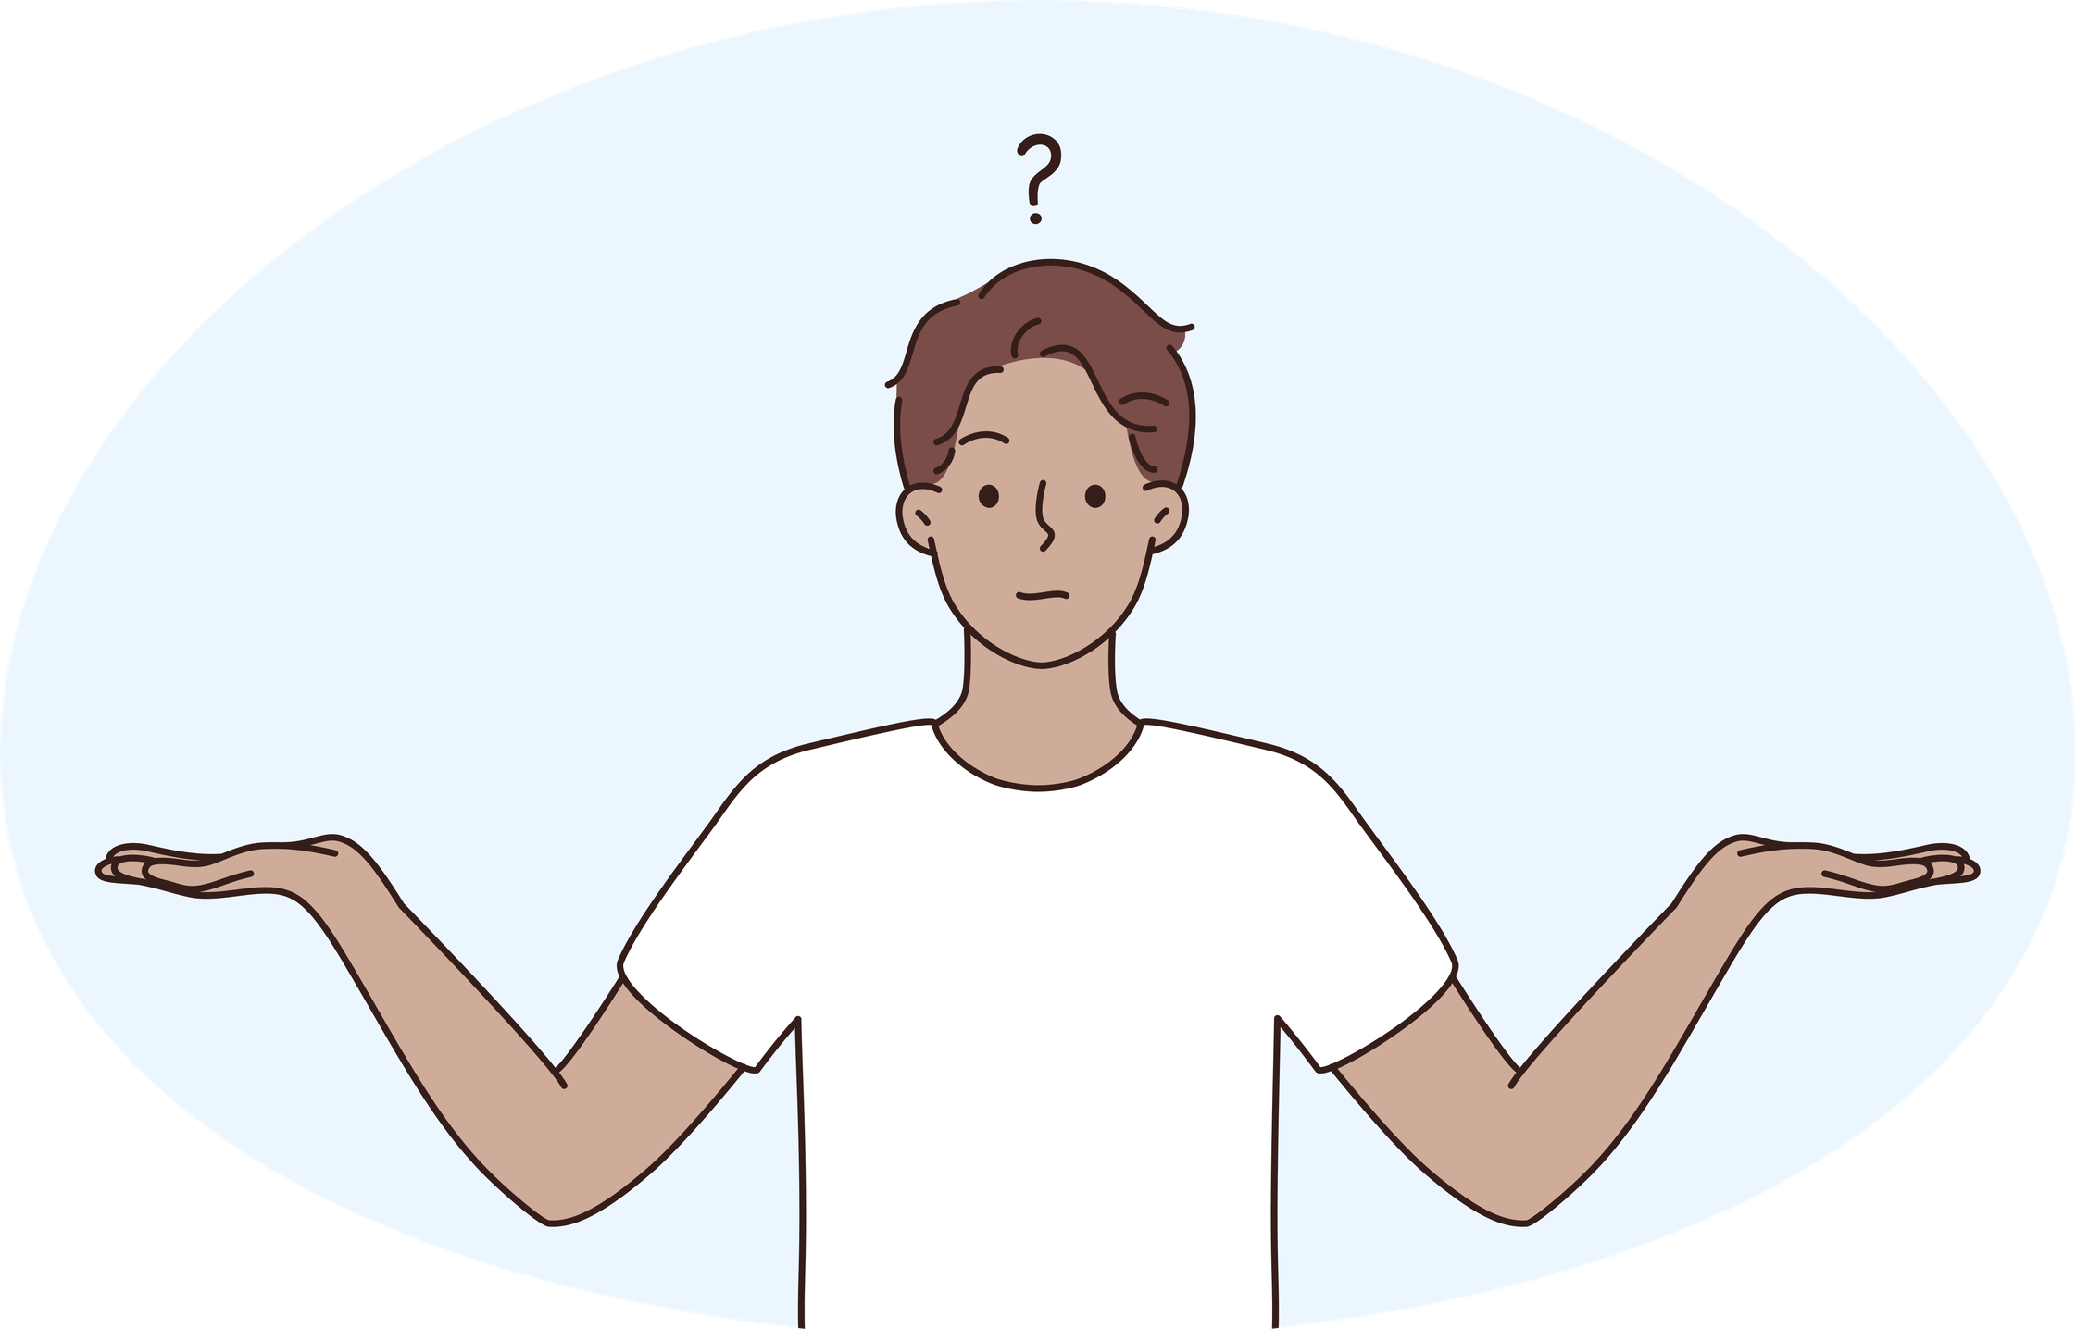
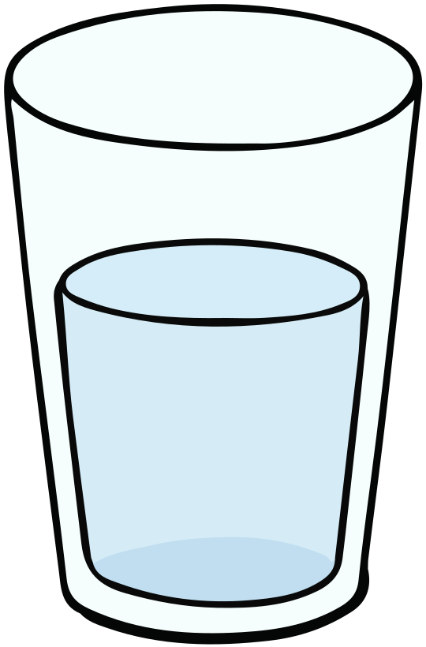

Step 2: Make a prediction
So, do you think the pencil will float or sink?
Create your hypothesis:
  “If I drop a pencil in water, I think it will .”
Why do you think the pencil will float or sink?
14
Notes:
Ask the class - will a pencil float or sink when put in water? Why do they think that?
At this point, invite them to discuss with their peers for 1 minute about what and why they think what will happen.
They have now completed 2 steps of the scientific method!

Slide 15
Step 3: Test the prediction
For our experiment, we need:
  1 clear container filled with water
  1 pencil
The procedure we will follow to test our prediction is:
  Drop the pencil in the water
  Observe if it floats or sinks
  Repeat 2 more times to be sure!
15
Notes:
If you feel it appropriate and manageable, get a volunteer from the class to help with this part.
This is the procedure:
1. Fill a large, clear container (such as a Tupperware) with water, about 2" deep.
2. Have a student, or yourself, drop the pencil in the water.
3. Record the data on a whiteboard or chalkboard.
4. Repeat two more times.

Slide 16
Step 4: Look at the results
What happened the 3 times we put the pencil in the water?
Was the result what you expected? Why or why not?
16
Notes:
It's time to look at the results that your class marked down!
Have one or two students share what they think happened and why. Was this was they expected?

Slide 17

Step 5: Communicate your results
How did this compare to your hypothesis?
Did you get the results you predicted? If not, why do you think the results are different than what you thought?
17
Notes:
Have students turn to their peers and communicate what happened from their perspective. Guide them with questions like:
"Did your peer notice anything that you didn't?" "Did you both hypothesize correctly?"

Slide 18
Demo time!
What do you think happens if a raisin is dropped in carbonated water?
Will it float or will it sink?
18
Notes:
This is another fun experiment with unexpected results and can really help to reinforce the basic steps of the scientific method.

Slide 19
Your turn
Use your new knowledge to test the scientific method!
19
Notes:
Have students go through the scientific method on their own time in the next slide.

Slide 20
will a raisin float or sink?
This time, work through the scientific method in pairs (or small groups) to come up with a hypothesis. Once you have it, come up to collect your data!
step 1:
Ask a question
step 2:
Make a prediction
Step 3:
Test the prediction
step 4:
Look at the results
step 5:
Communicate your results
20
Notes:
As a reminder, the first step "Ask a question" has already been done. The question is "Will a raisin float or sink in a carbonated beverage?"
Allow students to work through the rest of the scientific method on their own in small groups.

Slide 21
What happened?
Communicate your results to your peers! Is the result what you expected? Why or why not?
21
Notes:
Have students turn to their peers and discuss what they think happened! Then take some answers from students and have them share if this matched their hypothesis. Why or why not?

Slide 22
Any questions?
Next session: Scientific questions
22
Notes:
If you have any questions about the session, you can reach out to outreach@snolab.ca.

