Slide 1



Dark Matter Day
Poster Contest

Slide 2





Dark Matter Day
An annual international outreach event to celebrate the ongoing scientific hunt for the mysterious dark matter
Notes:
Learn more about Dark Matter Day – an international outreach celebration: https://www.interactions.org/dark-matter-day

Slide 3
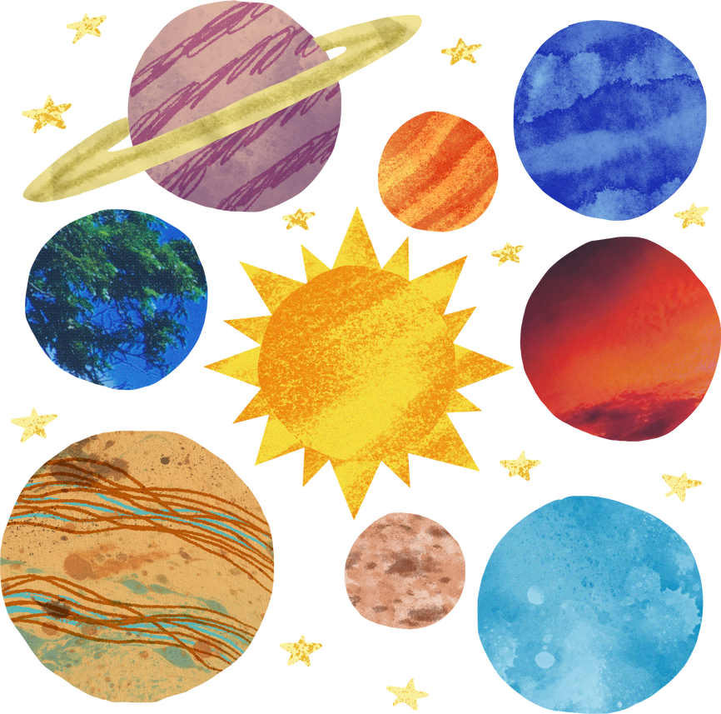

Everything we can see - stars, planets, and us - is only a tiny part of the universe

Slide 4

Dark Matter
27%
What we know ~5%
Dark Energy
68%
Notes:
Dark Matter and Dark Energy - CERN: https://home.cern/science/physics/dark-matter

Slide 5



What We Know
There must be something we can’t see that prevents galaxies from flying apart.
‘Dark Matter’
The unseen part of the universe that acts like invisible glue, holding galaxies together.
Notes:
Watch a TedEd animation about dark matter – the matter we can’t see: https://ed.ted.com/lessons/dark-matter-the-matter-we-can-t-see-james-gillies

Slide 6
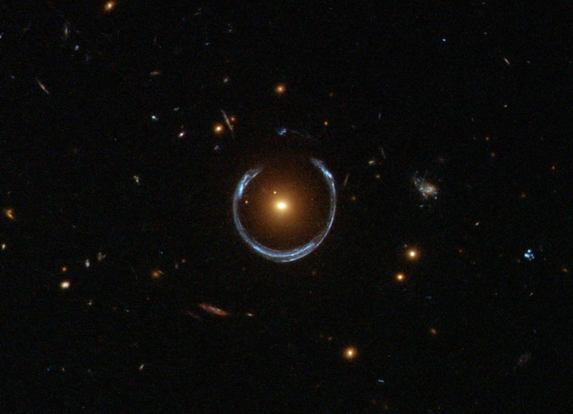
What We Know
Light from distant galaxies bends as it passes by huge amounts of invisible material.
‘Gravitational Lensing’
This bending helps scientists map where the invisible matter must be.
(Source: NASA)
Notes:
Learn about dark matter from the NASA kids website: https://spaceplace.nasa.gov/dark-matter/en/

Slide 7
How Scientists Study
Make it!
Break it!
Shake it!
Direct Production
Indirect Detection
Direct Detection
Notes:
An article reviewed by students about dark matter: How Do Scientists Know Dark Matter Exists?: https://kids.frontiersin.org/articles/10.3389/frym.2021.576034

Slide 8
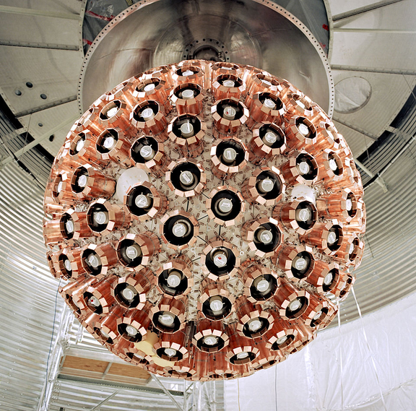
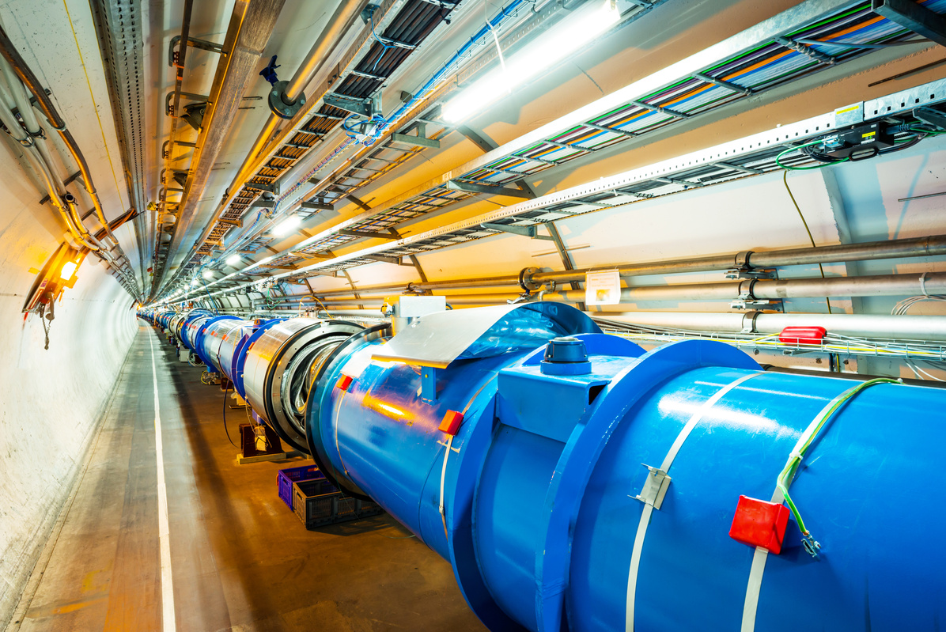
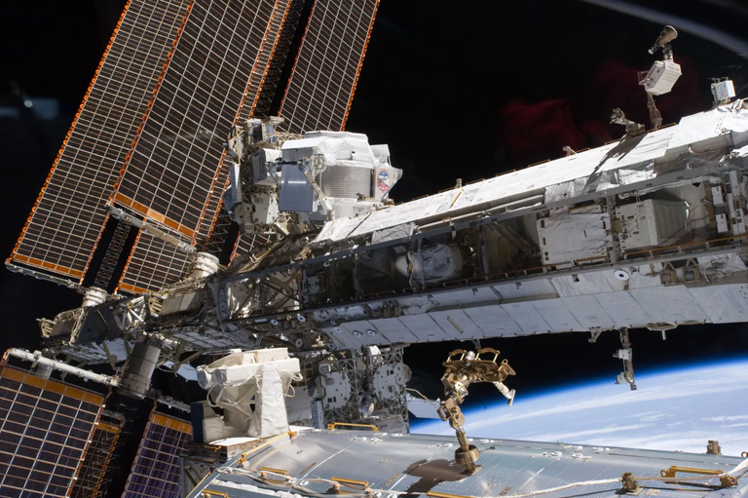
How Scientists Study
Make it!
Break it!
Shake it!
(Source: CERN)
(Source: NASA)
(Source: SNOLAB)
Particle Colliders
Space-based Telescopes
Underground Detectors
Notes:
How students can study (by observing 2 water bottles): Do an experiment to learn how scientists make observations about dark matter: https://www.jpl.nasa.gov/edu/teach/activity/how-do-we-see-dark-matter/

Slide 9
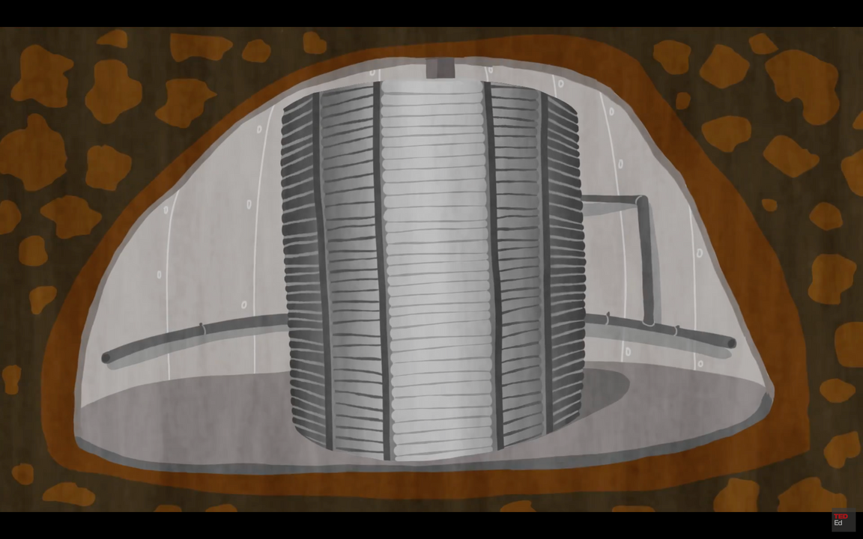
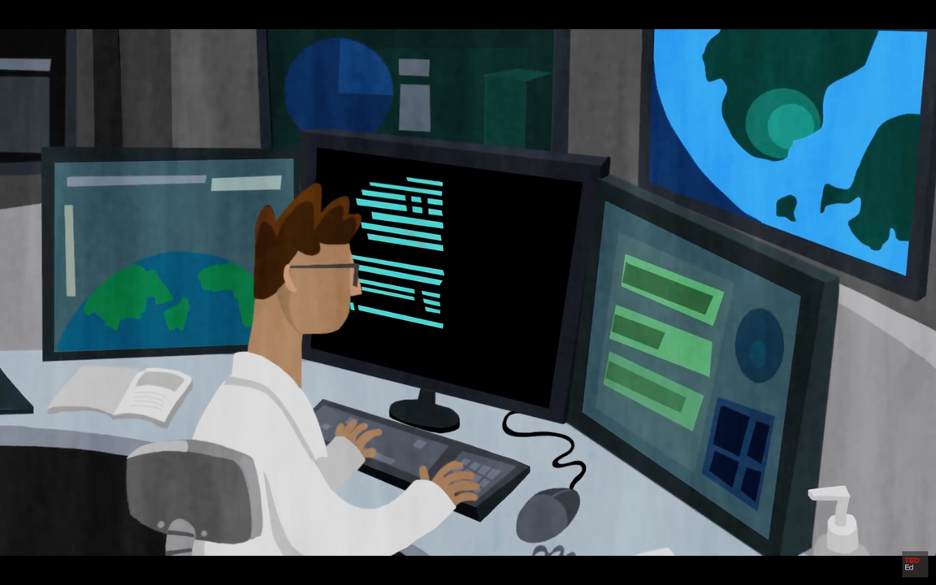
SNOLAB
Images sourced from TedEd animations
Underground science lab
2 km below Sudbury, Ontario
One of the cleanest and deepest labs on Earth!
Notes:
SNOLAB builds the underground science lab to avoid cosmic rays and noise.
Watch a TedEd animation about how we build dark matter experiments at SNOLAB: https://ed.ted.com/lessons/how-to-build-a-dark-matter-detector-jenna-saffin

Slide 10



Poster Contest
About
Dark Matter

Slide 11

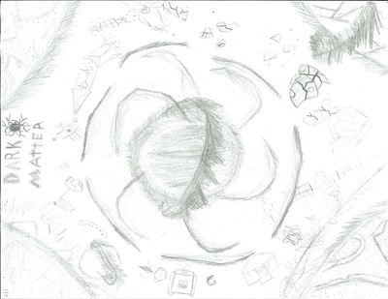
Could be a drawing, digital art, etc.
(Created by Elijah | 4-8 category)
(Created by Eric | 17-19 category)

Slide 12


Entry Requirements
Primary (ages 4–8)
Junior (ages 9–11)
Intermediate (ages 12–16)
Senior (ages 17–19)
Universal (ages 20–100+)
8.5" × 11" (letter size)
1 entry per person
Digital submission
scan or photo
no AI-generated

Slide 13



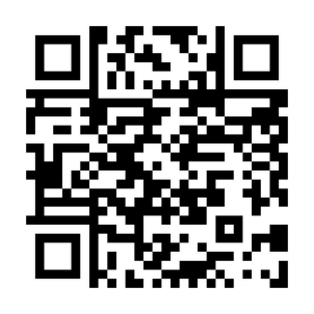

Poster Contest
11:59pm ET
Wednesday, October 29
More Info
All submissions will be digitally displayed at the SNOLAB facility!
Notes:
Deadline: Wednesday, October 29th at 11:59pm ET

Slide 14


Prize
Winning artwork will travel 2 km underground to be displayed at SNOLAB
It will also shine online through SNOLAB’s social media
Winners in Canada will receive physical prize packs
Notes:
Deadline: Wednesday, October 29th at 11:59pm ET

Slide 15
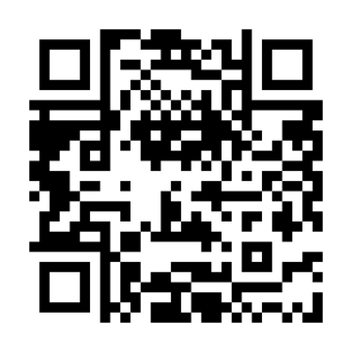
Dark Matter Day
Submit Here!
Everyone loves a mystery

