Slide 1
SNOLAB particle symphony

Slide 2
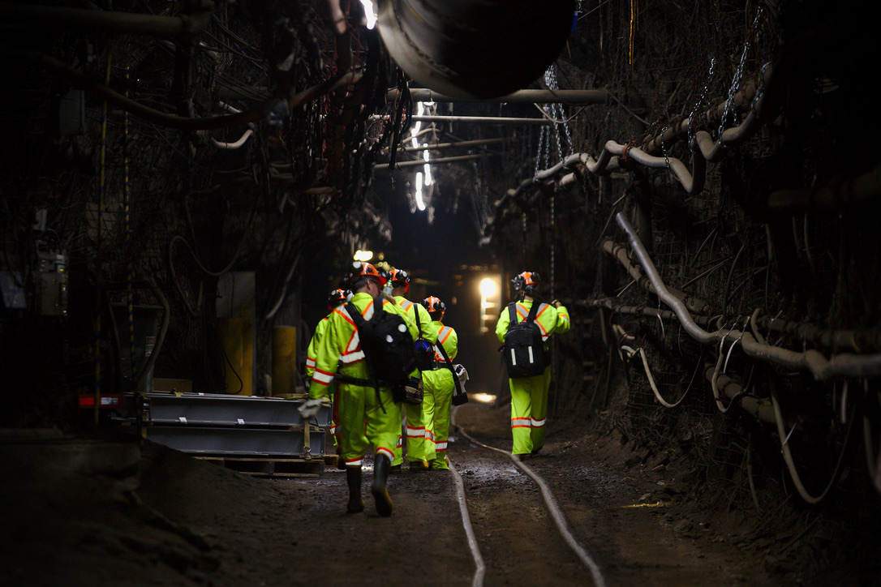
Notes:
SNOLAB is Canada's deep underground science laboratory, located deep underground in an active mine

Slide 3
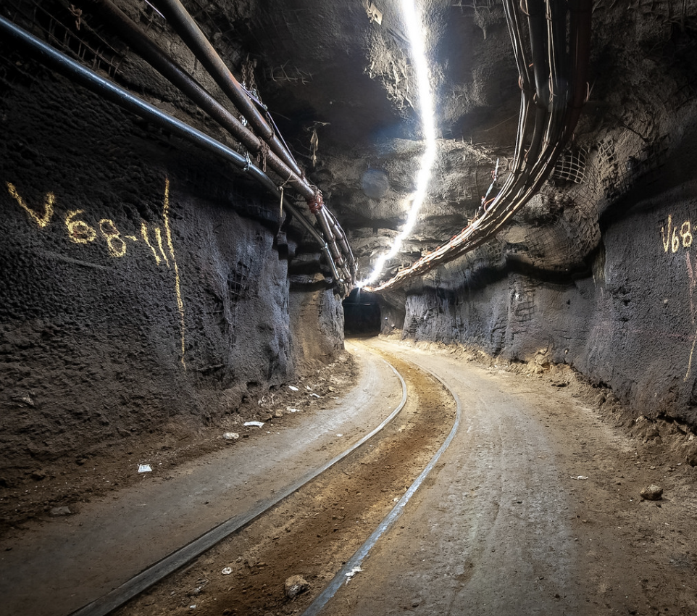
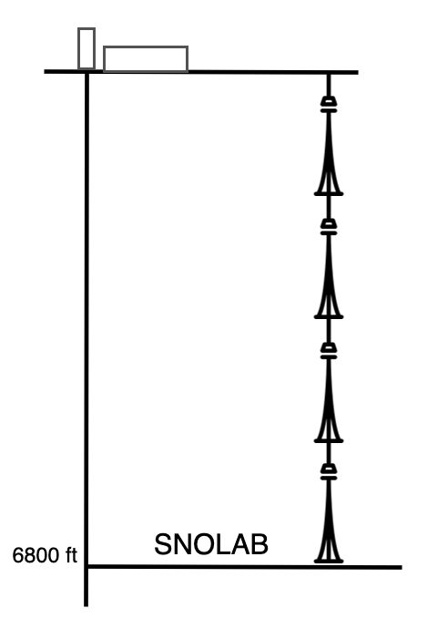
6800 feet underground!
Photo courtesy of SNOLAB
Notes:
We go deep underground to reduce the amount of cosmic ray particles. If you hold your hand out on the surface of the earth approximately 1 cosmic ray will pass through your hand every second. 2km underground at SNOLAB you would need to hold your hand out for several months before a cosmic ray would pass through it. There is a 50 million times reduction in cosmic rays 2km underground at SNOLAB! The neutrinos and dark matter that we are looking for are unlikely to be stopped by the rock, so they are free to keep travelling to our detectors. The deeper we go, the more of this shielding we have. SNOLAB is the deepest, cleanest of all the underground physics labs in the world.

Slide 4
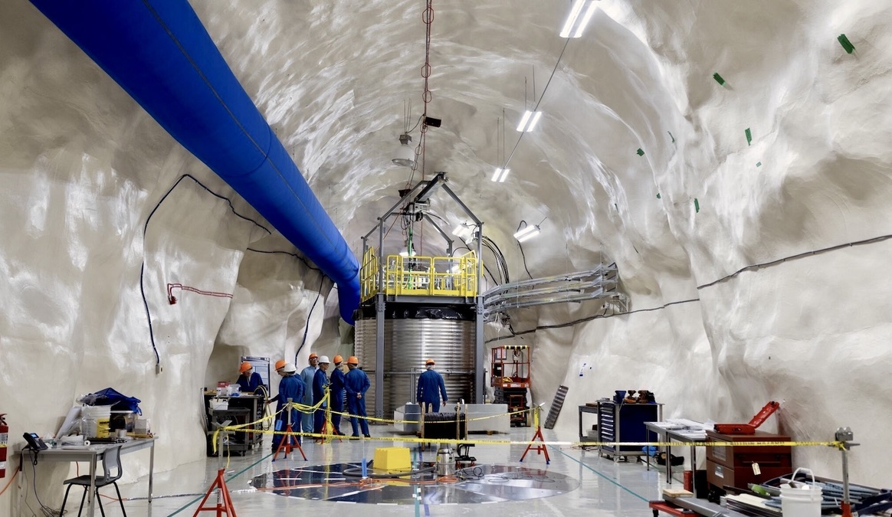
Notes:
The contrast in environment from the drift (mining term for the horizontal tunnel we walk through) is stark. The walls are smooth, not a speck of dust can be found anywhere in the lab, and the lab is well lit. Here you can see one of our experiments running and actively searching for particles.

Slide 5
Sub-atomic particles
Neutrinos
Dark Matter?
?
Image courtesy of Research Scientist at SNOLAB
Notes:
These sub-atomic particles that are being studied are smaller than an atom! The types of particles that our detectors are built to detect are neutrinos and dark matter. Both neutrinos and dark matter are weird and weakly interacting making them really difficult to observe. At SNOLAB go to great lengths to create an environment where these interactions can be observed.

Slide 6
Why go underground?
Photo courtesy of NASA
Image by Marc Ward/ Shutterstock
Photo courtesy of ASPERA/Novapix/L.Bret
Notes:
High energy cosmic rays collide with particles in our atmosphere creating showers of secondary particles.

Slide 7
Picture a pin drop…
Photo from of Online Thesaurus
Notes:
An analogy of trying to detect particles on the surface of the Earth: imagine the sound of a pin dropping. Take a moment and really imagine the sound of a metal pin hitting a hard surface.

Slide 8
… in a crowded dance floor
Photo from of Digital DJ Tips
Notes:
Now imagine the sound of a pin dropping in a crowded dance floor. You would need to turn down the music and get rid of all that background noise before even having a hope of hearing the sound of the pin dropping. The way we "get rid of the music" and other background noises are by going deep underground to reduce the cosmic rays interacting within the detectors.

Slide 9
Cosmic Radiation
Photo courtesy of NASA
Image by Marc Ward
Notes:
Cosmic radiation or charged particles are a huge source of noise for particle physics experiments. Charged particles come from different sources throughout the universe from supernovae, to our own sun. The earths magnetic field diverts much of these particles but there is still a high volume on the earths surface.

Slide 10
Charged cosmic radiation
Photo courtesy of NASA
Image by Marc Ward/ Shutterstock
Photo courtesy of NASA/ Tommy Richardsen
Notes:
This is a photo of the aurora borealis or more commonly known as the Northen Lights. Cosmic rays colliding with gasses in the atmosphere; different colours are from the presence of different gasses, ie: the green colour is from oxygen.

Slide 11
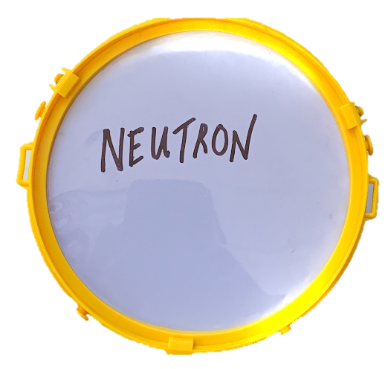
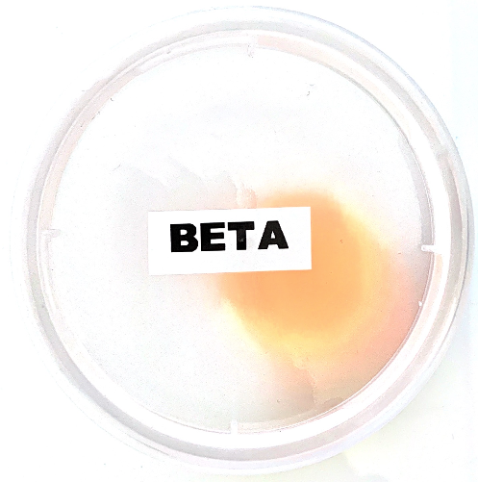
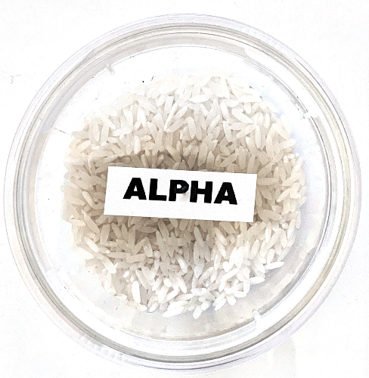
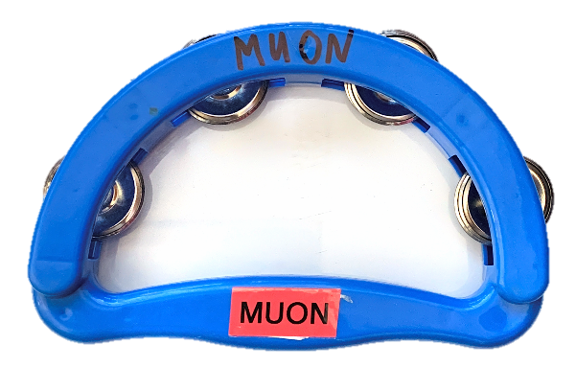
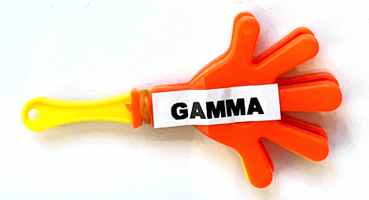
Particles
Galore!
betas
alphas
muons
neutrons
gammas
Notes:
There are a lot of particles that we need to keep out of our very sensitive experiments in order to detect neutrinos and/or dark matter.
We are going to assign an instrument to each of these particles to simulate the ”background noise” these particles present for the experiments.
Everyone will get an instrument, but it’s important that we listen to the conductor so that we aren’t all making noise when we aren’t supposed to.
Allow each group to test out their instruments to get that out of the way.
NOTE: You could also use different instruments (and include images of them) or body, sounds such as clapping, if instruments are not available. If using body sounds, include just the word of the sound or make a visual for each of the 5 sounds that will represent each of the particles.

Slide 12
Play your
Instruments!
betas
alphas
muons
neutrons
gammas
Notes:
There are a lot of particles that we need to keep out of our very sensitive experiments in order to detect neutrinos and/or dark matter.
We are going to assign an instrument to each of these particles to simulate the ”background noise” these particles present for the experiments.
Everyone will get an instrument, but it’s important that we listen to the conductor so that we aren’t all making noise when we aren’t supposed to.
Allow each group to test out their instruments to get that out of the way. Give muons to adults.

Slide 13
And STOP!

Slide 14
The Rules:
All instruments will be played together at the beginning
As we travel underground and inside a detector, instruments will be eliminated.
Play your instrument only when your instrument is on the projector. Look for your instrument to know if you should be playing. If there is a red circle over it, do not play your instrument.
muons
neutrons
Notes:
There are a lot of particles that we need to keep out of our very sensitive experiments in order to detect neutrinos and/or dark matter.
We are going to assign an instrument to each of these particles to simulate the ”background noise” these particles present for the experiments.
Everyone will get an instrument, but it’s important that we listen to the conductor so that we aren’t all making noise when we aren’t supposed to.

Slide 15
Journey to SNOLAB
Notes:
Now, let's begin our journey to SNOLAB!

Slide 16
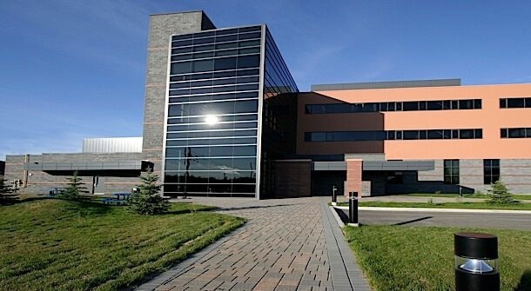
SNOLAB Surface Building
Notes:
SNOLAB has a surface building where there are offices, lab space, and area to prepare to go underground.

Slide 17
Play your
Instruments!
betas
alphas
muons
neutrons
gammas

Slide 18
And STOP!

Slide 19
Notes:
This linked video shows what travel down to SNOLAB is like!

Slide 20
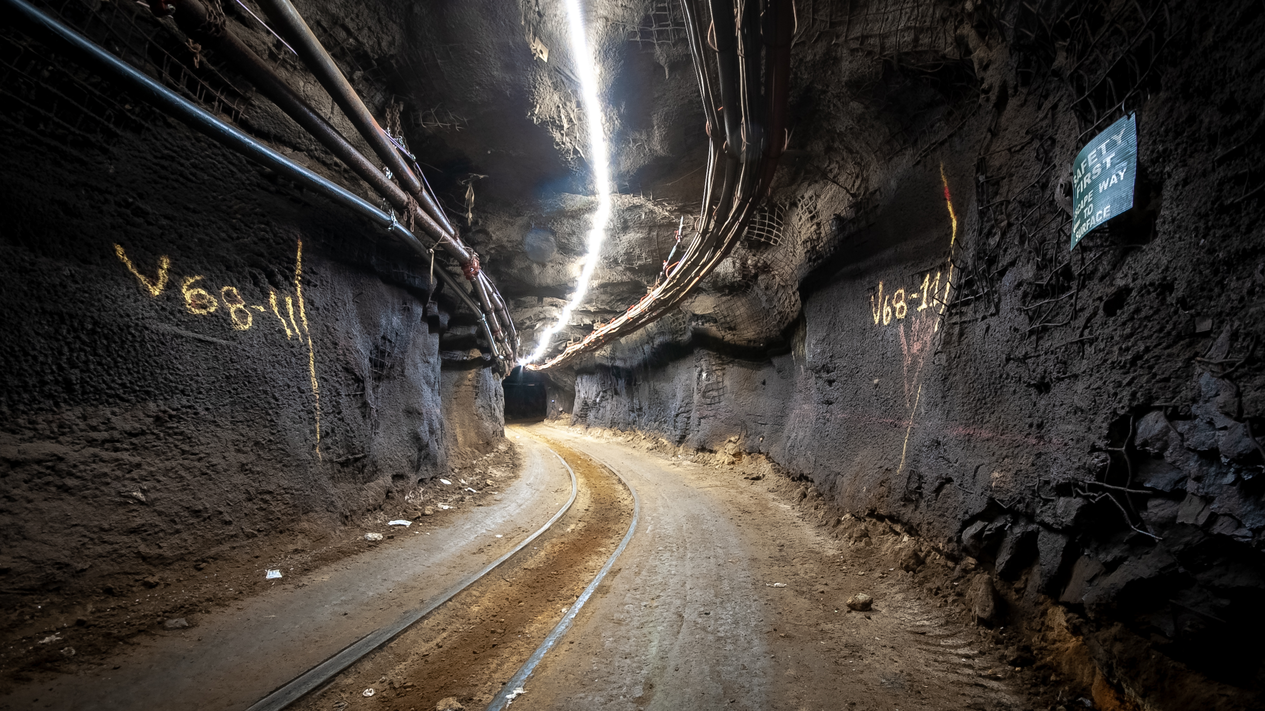
Walk to SNOLAB
Notes:
Workers walk 1.5km through a standard mining drift to get to SNOLAB.

Slide 21
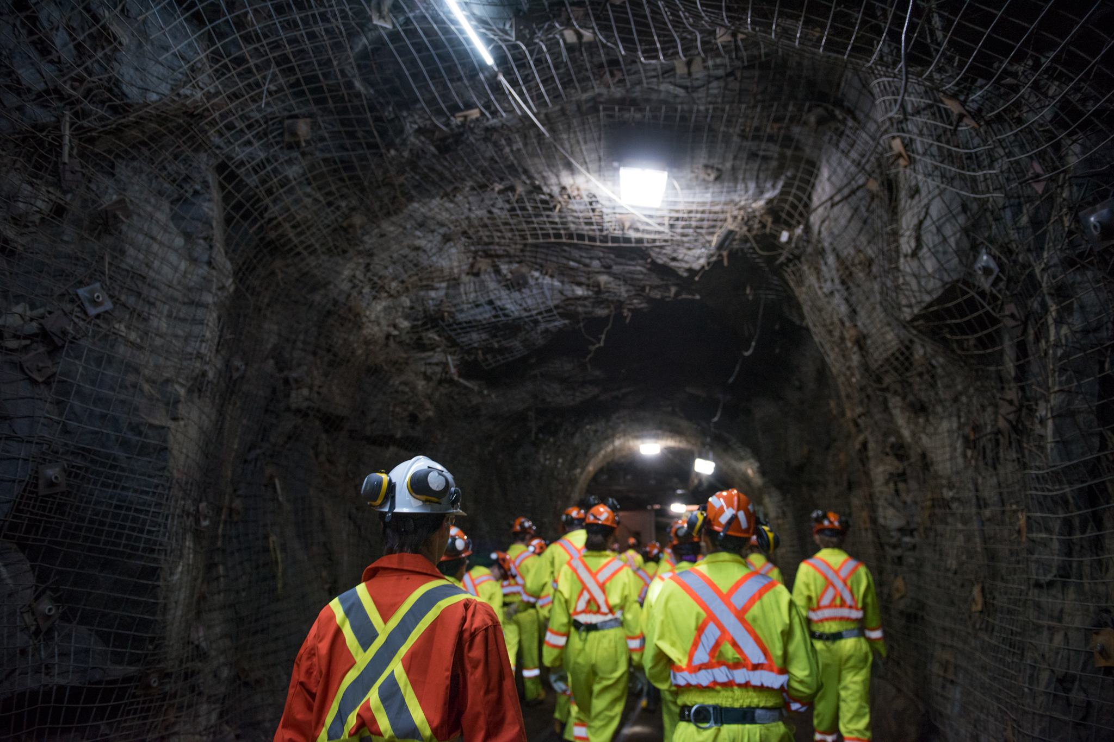
Walk to SNOLAB

Slide 22
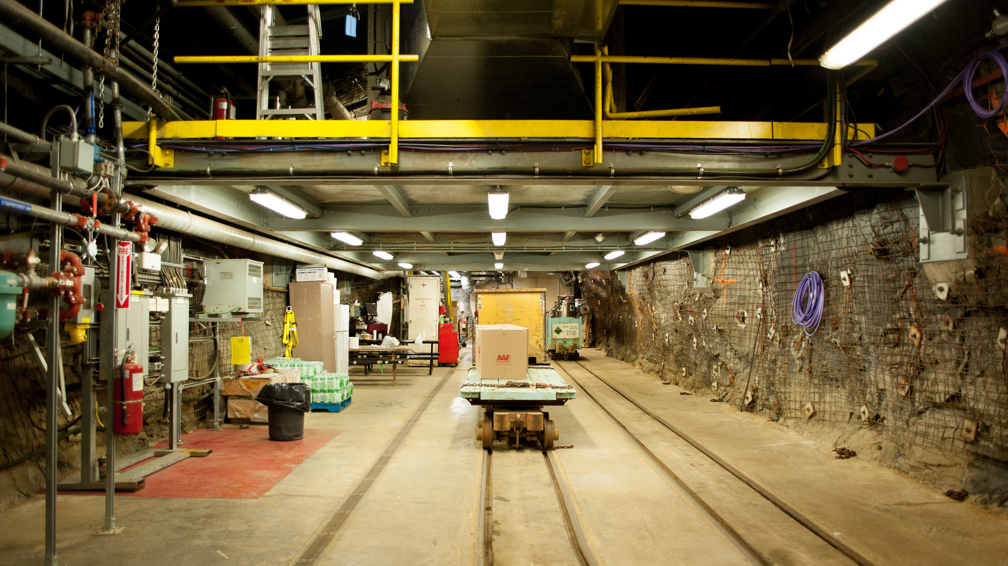
Underground entrance to SNOLAB

Slide 23
Play your
Instruments!
betas
alphas
muons
neutrons
gammas

Slide 24
And STOP!

Slide 25
What did we lose?
A heavy, high-energy, short-lived particle.
Source - most are created by collisions of high energy cosmic rays with particles in the atmosphere.
Reduced by going deep underground.
A factor of 50 million reduction at SNOLAB!
muons
Quiet
Loud

Slide 26
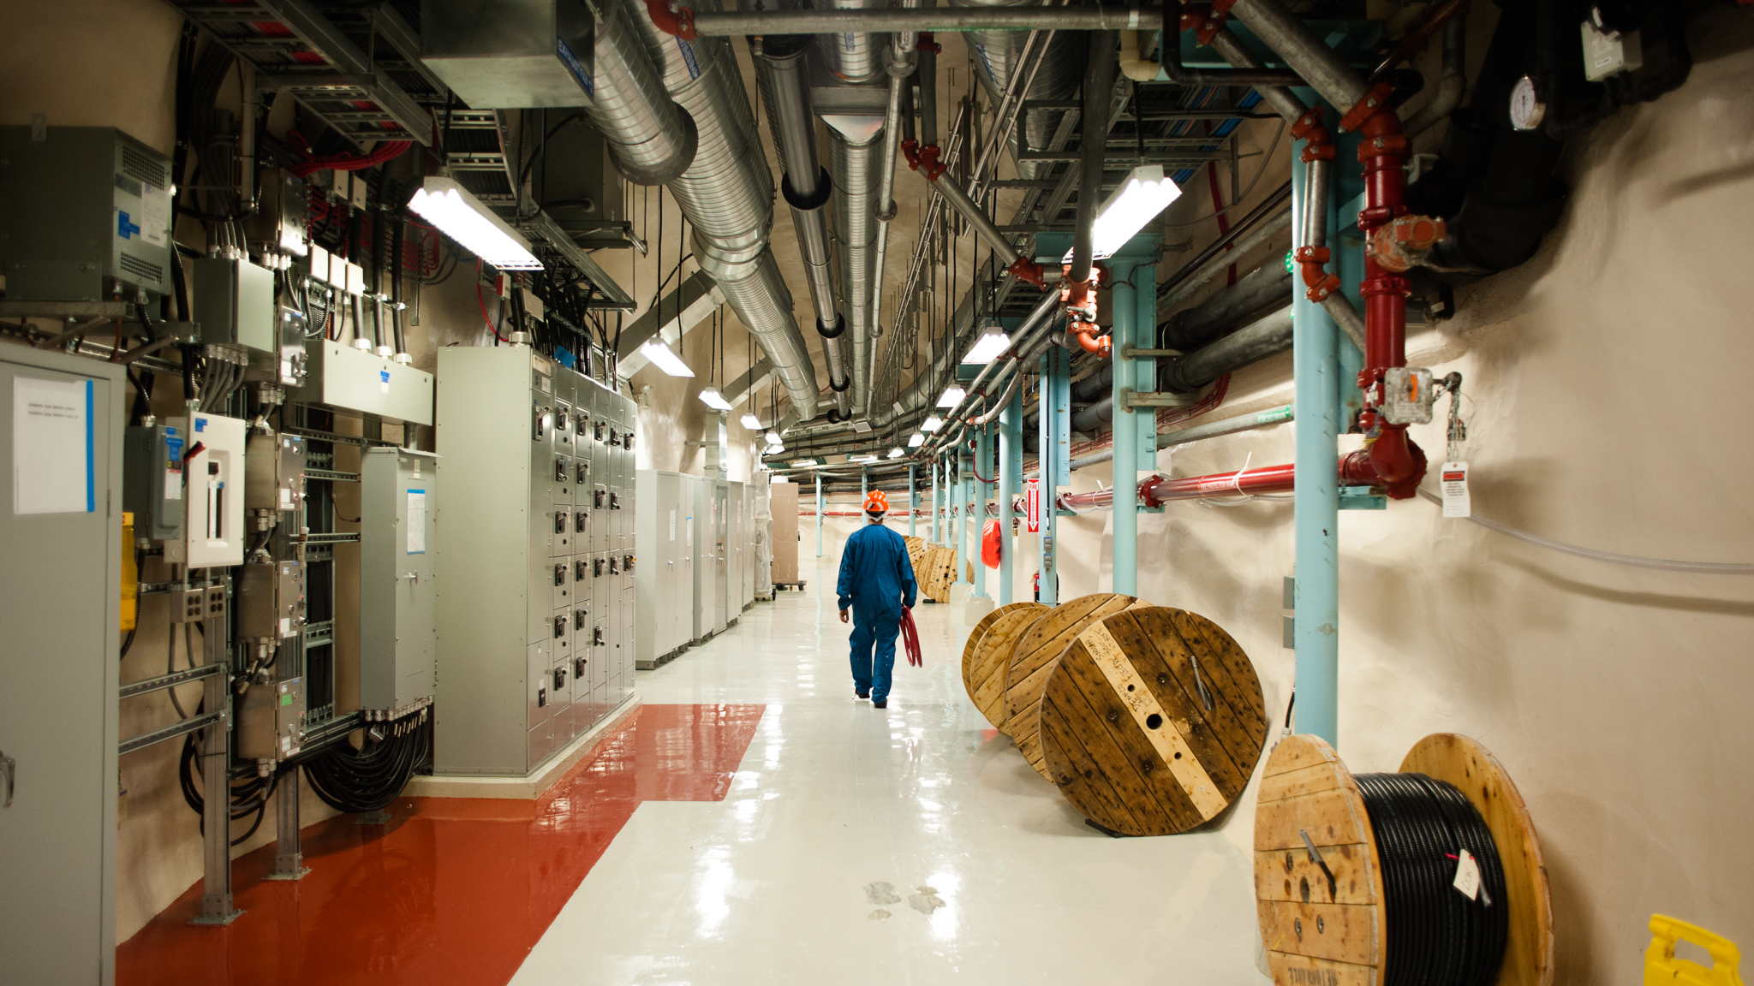
Underground at SNOLAB
Notes:
This is a view looking down one of the main hallways at SNOLAB.

Slide 27
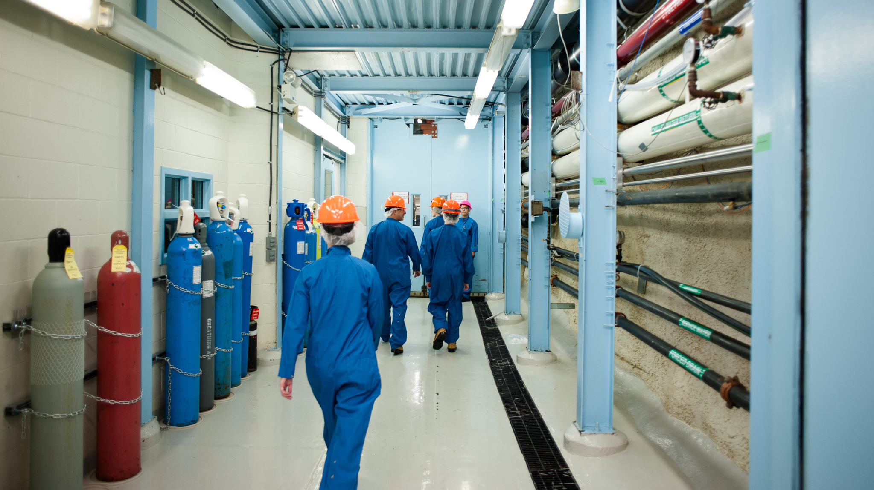
Walking to the experiments

Slide 28
Play your
Instruments!
betas
alphas
muons
neutrons
gammas

Slide 29
And STOP!

Slide 30
What did we lose?
neutrons
Neutrons come from the rock in the mine that surrounds SNOLAB. ​ ​
Neutrons are reduced by keeping the lab clean of any mine dust – everything is cleaned on its way into the lab.
​
Water shielding around the experiments to slows down neutrons and reduces their energy. ​
Notes:
Mine dust

Slide 31
Neutrons =
n
Made up of an up quark and two down quarks.
Source - the rock in the mine that surrounds SNOLAB is a huge source of neutrons.
Reduced by going into the lab and using
water shielding around experiments to slow
them down and reduce their energy.
Quite
Loud

Slide 32
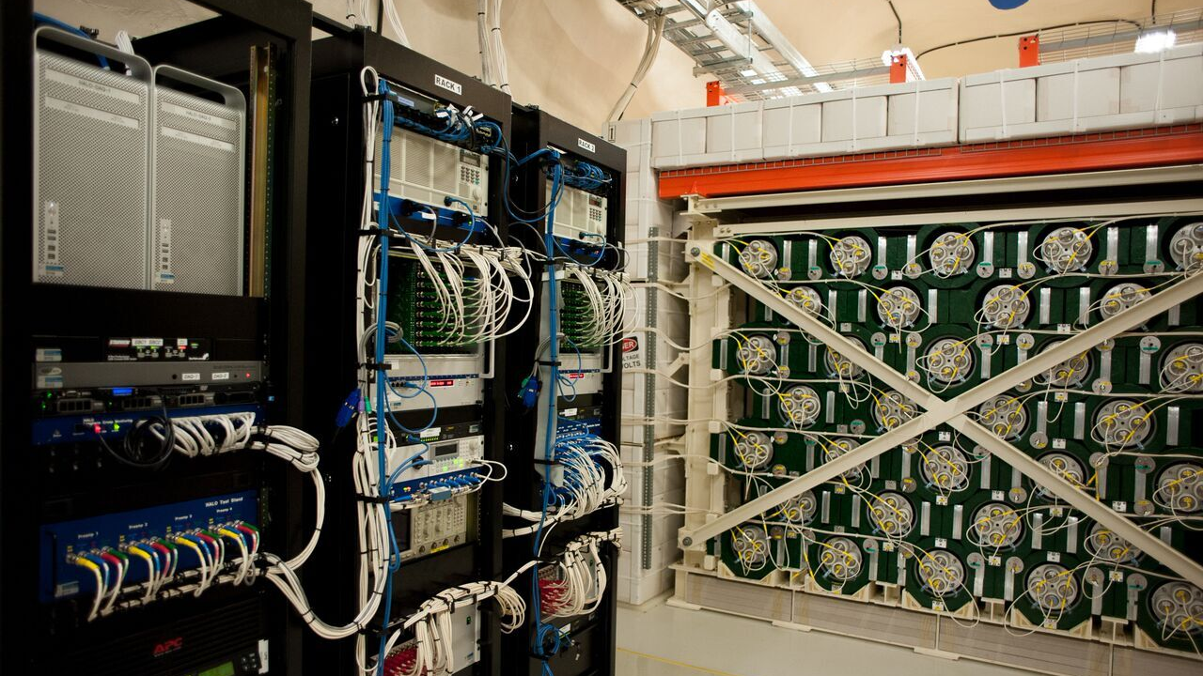
HALO Supernova Detector

Slide 33
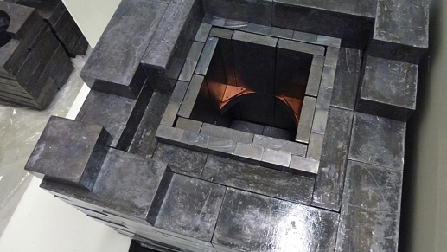
DAMIC experiment

Slide 34
Play your
Instruments!
betas
alphas
muons
neutrons
gammas

Slide 35
And STOP!

Slide 36
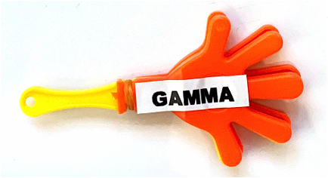
What did we lose?
Gammas come from the decay of radioactive materials, like the concrete walls of the lab and materials that experiments are made from.
Gammas are reduced by shielding experiments with lead or copper.
gammas

Slide 37
Gammas =
A wave given off during the decay of radioactive elements.
Source - the walls of the lab and the materials that experiments are built with are a big source.
Reduced by using shielding materials with heavy nuclei like lead and copper around experiments.
Quiet
Loud

Slide 38
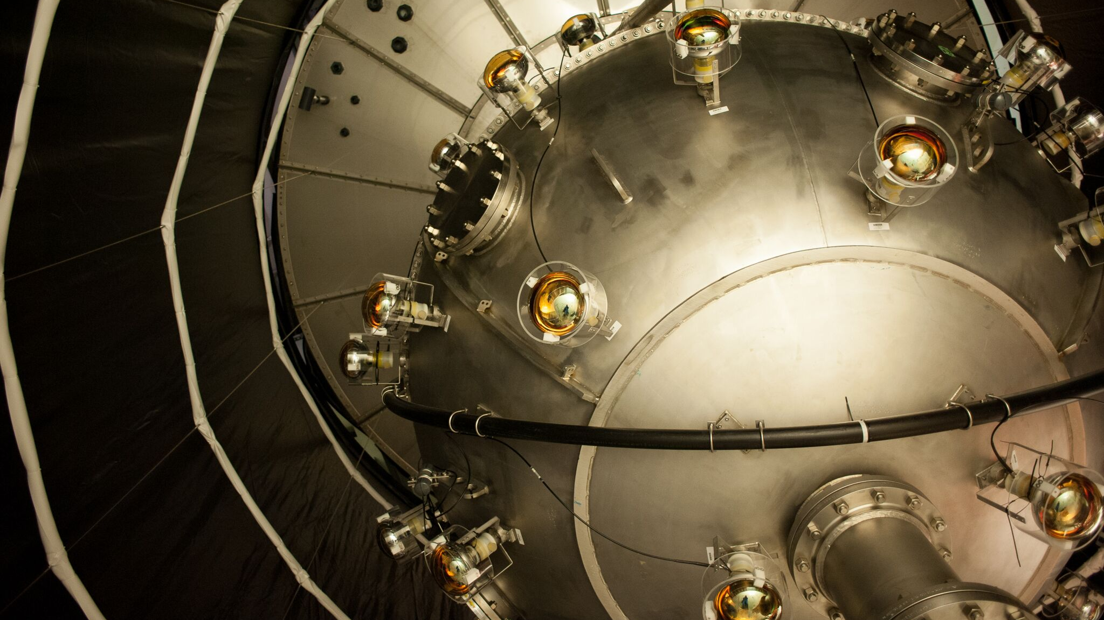
DEAP-3600 experiment

Slide 39
Play your
Instruments!
betas
alphas
muons
neutrons
gammas

Slide 40
And STOP!

Slide 41
What did we lose?
Betas are high-energy, high-speed electrons or positrons that come from decay of radioactive materials. They only travel about a metre in air.
Betas are reduced by using ultra clean materials with no radioactive elements to build our experiments with.
betas

Slide 42
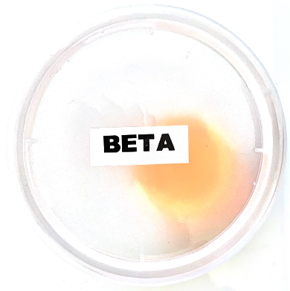
Betas =
High-energy, high-speed electron or positron emitted by the decay of radioactive elements.
Source - Materials.
Reduced by selecting ultra clean materials with no radioactive elements. Only travel about a meter in air so if present they are from the materials in the experiment.
Quiet
Loud

Slide 43
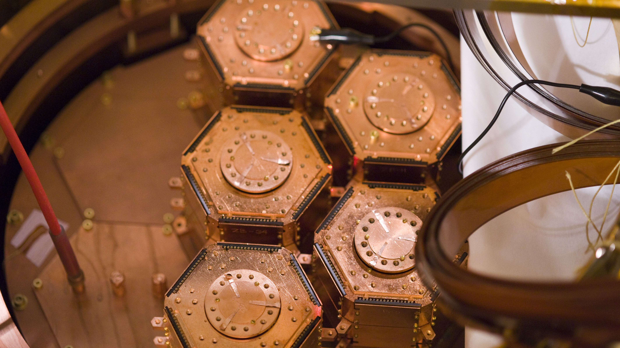
SuperCDMS Experiment

Slide 44
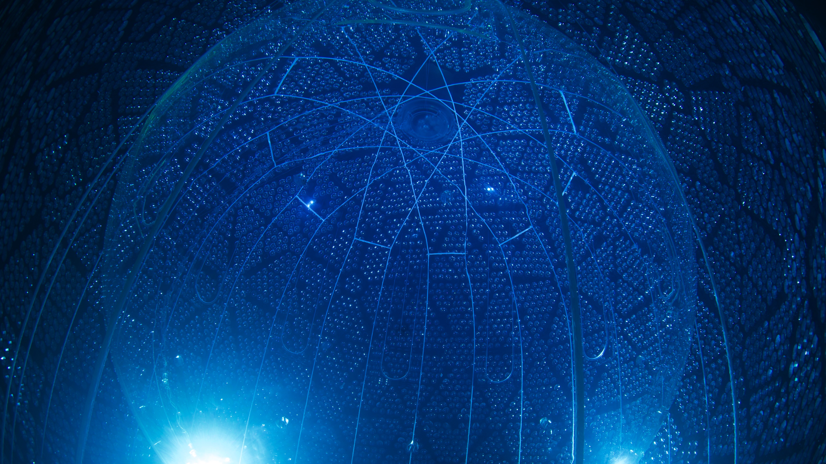
SNO+ experiment

Slide 45
Play your
Instruments!
betas
alphas
muons
neutrons
gammas

Slide 46
And STOP!

Slide 47
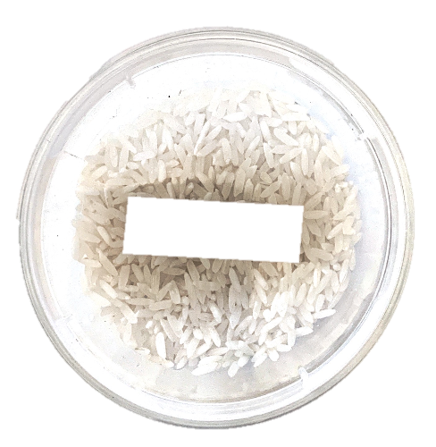
What did we lose?
Alphas are slow, positively charged particles made up of two protons and two neutrons. They only travel a few centimeters in air.
Alphas are reduced by using ultra clean materials with no radioactive elements to build our experiments with.
alphas

Slide 48
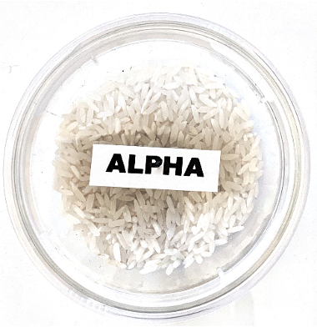
Alphas =
Large, slow, positively charged particles made up of two protons and two neutrons
Source - Materials.
Reduced by selecting ultra clean materials with no radioactive elements. Only travel a few cm in air so if present they are from the materials in the experiment.
Quiet
Loud

Slide 49
Listen carefully!
What do you hear?

Slide 50
Neutrinos? Dark Matter?
We detect invisible particles by:
Going deep underground,
Keeping the lab super clean,
Surrounding experiments with water shielding,
Surrounding experiments with lead or copper shielding, and
Using ultra-pure non-radioactive materials

Slide 51
Neutrinos or Dark Matter
Both are particles that interact weakly with regular matter.
The particles experiments at SNOLAB are looking for!
Quiet
Loud

