Slide 1
Production and counting of uncontained sources in SNO
Simon JM Peeters

Slide 2
Content
The SNO experiment
Calibration of the SNO experiment
Production of ²²²Rn and ²⁴Na sources
Distribution of uncontained radioactive sources
Conclusions
Registered at this conference
Notes:
17 pages article, representing a significant amount of work from 33 (SNO) authors, 16 registered at this conference.
Describes the production and counting of distributed sources of 24Na and 222Rn in the Sudbury Neutrino Observatory (SNO).
These are unique sources that have provided accurate calibrations of the response to:
- Neutrons (response He3 counter array)
(produced through photodisintegration of the deuterons in the heavy water target)
low energy betas and gammas (response of background Cherenkov light from trace amounts of natural radioactivity)
Although these sources were unique to SNO, we feel similar techniques could be extremely useful for the calibration of future low background detectors.

Slide 3
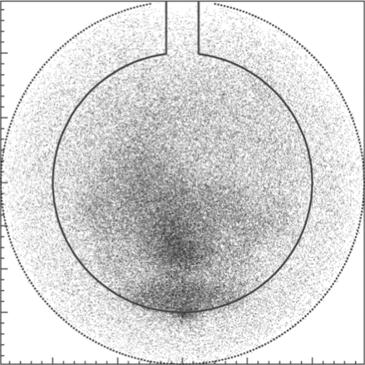
The sudbury neutrino observatory
Part I

Slide 4
Sudbury Neutrino Observatory
Detector parameters
Located here @ 5890±94 mwe
1 ktonne ultra-pure D₂O target inside 12 m diameter acrylic vessel
7 ktonnes ultra-pure H₂O shielding
Cavity with urylon liner
Nitrogen blanket
9456 inward + 91 outward 10” PMTs with light concentrators (54% coverage) on 17.8 m diameter support structure

Slide 5
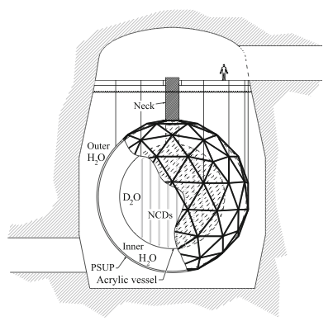
Sudbury Neutrino Observatory
Physics signal
Cherenkov light produced by electrons from ES/CC interactions
NC interactions Detection of the neutron via:
Phase I (2000/2001) Cherenkov light from Compton scattered electrons from gammas produced by neutron capture on D₂O
Phase II (2001/2003)
Enhanced NC sensitivity (2 tonnes NaCl) Cherenkov light from Compton scattered electrons from gammas produced by neutron capture on ³⁷Cl
Phase III (2005/2006) Array of ³He proportional counters

Slide 6
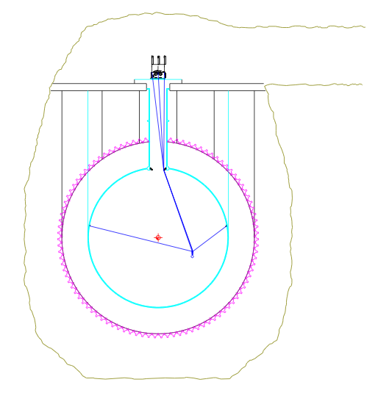
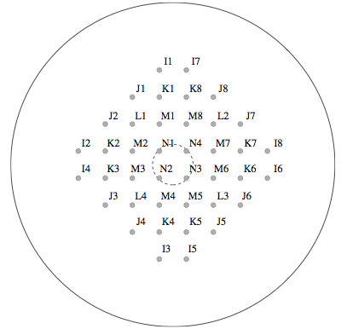
Summary of SNO calibration (i)
Response to signal-like events
Point sources, a.o. :
¹⁶N 6.1 MeV gamma, ~5 MeV Compton scattered electron
AmBe, ²⁵²Cf
Analytic and MC methods to interpolate between points Very difficult in phase III

Slide 7
Summary of SNO calibration (ii)
Response to background-like events
β-γ gammas from ²⁰⁸Tl (²³²Th) and
²¹⁴Bi (²³⁸U chain) can photo-disintegrate
the deuteron
Ex-situ techniques assay D₂O and H₂O
In-situ techniques low energy window (4-4.5 MeV)
Notes:
We have parameterised the mean angle and used in the in-situ analysis to distiniguish between U/Th in the same way it was used in the SNO analysis.

Slide 8
Use of uncontained sources in SNO
²²²Rn: : T_{1/2}=3.82 d, part of ²³⁸U chain
²⁴Na: T_{1/2}=15 hrs, pd (2.754 MeV gamma), ²³²Th-like (1β,2γ)
Signal (²⁴Na)
Backgrounds (²²²Rn and ²⁴Na)
Response of the ³He proportional counters making up the Neutral Current Detector array.
Precise determination of the neutron capture of the Neutral Current Detector array
Calibrate the response of the detector electron equivalent energy and isotropy
Helped with the determination of the detector response to light from the H₂O

Slide 9
Source production
Part II

Slide 10
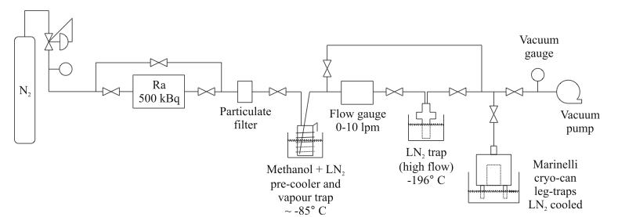
²²²Rn Production
Extraction from mine air (D₂O)
From ²²⁶Ra (H₂O)
Mine air 100 Bq/m³
Pass to NaOH filters to remove CO₂ and a -85 C trap to remove water vapour
Cryogenic trap, counted in Lucas cells
Dissolved in water
Samples counted using ex-situ assay methods
Commercial Pylon source
N₂ carrier gas (no CO₂)
Marinelli beaker for activity measurement on Ge detector
No Ra: checked by bubbling carrier gas through water and assay the water
~50 kBq
~100 Bq

Slide 11
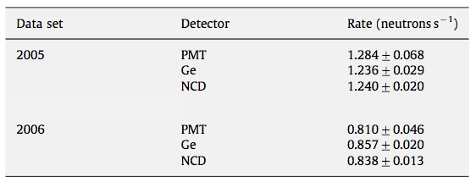
²⁴Na production
Th source (SNO phase II)
Phase III activity measurements
330 kBq Th source(2.6 MeV gamma)
inside the fiducial volume SNO (D₂O +0.2% NaCl)
Sample on carefully calibrated and checked using a Ge detector
Delrin can with sample in the centre of the detector compared to ²⁵²Cf source at the same location:
PMT array
NCD array
Activation (SNO phase III)
10% brine (from phase II)
SLOWPOKE-2 (Royal Mil. Coll, Kingston) 3.75 ml, 20 min, 5x10¹¹ n cm² s¹
Injected into 2.5 l D₂O
Pumped into vessel using calibration manipulator
Notes:
1 in 456 gammas produced a neutron. One in 73 neutrons produced 24Na.

Slide 12
MIXING SOURCES INTO SNO
Part III

Slide 13
Early mixing studies
Th activation data
SNO recirculation systems used to distribute the radio-activity
Hard to predict exact water movement:
Low viscosity D₂O
Movement of source
Temperature difference of injected and target water
Volume weighted nr of events
Notes:
Recirculation: 150 l/min
Top half mixes quickly (135 m3 moved in first 15 hours, top half mixed)
Stratification: layer moving down

Slide 14
Mixing in SNO phase III
²⁴Na injection data
First spike:
Based on evidence, inject
along z, most in the bottom.
Mixed after 70 hours.
Second spike:
inject 1-3 C warmer spike at the bottom. Induced rotation of the bulk, reverse circulation. Mixed after 50 hours.
Notes:
We used different, significant ways to establish mixing – for example, it was observed the rate of the NCDs had been very stable before we declared it to be absolutely mixed.

Slide 15
Conclusions
I have discussed the production and application of distributed ²⁴Na and ²²²Rn sources in SNO
These techniques have been very useful in the determination of the neutron detection efficiency and response of to natural radiation for SNO
Similar techniques could be useful for future low-background detectors

Slide 16
FIN

Slide 17
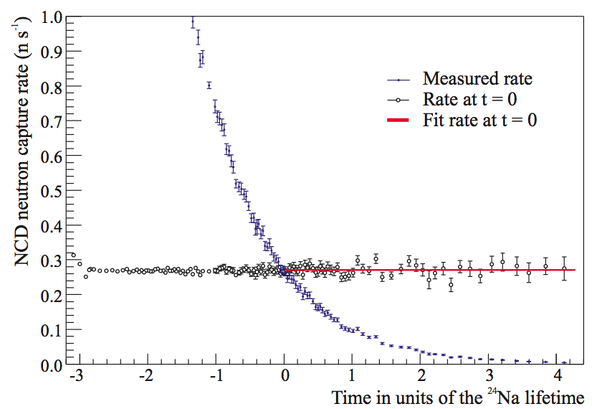

Slide 18
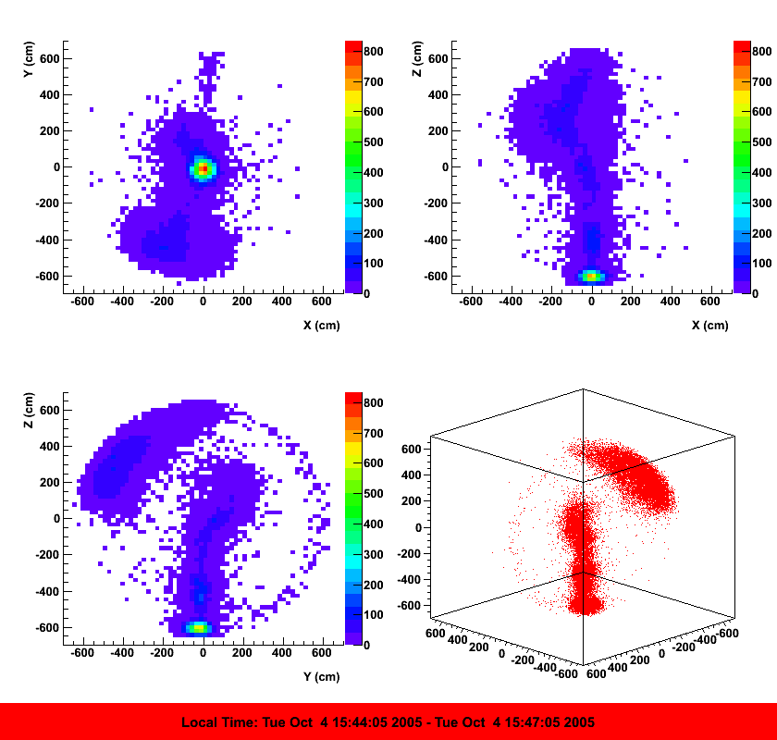

Slide 19
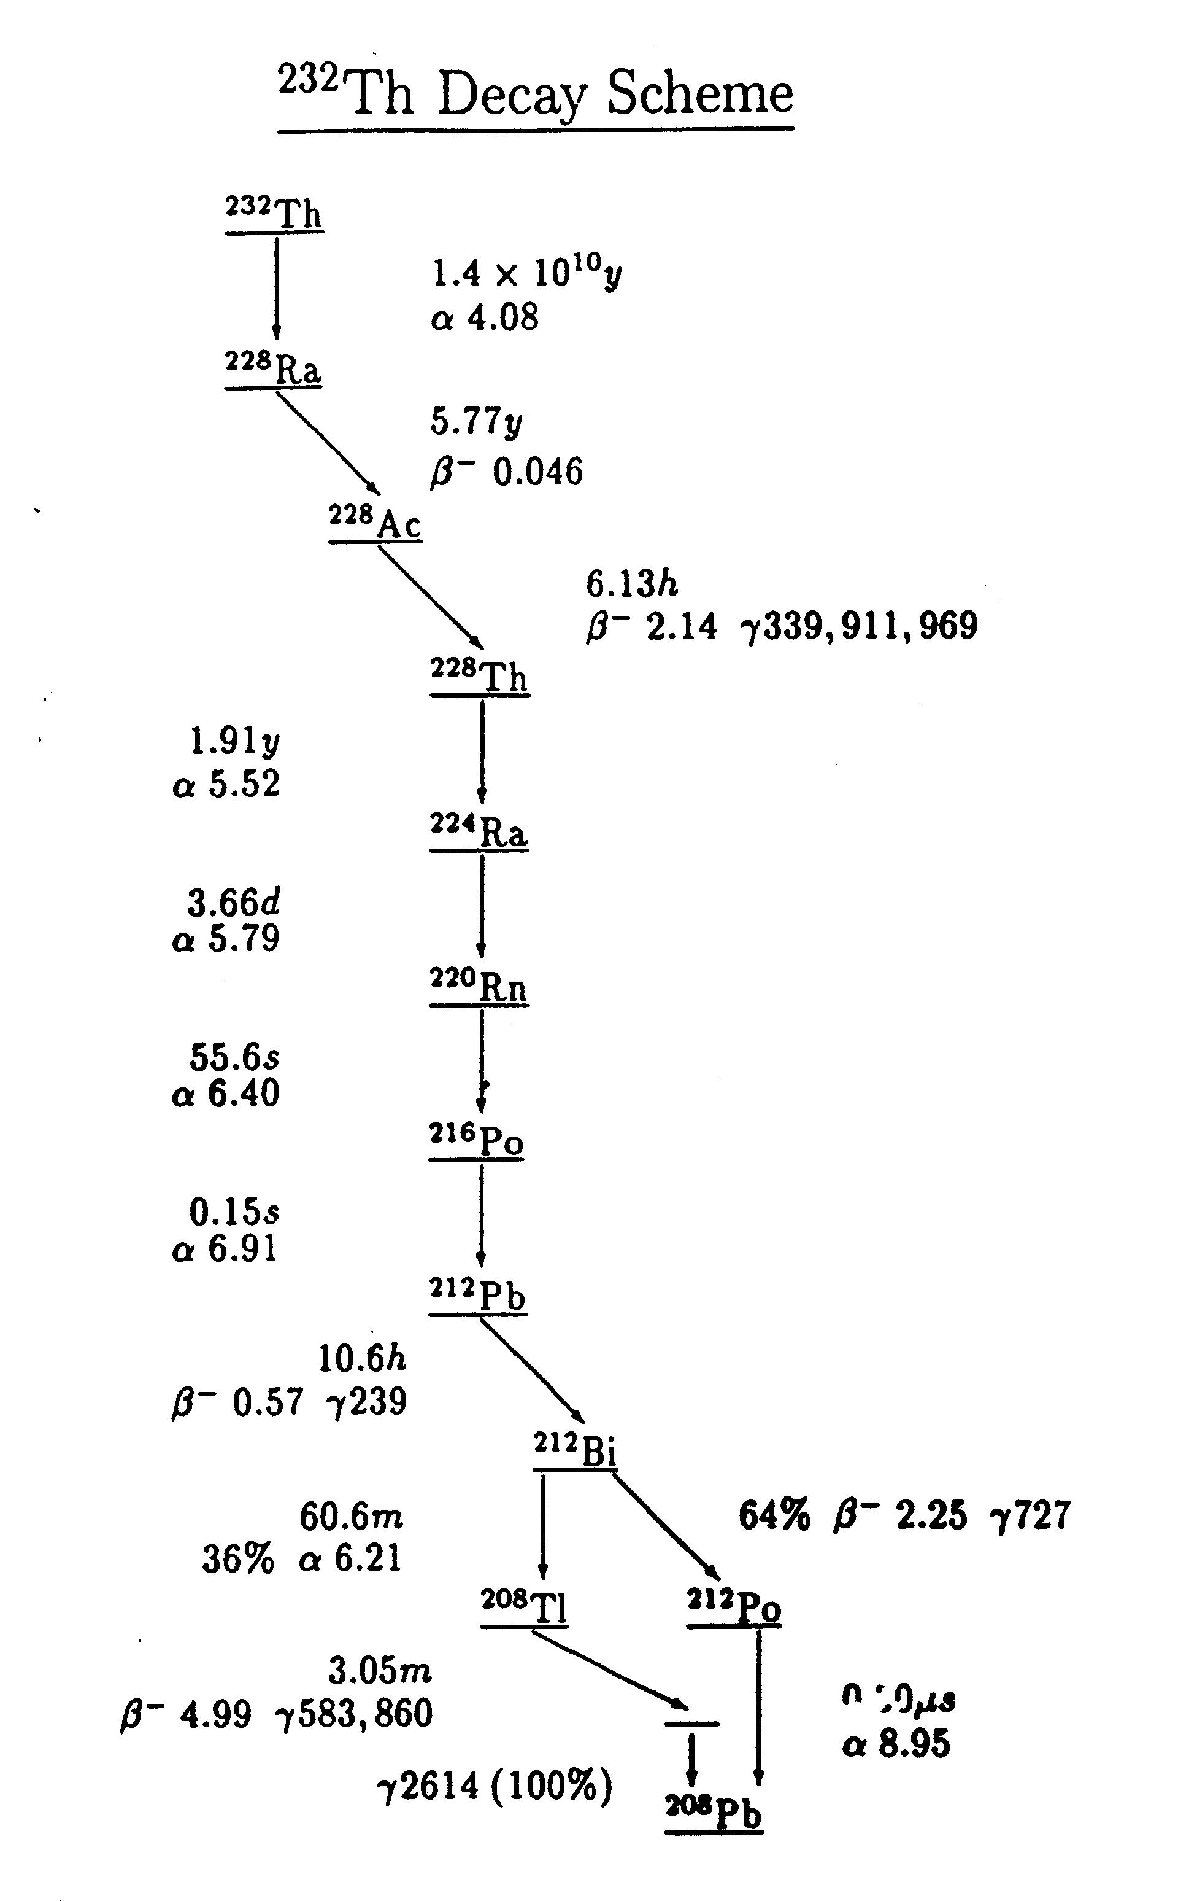
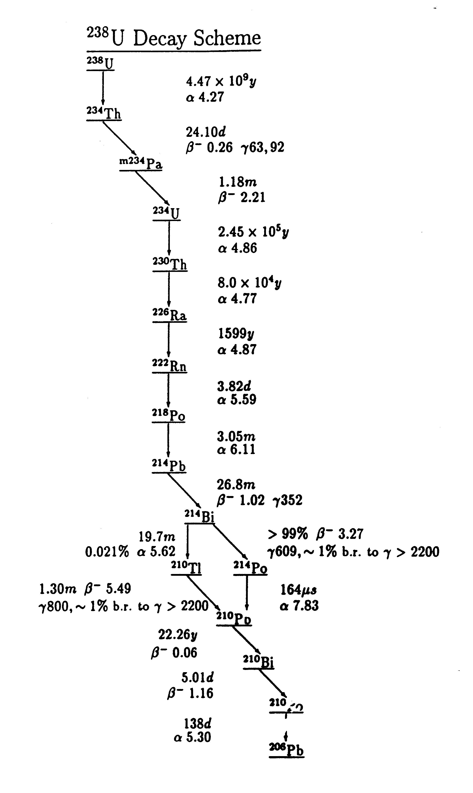
U/Th decays

Slide 20
Event Isotropy

Slide 21
SNO programme
1998
1999
2000
2001
2002
2003
2004
2005
2006
Comm.
Phase I
Phase II
Phase III
D₂O
Salt
(NaCl)
D
2
O
³He Counters
n captures on deuterium
σ = 0.0005b
6.25 MeV γ
n captures on ³He prop. counter array
σ = 5330b
0.764 MeV
n captures on chlorine
σ = 44b
8.6 MeV multiple γs
n
n
γ
γ
γ
n
γ
5 cm
³H
³H*
³⁶Cl*
p
²H
³H
³⁵Cl
³He
³⁶Cl
n + ³He → p + ³H

