Slide 1
Lead Removal from Liquid Scintillator for the Solar Phase of KamLAND
Greg Keefer
Lawrence Livermore National Lab
Aug. 28, 2010
LRT 2010, SNOLAB

Slide 2
Low Energy Internal Backgrounds
 | T_{1/2} | Measured KamLAND Concentrations | Goal of Purification
²¹⁰Pb | 22 y | (2.17 ± 0.09) x 10⁻²⁰ g/g | 10⁻²⁵ g/g
⁴⁰K | 10⁹ y | (1.3 ± 0.11) x 10⁻¹⁶ g/g | 10⁻¹⁸ g/g
³⁹Ar | 269 y | < 4.3 x 10⁻²¹ g/g | 10⁻²⁴ g/g
⁸⁵Kr | 11 y | (6.10 ± 0.14) x 10⁻²⁰ g/g | 10⁻²⁶ g/g
²³⁸U | 10⁹ y | (3.3 ± 0.5) x 10⁻¹⁸ g/g | 10⁻¹⁷ g/g
²³²Th | 10¹⁰ y | (5.2 ± 0.08) x 10⁻¹⁷ g/g | 10⁻¹⁶ g/g
The disequilibrium can be seen in the ratio of the T_{1/2}
This is a result ²²²Rn contamination
10⁻²⁵ g ²¹⁰Pb /g LS → 400 ²¹⁰Pb atoms per m³ of LS!

Slide 3
²¹⁰Pb Effect on the Low Energy Spectrum
250-800 keV
KamLAND Integral Rate: 4 x 10⁷ events/kton-day
BS05(OP) Expected Rate: 3 x 10² events/kton-day

Slide 4
How can one measure factors of 10⁵ reduction in ²¹⁰Pb at concentrations of 10⁻²² g/g in the LAB! ?

Slide 5
Experimental Procedure
Fundamental Assumption:
All isotopes of Lead born via alpha decay will have similar chemical characteristics in liquid scintillator, or the individual components, and thus similar removal efficiencies in these liquids respectively.
We then use the ²²⁰Rn and ²²²Rn daughters from commercial sources (Pylon Electronics) to load ²¹²Pb and ²¹⁴Pb into the LS respectively.
At a concentration of 10⁻²⁰ g/g the specific ²¹²Pb activity is 0.83 Bq/l, a factor 1.8x10⁴ larger than that of ²¹⁰Pb at equal concentration.
Bubble LS with Rn loaded N₂ gas and achieve activities on the order of 5 kBq/l depending on the liquid (LS, Dodecane, PC)

Slide 6
Experimental Procedures Continued
Measure Gammas using Ge Detector:
Specific activities down to 1 Bq/l
Achieving 10³ reduction
^{212/214}Bi-Po β-α Coincidence
Specific activities down to 10 mBq/l
Achieving 10⁵ orders of reduction capability
Thus, using these methods we can determine lead reduction in LS at the order of 10⁵ and ²¹²Pb concentrations as low as 10⁻¹⁷-10⁻²² g/g!

Slide 7
How can one obtain factors of 10⁵ reduction in ²¹⁰Pb?

Slide 8
Reducible Backgrounds
²¹⁰Pb, ²¹⁰Po, ²¹⁰Bi, ²²²Rn
Other contaminants to consider: ⁸⁵Kr, ³⁹Ar, ⁴⁰K
I will present results from the in depth studies pertaining to the removal of radiogenic atoms and molecules from liquid scintillator via:
Filtering
HTiO
Water Extraction
Isotope Exchange, Filtering, HTiO
Adsorption (SiO₂, CuMn, Aerogels)
Distillation
Heating
Chemical extraction

Slide 9
Laboratory Results I
*note: Experiments performed on ²¹²Pb unless specifically noted as using ²¹⁴Pb.
Filtering:
Observed that multiple passes through filters produced a factor 1.1 (10%) reduction in ²¹²Pb
Approximately factor 1.5 (30-40%) reduction was observed when the gas used to load the LS was not pre-filtered.
HTiO:
0.64 g/cm3 HTiO was loaded on a HEPA PTFE filter. Then passed 125 ml LS at a rate of 3 and 16 cm³/min
Observed small effect when passing through HTiO 1.06 ± 0.01

Slide 10
Laboratory Results II
Lead Extraction with De-Ionized Water:
Produced modest factors of 1.02 – 1.1 reduction in ²¹²Pb
pH dependence with Water Extraction:
Indicated a clear anti-correlation with pH (increased efficiency with lower pH)
However, this was only a 15% increase relative to the DI Water.
Isotope Exchange:
Pass the LS over bed of lead granules in hopes of an exchange of ²¹⁰Pb for another isotope such as ²⁰⁶Pb. This would occur due
No ²¹²Pb reduction observed

Slide 11
Laboratory Results III
Adsorption: removes charged atoms, i.e. Pb⁺² or polar molecules by retention on the surfaces of the adsorption particles (silica gel, Alusil, Cu/Mn).
²¹²Pb: 89 ± 2 ²¹⁴Pb: 39 ± 8
²²²Rn: 2.58 ± 0.01
²¹²Bi: > 633 ²¹⁴Bi: 79 ± 32
²¹⁴Pb: 39 ± 8
²¹⁸Po: 2.6 ± 0.5
Distillation:
²¹²Pb Reduction: 10⁴ Measured by β-α coincidence of ²¹²Bi – ²¹²Po decay (0.43 ms)
^{nat}Kr Reduction: 10⁵ Gas Chromatography
²²²Rn Reduction: 10⁶ Measured by β-α coincidence of ²¹⁴Bi – ²¹⁴Po decay (233 ms) *added small N₂ flow
Tests our fundamental
hypothesis

Slide 12
Radiation Interaction with Benzene Chains
Most interactions create some ionic/polar species of the decay product.
However, ~5% of these atoms are bound in an organo-metallic compound
n-dodecane
e- / e+ decay
nuclear recoil
Radioactive Tetramethyl lead
α decay
β decay
Supplies sufficient kinetic energy to
break the C-C bond in molecule

Slide 13
Organic Pb Compounds
In order of decreasing molecular weight and increasing molecular stability.
Tetraethyllead C₈H₂₀Pb
BP: Decomposes at 200 ºC
ρ: 1.653 g/cm³ @ 20 ºC
Pb
The fewer ethyl groups the lower the boiling point of the molecule.
Ethyl Group
CH₃CH₂
Methyltriethyllead C₇H₁₈Pb
BP: 70 ºC
ρ: 1.71 g/cm³ @ 20 ºC
Methyl Group
CH₃
Pb

Slide 14
Organic Pb Compounds
Diethyldimethyllead C₆H₁₆Pb
BP: 51 ºC
ρ: 1.79 g/cm³ @ 20 ºC
Pb
Ethyltrimethyllead C₅H₁₄Pb
BP: 27 ºC
ρ: 1.88 g/cm³ @ 20 ºC
Pb
Tetramethyllead C₄H₁₂Pb
BP: 110 ºC
ρ: 1.995 g/cm³ @ 20 ºC
Pb

Slide 15
Laboratory Results IV
Heating: Used to break organo-metallic bonds, which then ionize the Pb, Po, Bi, etc. atom and can be removed by adsorption or distillation.
Operating Temperature: 100 – 200 ºC
Used in combination with adsorption column
²¹²Pb Reduction boost factor: 10 (Total ²¹²Pb reduction = 278 ± 23)
FeCl₃ SnCl₄ MoS₂ and Thiol Resin:
SiO₂ + FeCl₃ + SiO₂: 1250
However, these are very destructive to the LS.

Slide 16
Results of Laboratory Experiments
Distillation was the best purification method for removing metallic radio-isotopes
10⁴ reduction in ²¹²Pb observed
This method is extremely tedious and care must be taken:
remove the first and last amounts of liquid
Never allow to rapidly boil, smooth processes
Multiple distillation > 3x to achieve 10⁴
Observed of an organic component of ^{212/214}Pb (using Silica Gels)
Evidence of existence by performing experiments to address this specific species resulted in high removal efficiencies.
Must be addressed to achieve ultra-pure liquid scintillator.

Slide 17
Backgrounds from Calibration Deployments
Berger,B. et al., JINST 4:P04017,2009
Not controlling backgrounds during calibration can re-contaminate your experiment with ²¹⁰Pb:
Observed: 0.13-8.0 μBq ²¹⁰Pb / deployment
Requirement: < 1 μBq ²¹⁰Pb or contaminations < mBq/m³ ²²²Rn

Slide 18
References of Interest
Preparing NIM paper on the removal of Radon Daughters from KamLAND LS.
My thesis provides extensive details on these measurements and is the basis for the NIM paper. Can be found on SPIRES
There are also colleagues from Tohoku University who performed complementary studies and wrote Masters thesis. However, only available in Japanese.
The Silica Gels were counted for radio-purity on HPGe to determine Rn out-gassing and other possible contamination. These can be found in the EXO publication mentioned by Ryan MacLellan.
D.S. Leonard et al., Nucl.Instrum.Meth.A591:490-509,2008

Slide 19
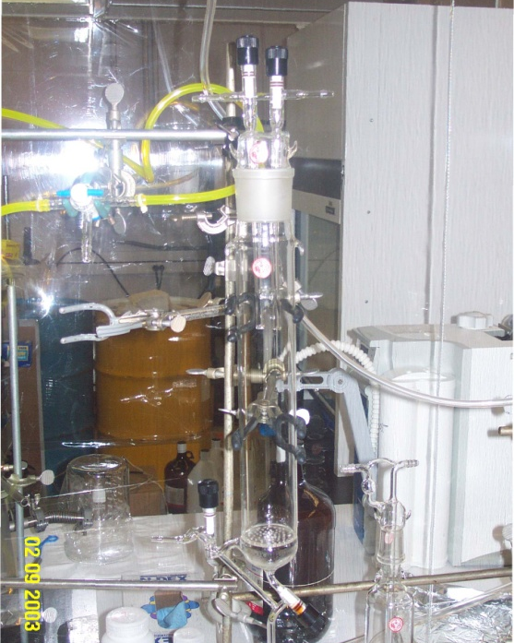
Questions ??
Heating
Distillation
Adsorbents
Water Extraction

Slide 20
Supplemental Slides

Slide 21
Properties of the Solvent
n-dodecane should be considered the solvent since it is the
dominant molecule and is non-polar.
CH₃-(CH₂)₁₀-CH₃
BP: 215-217 ºC @ 760.00 mmHg
MP: -9.6 ºC
ρ: 0.7495 g/cm³ @ 20 ºC
Interacts with the other molecules by dispersive forces,
a statistically random induced dipole moment.
All values on this and the next slides were obtained from the CRC.

Slide 22
What Solutes are in KamLAND?
1,2,4-Trimethybenzene (PC)
PC and PPO are
Aromatic Molecules
CH₃
C₆H₃(CH₃)₃
BP: 169 ºC @ 760.00 mmHg
MP: -43.77 ºC
ρ: 0.8758 g/cm³ @ 20 ºC
CH₃
CH₃
2,5 Diphenyloxazole (PPO)
N
C₁₅H₁₁NO
BP: 360 ºC @ 760.00 mmHg
MP: 74 ºC
ρ: 1.0940 g/cm³ @ 20 ºC
O
Chromatographic separation at the MP of PPO may allow us to reduce
The amount of PPO adsorbed onto the surface of the Silica Gel.

Slide 23
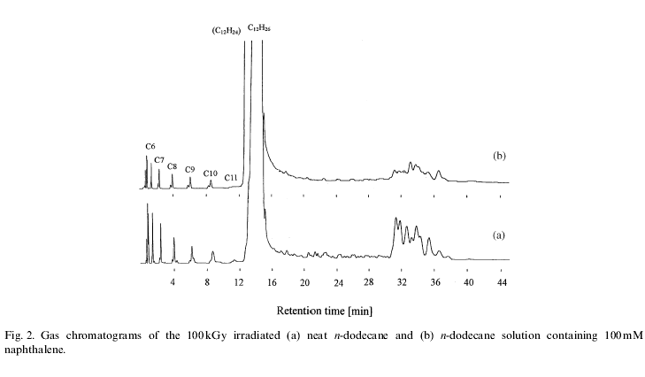
Some Interesting Data for Dodecane
Result:
The larger the concentration of aromatic molecules
in the dodecane the lower the concentration of
fragmented C-chains after irradiation.
N-dodecane from Aldrich Chem. Co. was purified with active alumina
and silica gel column, then distilled. > 99.2% pure n-dodecane.
The dodecane was doped with up to 10 mM of different aromatic
hydrocarbons.
The samples were then exposed to 100 kGy = 100 kJ/kg of ⁶⁰Co gamma
rays.
- They then analyzed the samples for fragmented molecules.

Slide 24
KamLAND Detector Details
Calibration system
(z-axis and 4pi systems)
1325 17 inch PMTs
554 20 inch PMTs
photocathode coverage:
22% (17 inch)
34% (17+20 inch)
Filled with mineral oil
Water Cherenkov
Outer detector
(2.6 ktons)
Non-scintillating buffer region
(1.4 ktons mineral oil)
225 20 inch PMTs
Stainless steel containment vessel (18 m diameter)
Balloon 135 μm (Nylon/EVOH)
13 m diameter
Kavlar ropes
0.9 ktons Liquid Scintillator
80.2% n-Dodecane
19.8% Pseudocumene
1.36 g/L PPO (primary fluor)
Acrylic sphere to shield from ²²²Rn out-gassing from the PMTs and SS sphere

Slide 25
Integrated Regions 250 – 800 keV
Solar ν_{e} Elastic Scattering | Rate [Events/kton-day]
¹³N | 13.7
¹⁵O | 15.8
¹⁷F | 0.4
(862 keV) ⁷Be | 290.8
(384 keV) ⁷Be | 0.5
⁸B | 0.5
PEP | 13.4
PP | 12.2
Total Solar Signal | 347
Radio-isotope | Rate [Events/kton-day]
⁴⁰K | 21.6
⁸⁵Kr | 37.6
³⁹Ar | 0.1
²¹⁰Bi | 29.1
²¹⁰Po | 30.7
¹¹C | 0.5
²³⁸U | 2.0
²³²Th | 13.1
Total Background | 135
Expected Signal-to-background ratio: 2.6

