Slide 1
Low-background aspects of GERDA
Hardy Simgen
Max-Planck-Institut für Kernphysik / Heidelberg
on behalf of the GERDA collaboration

Slide 2
Outline
Introduction
The GERDA experiment
Selected low-background aspects:
Radio-purity of liquid argon
Cryostat fabrication
Frontend electronics radioactivity
LAr scintillation veto
Conclusions

Slide 3
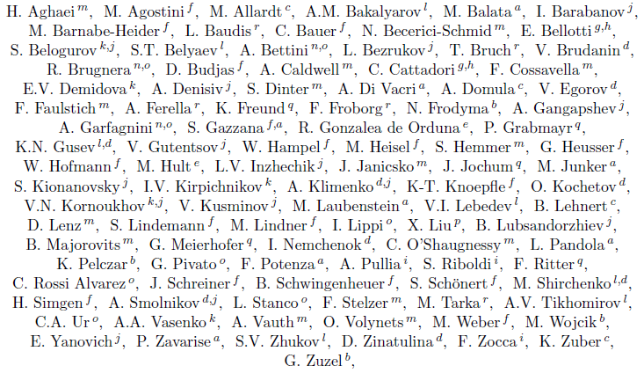
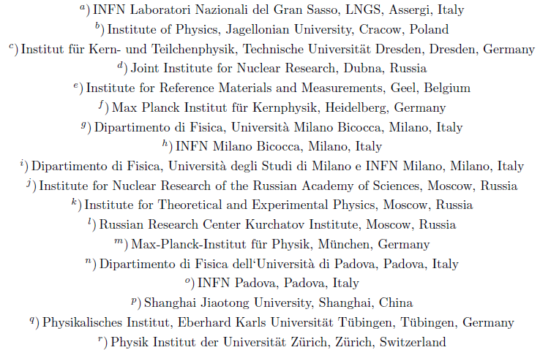
The GERDA collaboration
~100 physicists
18 institutions
7 countries

Slide 4
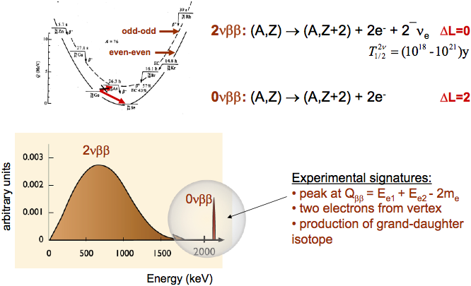
Double beta decay

Slide 5
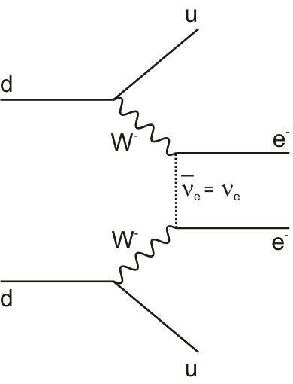
Double beta decay and Majorana neutrino mass
Phase space factor (~Q_{ββ}⁵)
Nuclear matrix element
Effective Majorana neutrino mass
If leading term is Majorana neutrino mass term
Coherent sum

Slide 6
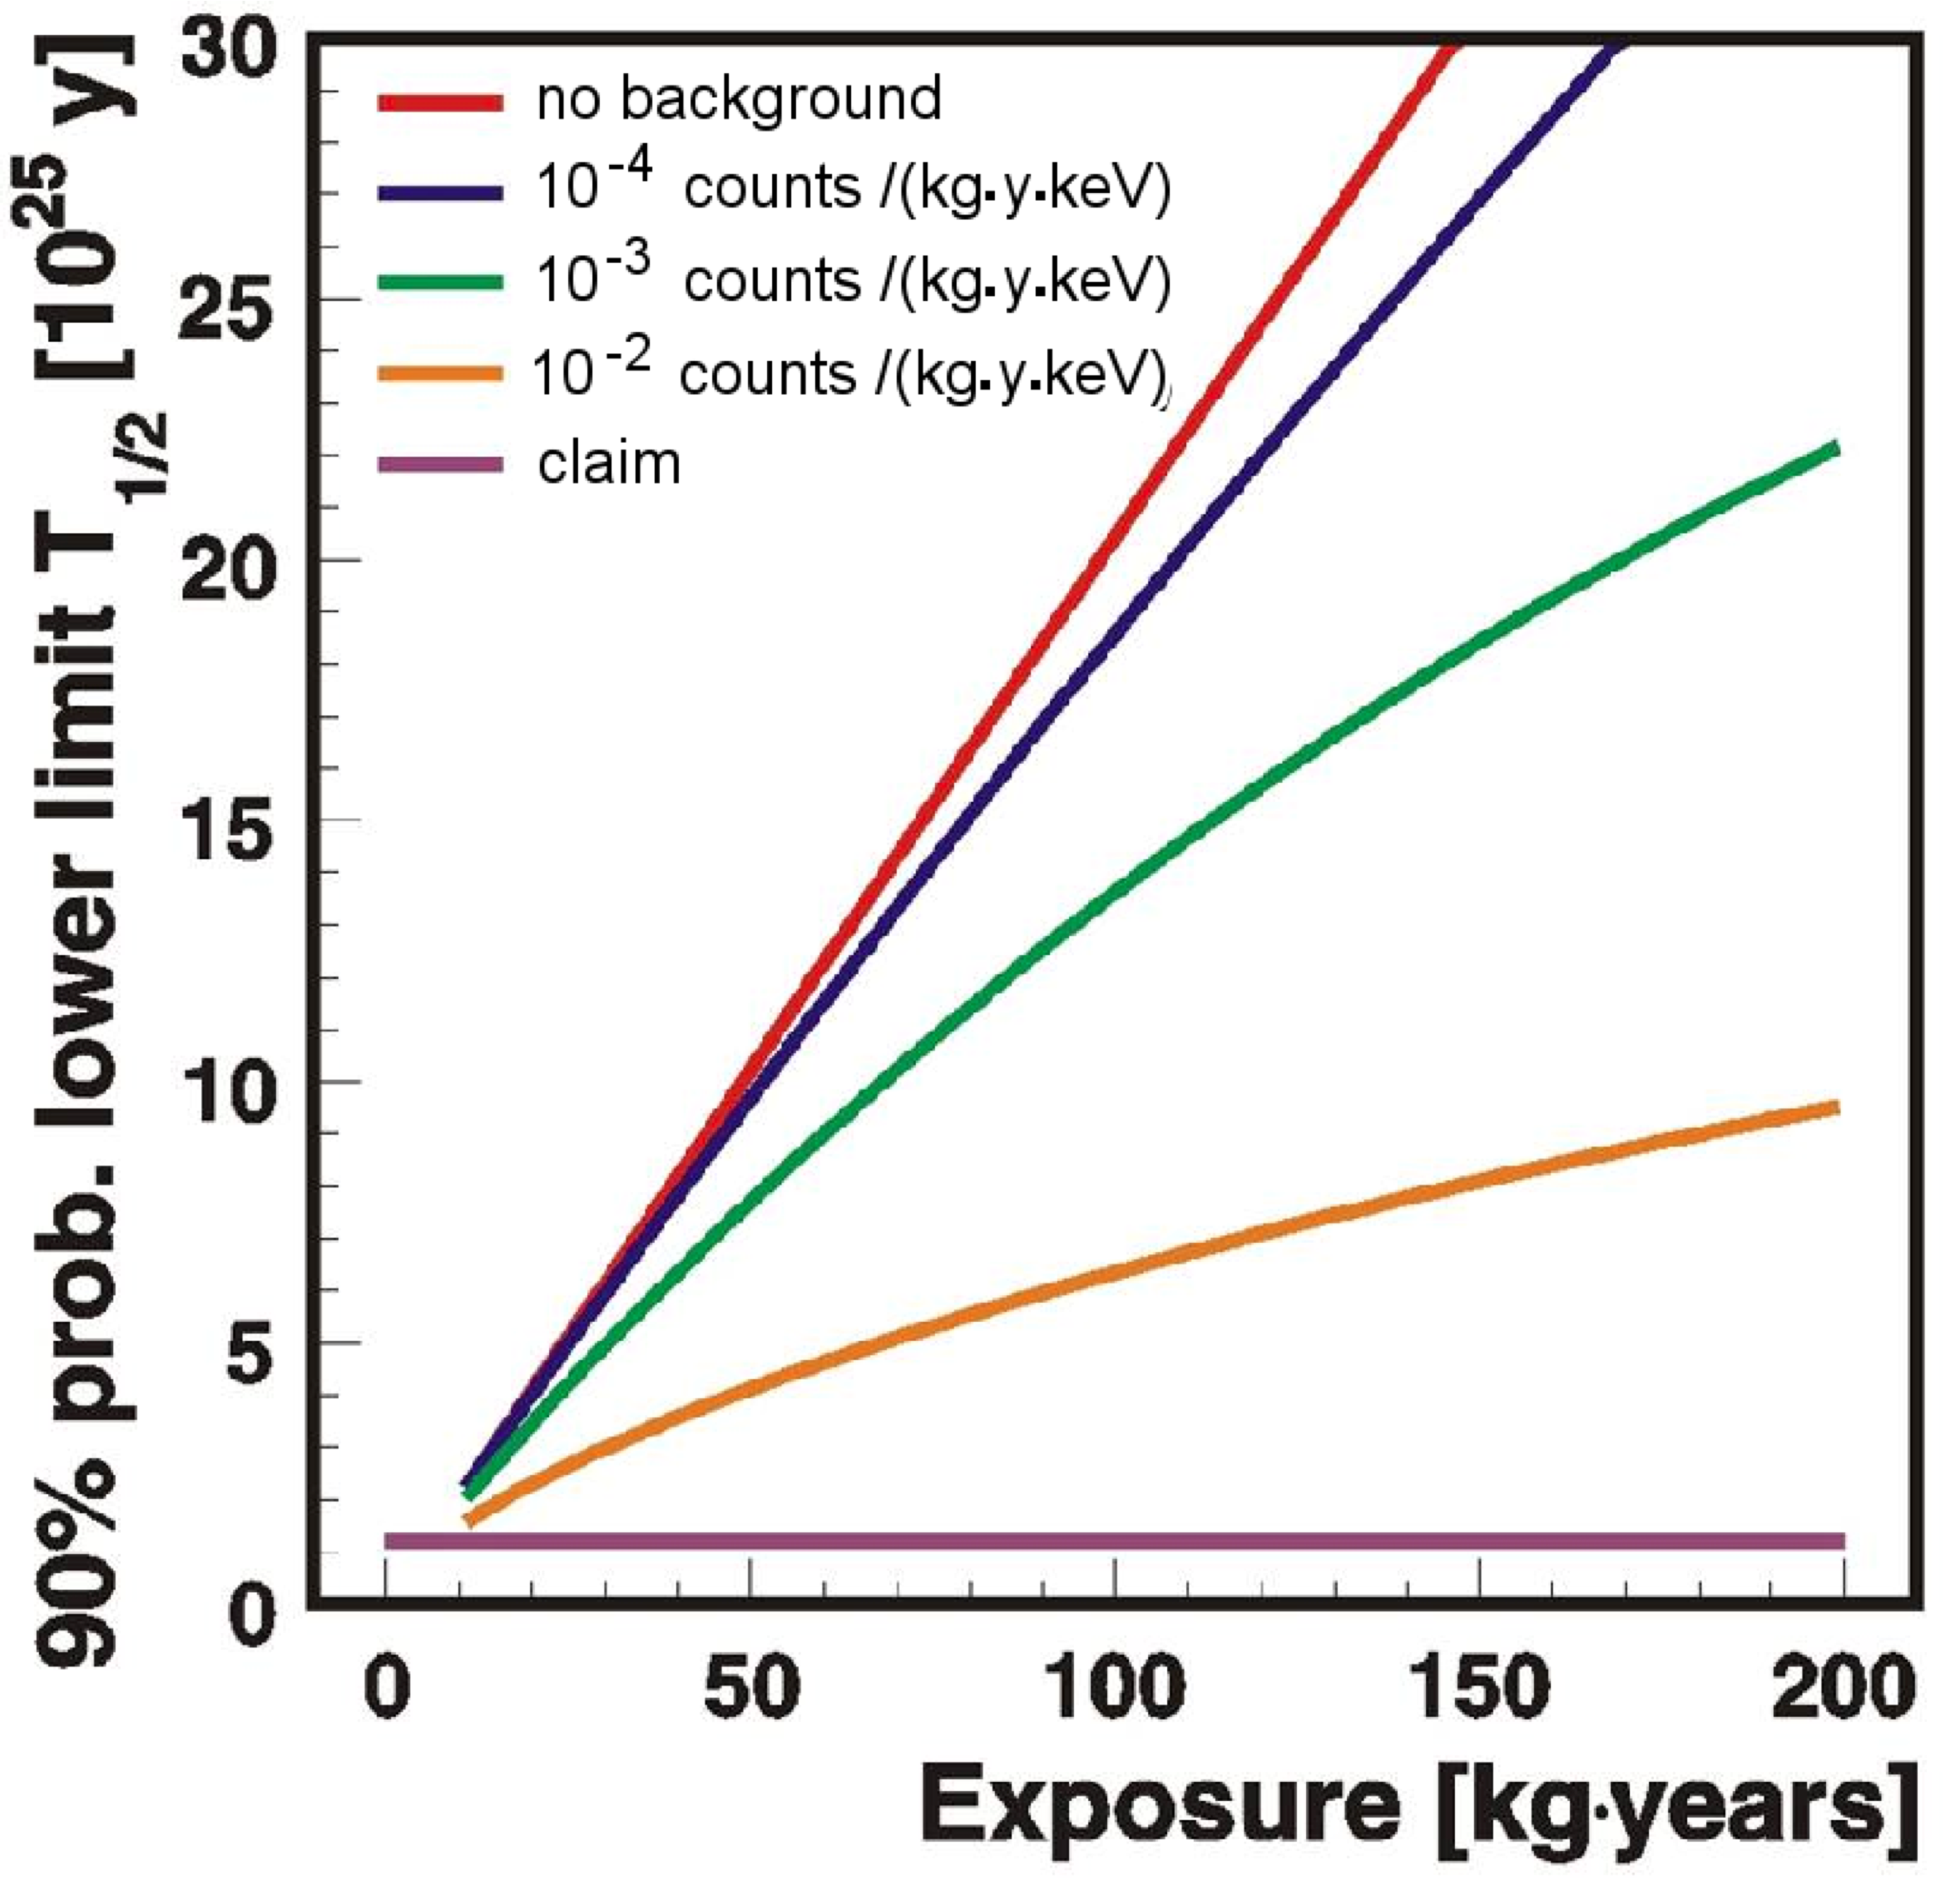
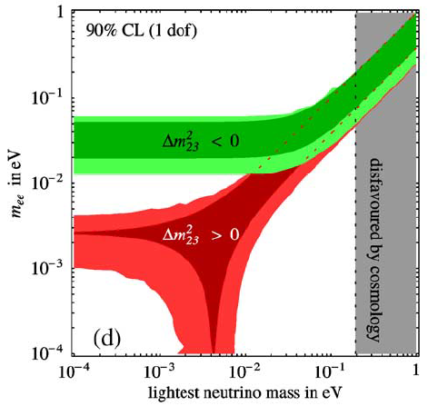
GERDA sensitivity
Feruglio, Strumia, Vissani NPB 659
Assumes ΔE= 4 keV
phase I
phase II
phase II
KKDC claim
phase I
Using <M^{0ν}>=3.92, V.A. Rodin et al., Nucl. Phys. A 366 (2006) 107-131
Erratum: Nucl. Phys. A 793 (2007) 213-215

Slide 7
GERDA in brief
Ge spectroscopy with array of ⁷⁶Ge-enriched diodes in ultrapure cryogenic liquid (LAr)
Phase I:
Use of existing ⁷⁶Ge-diodes from Heidelberg-Moscow and IGEX-experiments
17.9 kg enriched diodes ⇒ ~15 kg ⁷⁶Ge
Bkg-level <10⁻² counts/(keV·kg·y) @ 2039 keV to check KKCD-claim without background
Phase II:
Adding new Ge diodes (total: ~40 kg ⁷⁶Ge)
New active background suppression techniques
Demonstration of bkg-level <10⁻³ counts/(keV·kg·y) @ 2039 keV for a future one-ton experiment

Slide 8
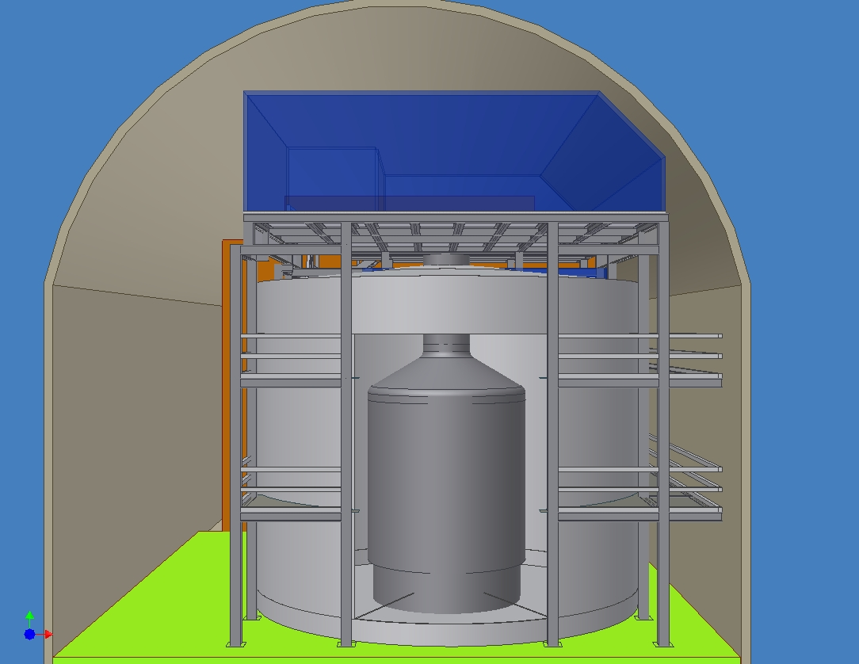
GERDA design
Cleanroom
Lock
Water tank (590 m³ H₂O)
Cryostat (65 m³ LAr)

Slide 9
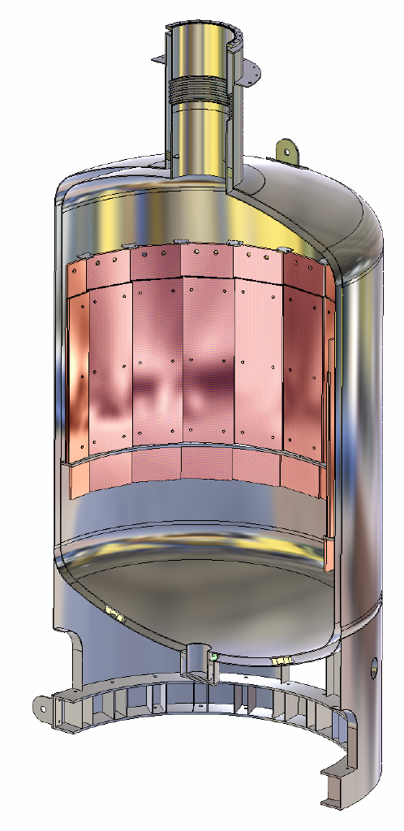
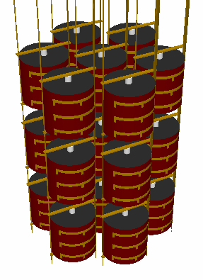
GERDA design
Additional inner copper shield
Germanium-detector array
Liquid argon
Vacuum-insulated double wall stainless steel cryostat

Slide 10
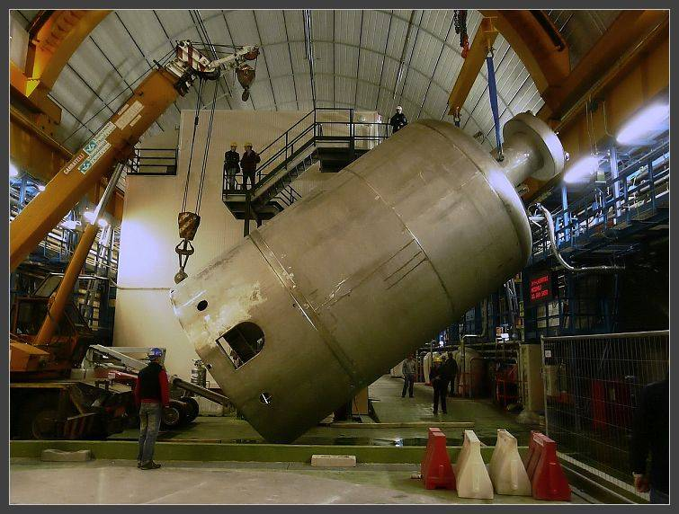
Cryostat delivery

Slide 11
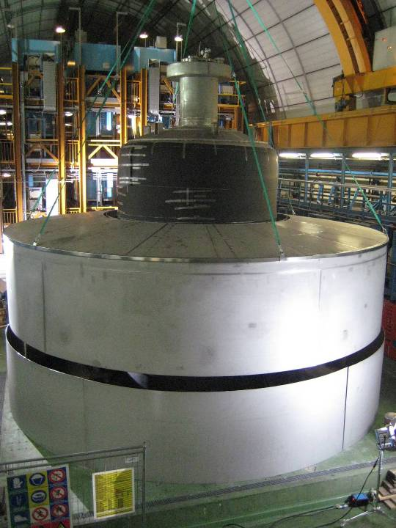
Water tank construction

Slide 12
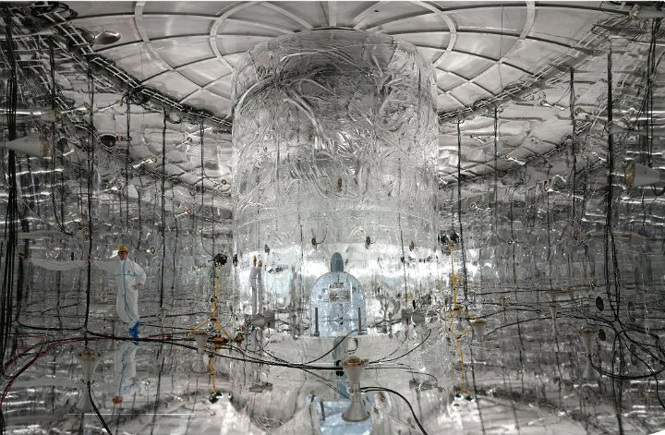
Installation of muon veto system

Slide 13
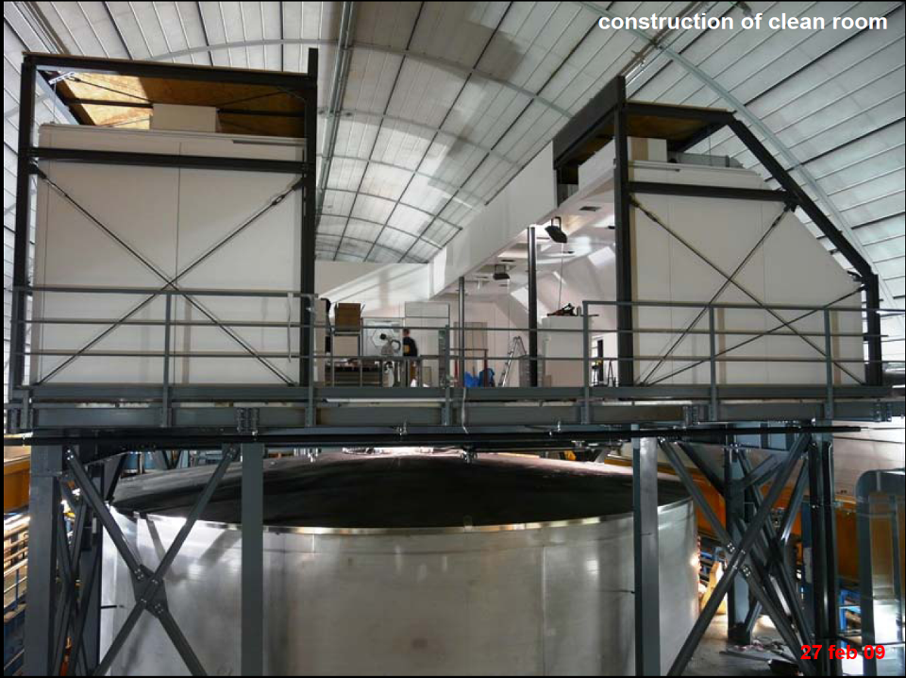

Slide 14
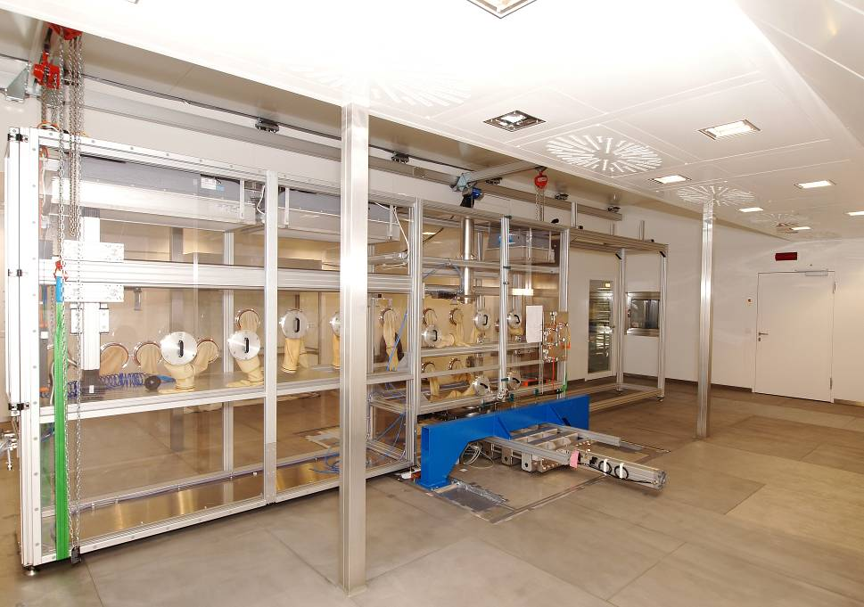
Glove-box for Ge-detector handling under protective atmosphere

Slide 15
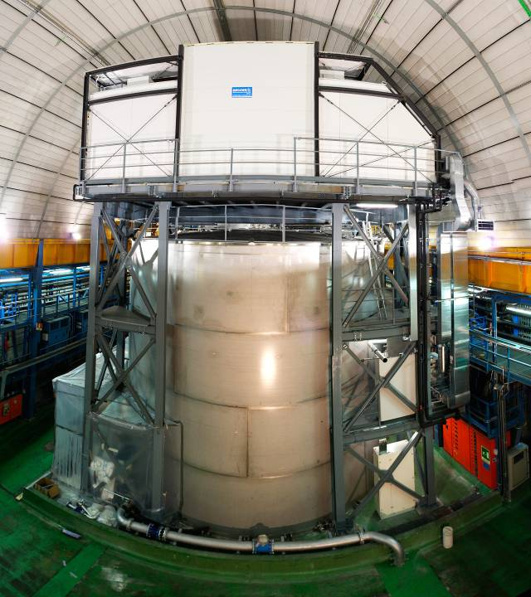

Slide 16
Recent progress and status
December 2009: Liquid argon fill
January 2010: Commissioning of the cryogenic system
April/May 2010: Installation of the (commissioning-) lock
May 2010: 1st deployment of FE electronics & detector mock-up (27 pF)
pulser resolution 1.4 keV (FWHM)
June 2010: First deployment of ^{nat}Ge detectors
Since July 2010: Commissioning run with ^{nat}Ge detector string (3 diodes):
1st data show more ⁴²Ar than expected → requires dedicated analysis
Afterwards: Start phase I physics data taking

Slide 17
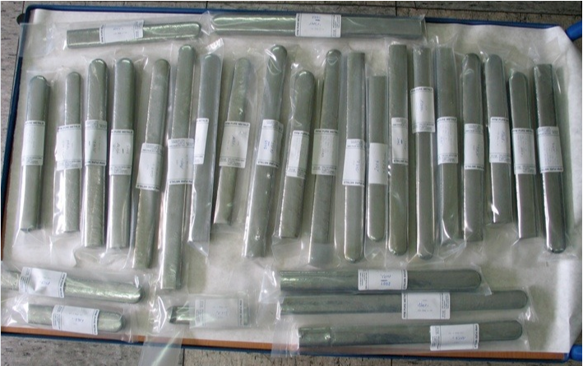
GERDA phase II
37.8 kg of ^{enr}Ge reduced and
purified (Yield: 35.5 kg 6N grade + 1.2 kg tail)
Cosmic-ray exposure minimized
Baseline for phase II: Broad Energy Ge (BEGe) diodes (Fall-back: segmented diodes)
Distinct pulse shapes → excellent
multi-site event rejection
LAr operation successfully tested
Entire BEGe production chain successfully tested with ^{dep}Ge

Slide 18
Radio-purity of liquid argon
GERDA ²²²Rn specs: <0.5 μBq/m³ Ar (STP)
Cryo-adsorption of Rn on activated carbon proven to provide ultra-pure N₂ (Borexino)
Try to adapt same technique for LAr, but
T(LAr) = T(LN₂) + 10K
Risk of Ar freezing
Tests performed using MoREx and low background proportional counters
H. Simgen and G. Zuzel, Appl. Rad. Isot. 76 (2009) 922-925

Slide 19
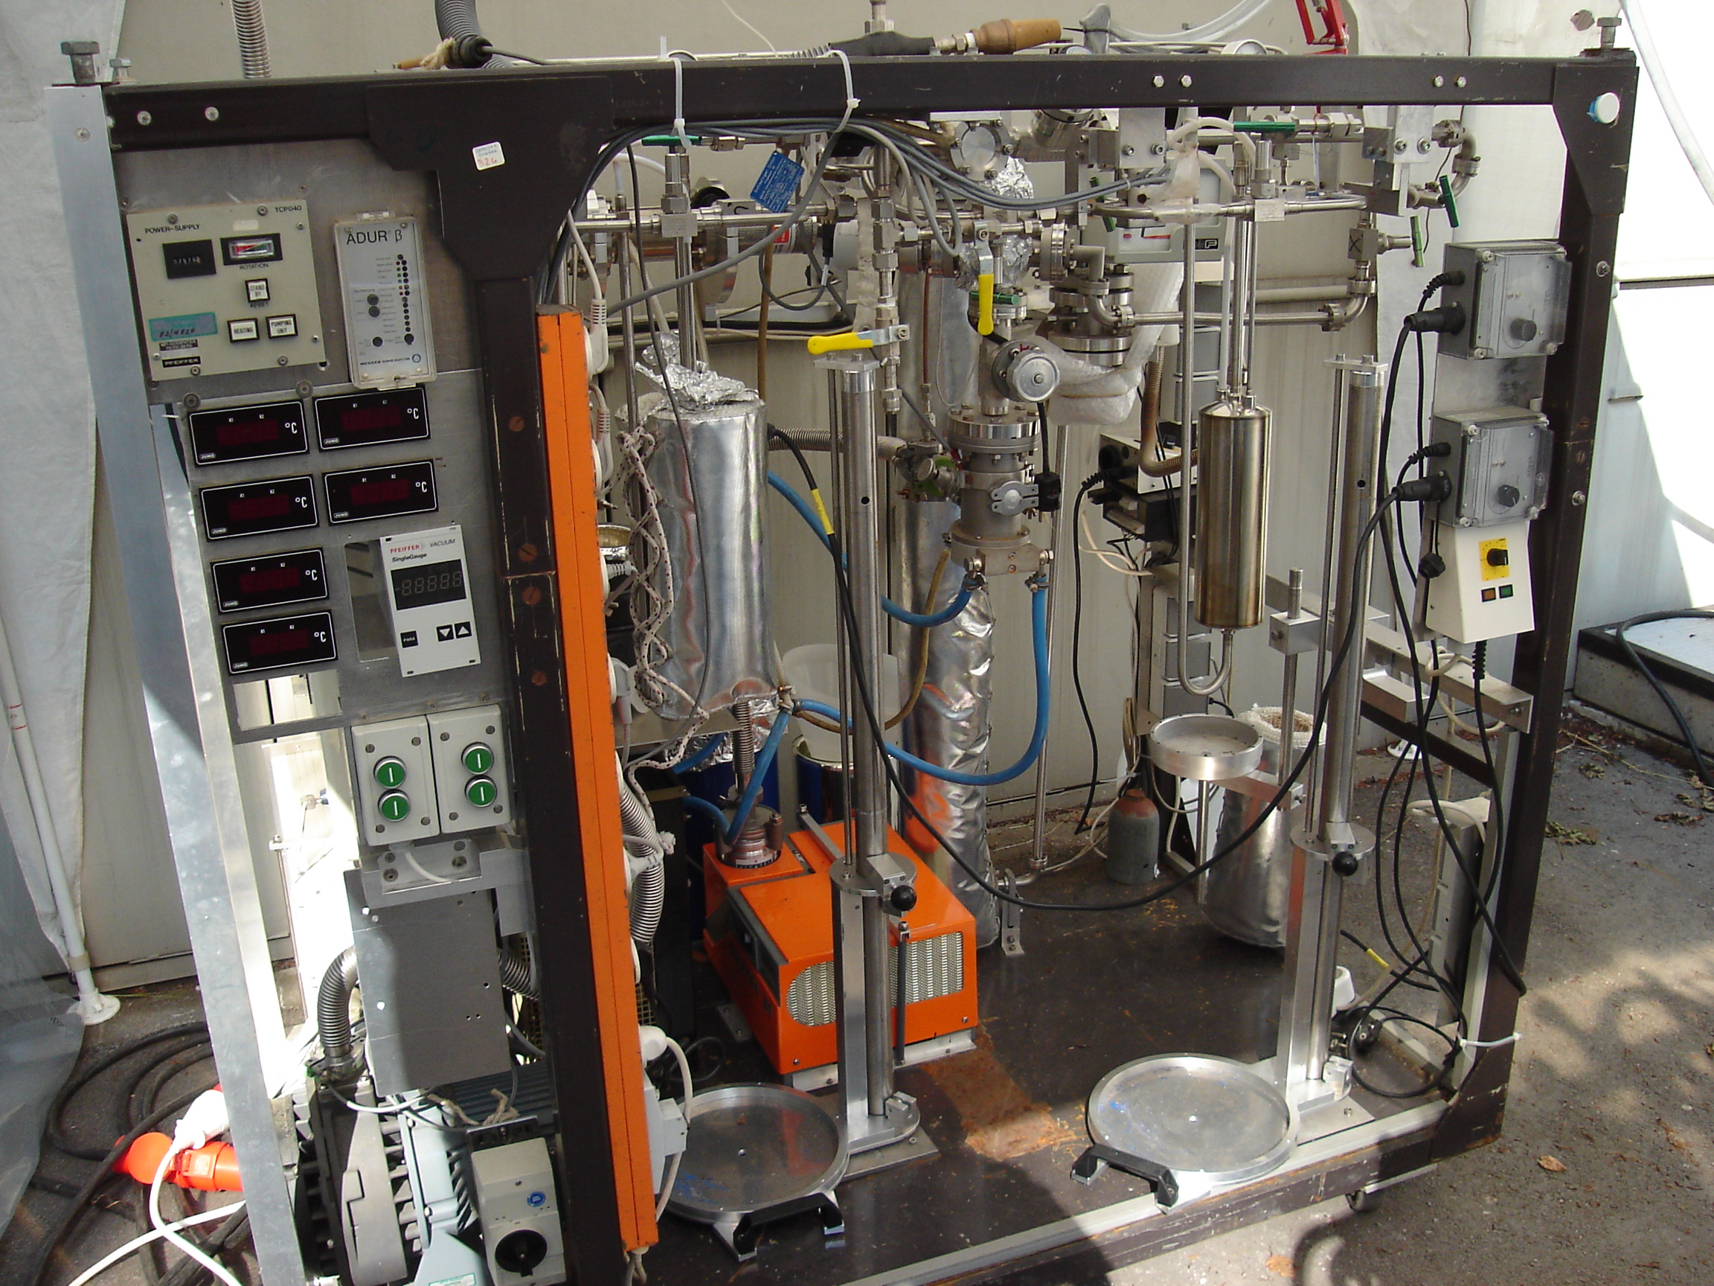
Results on ²²²Rn removal from Ar by cryo-adsorption
Gas phase results
Volume [liter LAr] | Reduction factor R | Leaking fract. 1/R [%]
96 | >360 | <0.28
169 | >1120 | <0.09
Liquid phase results
Volume [liter LAr] | Reduction factor R | Leaking fract. 1/R [%]
58 | 58.5 ± 17.1 | 1.7 ± 0.5
120 | 30.2 ± 9.7 | 3.3 ± 1.1
120 | 27.7 ± 6.5 | 3.6 ± 0.8
125 | 21.1 ± 2.7 | 4.7 ± 0.6
168 | 42.4 ± 5.7 | 2.4 ± 0.3
188 | 8.5 ± 1.0 | 11.8 ± 1.5
193 | 4.9 ± 0.6 | 20.4 ± 2.4
222 | 160 ± 28 | 0.6 ± 0.1
240 | 10.1 ± 0.6 | 9.9 ± 0.6

Slide 20
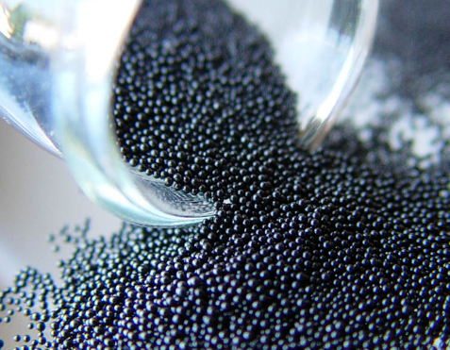
Summary on Rn purification of Ar by cryo-adsorption
Gas phase purification very efficient
Liquid phase less efficient (poor kinetics)
Unclear picture, but factor 100 reduction seems possible with GERDA’s 1 kg carbon column
Problem: CarboAct activated carbon has very irregular shape:
Not optimized for column purification
Probably formation of accidental channels between carbon grains
New product: Spherical carbon balls
²²²Rn emanation: <0.5 mBq/kg

Slide 21
²²²Rn concentration in com- mercial Ar when truck is loaded
Company | Grade | ²²²Rn [mBq/m³ (STP)]
Air Liquide | technical (4.8) | 1.62 ± 0.08
Air Liquide | technical (4.8) | 0.38 ± 0.03
Westfalen AG | technical (4.6) | 1.11 ± 0.05
Westfalen AG | technical (4.6) | 1.04 ± 0.09
Westfalen AG | technical (4.6) | 0.50 ± 0.02
Westfalen AG | technical (4.6) | 0.007 ± 0.001
Westfalen AG | technical (5.0) | 8.4 ± 0.4
Westfalen AG | high purity (6.0) | 0.38 ± 0.01
LINDE | technical (5.0) | 0.37 ± 0.06 *⁾
*⁾ At time of delivery

Slide 22
Initial Ar impurities
Ar is usually delivered from a local distribution center → Unknown storage time yields unpredictable results, because
Initial ²²²Rn decays
New ²²²Rn may be produced (emanation)
Trend shows higher initial ²²²Rn concentration in Ar than in N₂ (~0.1 mBq/m³ (STP))
Possible Explanation: Boiling points (Rn > Ar > N₂)

Slide 23
²²²Rn emanation of storage tanks for cryogenic liquids
Tank from | Grade of stored gas | Vol. [m³] | ²²²Rn activity in saturation [mBq] | specific ²²²Rn act. [mBq/m³]
Westfalen AG | technical | 3 | 177 ± 6 | 59 ± 2
Air Liquide | technical | 0.67 | 1.8 ± 0.4 | 2.7 ± 0.6
LINDE | technical | 6.3 | 3.5 ± 0.2 | 0.56 ± 0.03
Westfalen AG | 6.0 | 0.67 | 42 ± 2 | 63 ± 3
SOL | 6.0 | 16 | 65 ± 6 | 4.1 ± 0.4
LINDE | 7.0 | 3 | 2.7 ± 0.3 | 0.9 ± 0.1

Slide 24
²²²Rn emanation of storage tanks for cryogenic liquids
Tank from | Grade of stored gas | Vol. [m³] | ²²²Rn activity in saturation [mBq] | specific ²²²Rn act. [mBq/m³]
Westfalen AG | technical | 3 | 177 ± 6 | 59 ± 2
Air Liquide | technical | 0.67 | 1.8 ± 0.4 | 2.7 ± 0.6
LINDE | technical | 6.3 | 3.5 ± 0.2 | 0.56 ± 0.03
Westfalen AG | 6.0 | 0.67 | 42 ± 2 | 63 ± 3
SOL | 6.0 | 16 | 65 ± 6 | 4.1 ± 0.4
LINDE | 7.0 | 3 | 2.7 ± 0.3 | 0.9 ± 0.1
Selected for GERDA

Slide 25
The GERDA cryostat
Vacuum-insulated stainless-steel (SS) cryostat made from low-radioactivity austenitic steel
²²⁸Th <1 mBq/kg for cylindrical part
²²⁸Th <5 mBq/kg for top and bottom parts
For all screening results see
W. Maneschg et al., NIM A 593 (2008) 448–453
Additional passive copper shield inside
Active LN₂ cooling system to avoid evaporation losses

Slide 26
²²²Rn emanation test of the GERDA cryostat
Remove air-borne ²²²Rn
Fill with ²²²Rn-free N₂ (purified by cryo-adsorption)
Wait for ≥1 week to let grow-in emanating ²²²Rn
Mix to establish homogeneous ²²²Rn distribution
Extract small fraction of N₂ from cryostat and determine its ²²²Rn concentration
Scale to entire cryostat to find total ²²²Rn emanation rate

Slide 27
Cryostat ²²²Rn emanation
No. | Date | Description | Single results [mBq] | Average [mBq]
1 | Nov 07 | After construction and cleaning, no N₂ mixing | 16.9 ± 1.6_{stat} ± 3.0_{sys} 29.8 ± 2.4_{stat} ± 5.8_{sys} | 23.3 ± 3.6
2 | Mar 08 | After additional cleaning | 13.6 ± 0.7_{stat} ± 2.4_{sys} 13.7 ± 0.7_{stat} ± 2.7_{sys} | 13.7 ± 1.9
3 | Jun 08 | After Cu mounting | 33.0 ± 2.8_{stat} ± 7.0_{sys} 35.7 ± 2.9_{stat} ± 8.8_{sys} | 34.4 ± 6.0
4 | Nov 08 | After wiping of Cu / steel surfaces. | 33.2 ± 3.5_{stat} ± 1.9_{sys} 31.3 ± 4.6_{stat} ± 3.4_{sys} 27.3 ± 2.4_{stat} ± 0.7_{sys} | 30.6 ± 2.4
5 | Sep 09 | After mounting of shroud, manifold, compensator, and cryogenic tubing | 49.9 ± 3.3_{stat} ± 2.1_{sys} 63.8 ± 4.1_{stat} ± 3.1_{sys} 56.2 ± 3.7_{stat} ± 2.7_{sys} 49.1 ± 3.3_{stat} ± 2.2_{sys} | 54.7 ± 3.5

Slide 28
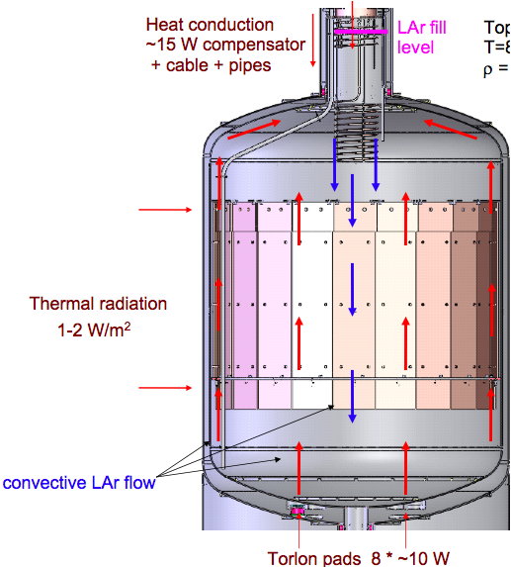
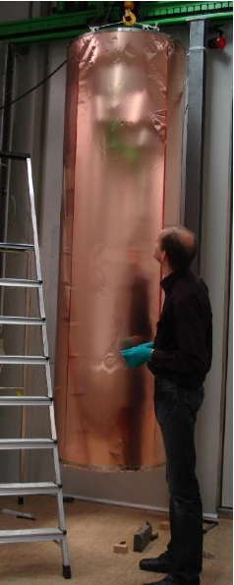
Radon shroud

Slide 29
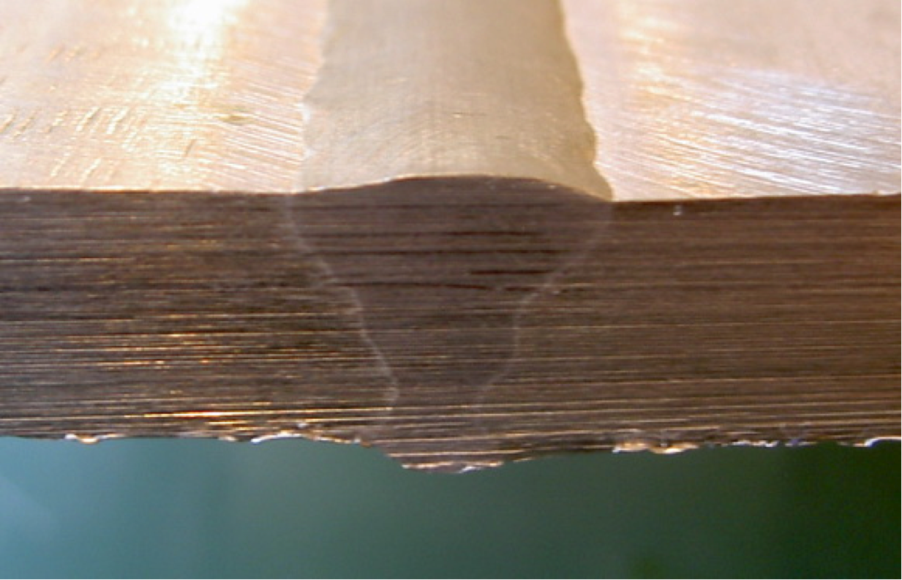
Welds as source for SS ²²²Rn emanantion
No | Description | Result [mBq/m]
1 | SS after welding | 0.36 ± 0.04
2 | SS after welding + etching (HF+HNO₃) | <0.1
3 | SS after welding + electropolishing | 0.10 ± 0.04
4 | Sample No. 3 + additional etching | <0.04
SS tape: (5 – 10) μBq/m²
cannot explain cryostat result
Emanation of SS welds!
Surface effect: ²²⁶Ra can be removed by etching
Poster on surface cleaning from ²²²Rn daughters by G. Zuzel
What happens in LAr? → Next talk by Sebastian Lindemann
Results on ²²²Rn emanation of welds

Slide 30
Homogeneity test
Before mixing:
c_{top} = (0.42 ± 0.05) mBq/m³ (STP)
c_{bot} = (0.28 ± 0.03) mBq/m³ (STP)
After mixing:
c_{top} = (0.23 ± 0.03) mBq/m³ (STP)
c_{bot} = (0.27 ± 0.05) mBq/m³ (STP)
If system is untouched ²²²Rn is NOT homogeneously distributed
Relatively stronger ²²²Rn source in top part of cryostat

Slide 31
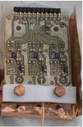
Screening of GERDA FE electronics
Here I want to mention some results of the electronics screening, in particular the discovery of low 226Ra Ta capacitors and the purity of PEN cables.
Sample | ²²⁶Ra | ²²⁸Th | ²²⁸Ra | ⁴⁰K
 | Units: mBq/piece
Old frontend „PZ0“ | 6.3 ± 0.5 | 0.2 ± 0.1 | 0.2 ± 0.1 | 2.2 ± 0.7
New frontend “CC2” | 0.32 ± 0.09 | 0.44 ± 0.10 | <0.36 | 2.6 ± 1.3
Main source of ²²⁶Ra in PZ0: Ba containing capacitors
X5R capacitors (Ba) | 0.19 ± 0.02 | 0.04 ± 0.01 | <0.05 | <0.15
New capacitors (Ta) | <0.003 | 0.008 ± 0.002 | <0.01 | 0.07 ± 0.03
Improvements in CC2 with respect to PZ0:
Number of components reduced
Hot components removed (Ba capacitors, but also resistors, pins)
FE still critical for phase II background index
Paper in preparation

Slide 33
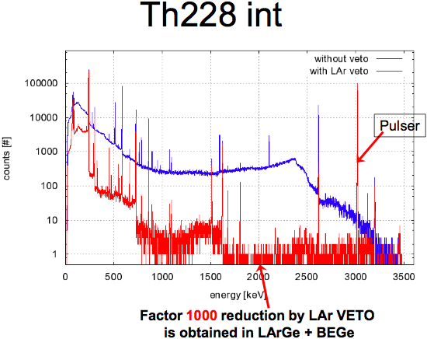

Slide 34
Summary and conclusions
Many different techniques applied to control radiopurity of GERDA during construction
LAr purity under control
Cryostat emanation too high → shroud
FE electronics critical, but OK for phase I
Promising results from LAr scintillation veto (+ pusle shape discrimination with BEGe’s)
GERDA setup ready. Physics data taking will start after study of ⁴²Ar issue

