Slide 1
Asian facilities
LRT2010, August 28, 2010
M. Nakahata
Kamioka observatory,
ICRR/IPMU, Univ. of Tokyo
YangYang Underground Laboratory (Korea)
India-based Neutrino Observatory(India)
JinPing Deep Underground Laboratory (China)
Kamioka Observatory (Japan)

Slide 2
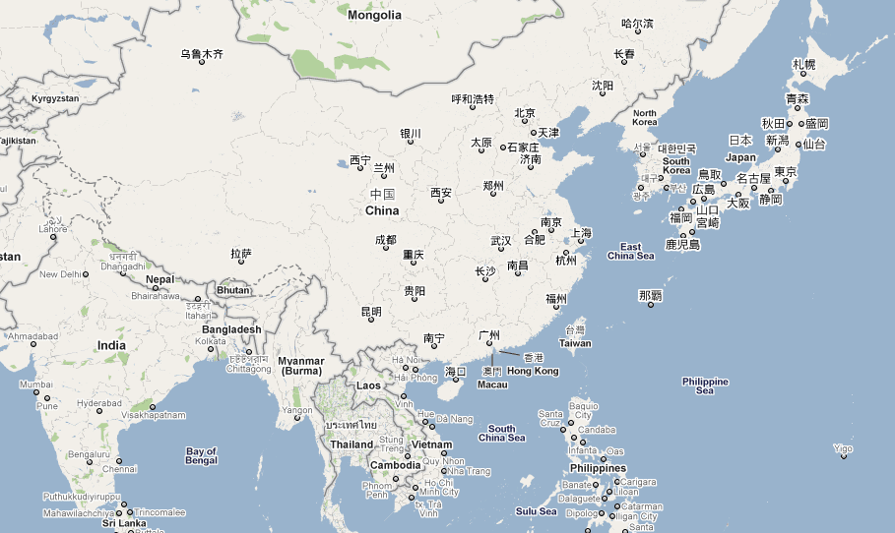
Asian underground facilities
YangYang
Kamioka
JinPing
INO(Kambam)

Slide 3
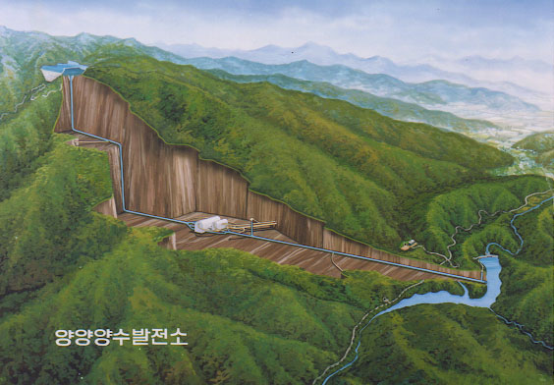
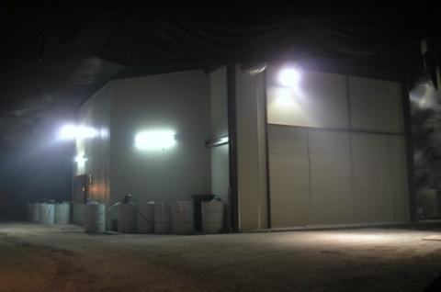
YangYang Underground Laboratory(Y2L)
(Upper Dam)
Y2L
Located in a tunnel of
Yangyang Pumped Storage Power Plant
Korea Middleland Power Co.
Minimum vertical depth : 700 m
Access to the lab by car (~2km)
Experiments:
KIMS: DM search exp. in operation
AMORE: DBD Search exp. in preparation
(additional laboratory space in design)
(Power Plant)
(Lower Dam)
From Sunkee Kim

Slide 4
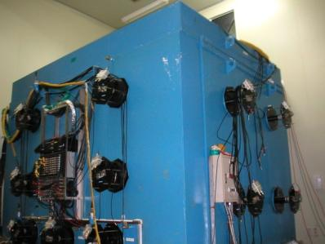
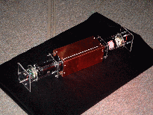

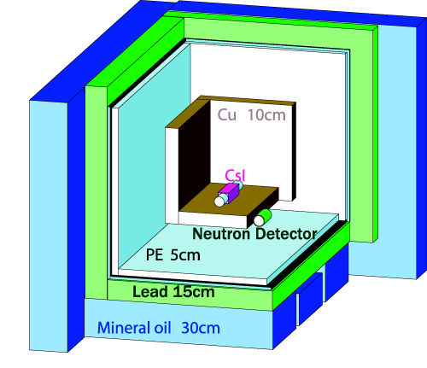
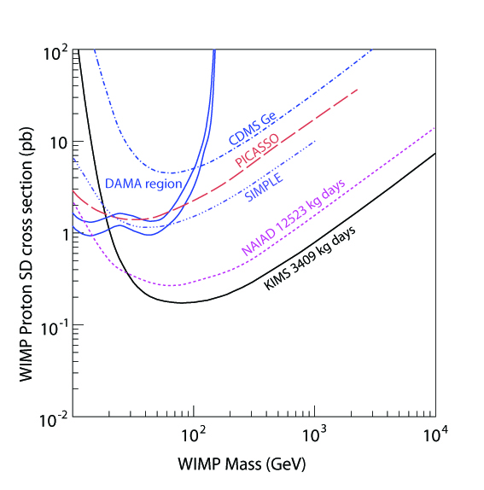
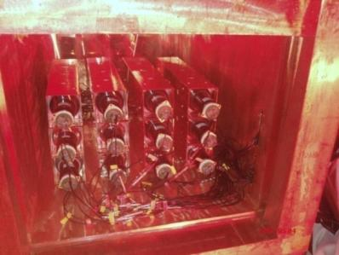
KIMS(Korea Invisible Mass Search)
DM search experiment with CsI crystal
CsI(Tl) Crystal 8x8x30 cm³ (8.7 kg)
3” PMT (9269QA) : Quartz window, RbCs photo cathode
~5 Photo-electron/keV
SD interaction
PRL 99, 091301 (2007)
12 crystals(104.4kg) running
Stable data taking for more than a year
Unique experiment to test DAMA annual modulation
Best limit on SD interactions
in case of pure proton coupling
From Sunkee Kim

Slide 5
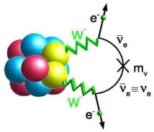
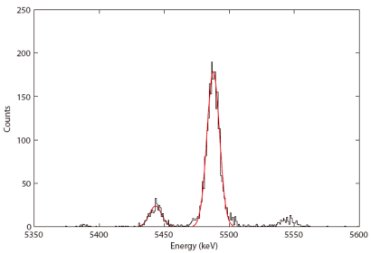
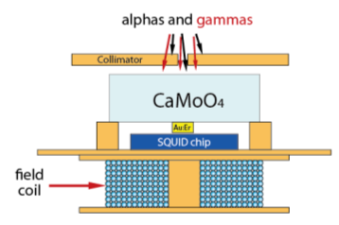
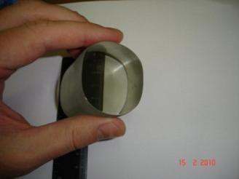
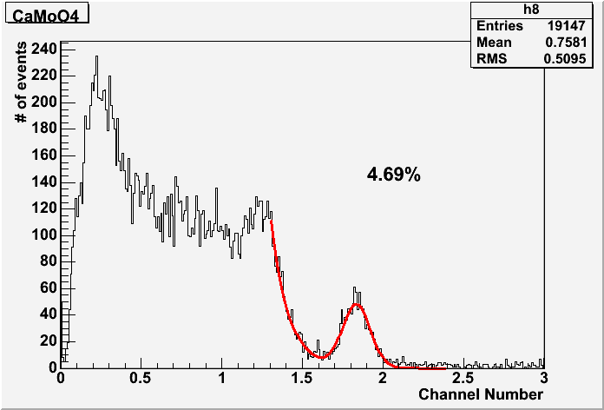
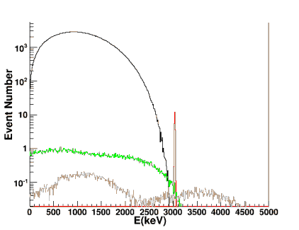
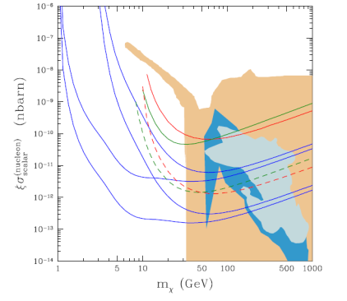
AMORE Experiment at Y2L
Double beta decay search with ⁴⁰Ca¹⁰⁰MoO₄ crystal
Int. Collaboration : Korea, Russia, Ukraine, China
in preparation
⁴⁰Ca¹⁰⁰MoO₄ crystal
Unique in the world (depleted Ca + enriched Mo)
Scintillation crystal + Cryogentic detector
MMC+CMO at low temperature
FWHM = 11.2 keV
5.5 MeV alpha
good DM detector as well
Energy spectrum for 600 keV gamma
Scintillation readout
E_{th}=10 keV
(5 and 100 kg year)
Cryogenic CaMoO₄ Sensitivity
E_{th}=1 keV
(5 and 100 kg year)
0.5% FWHM →15 keV FWHM for low temp.
5 years, 100 kg ⁴⁰Ca¹⁰⁰MoO₄ :
T_{1/2} = 7.0x10²⁶ years → <m> = 20 – 70 meV
Fully covers inverted hierarchy
From Sunkee Kim

Slide 6
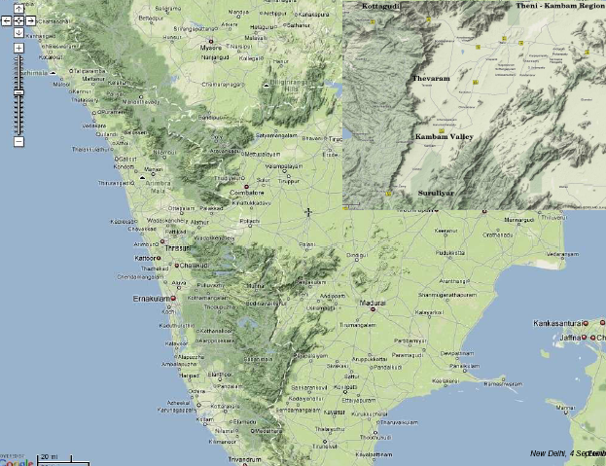
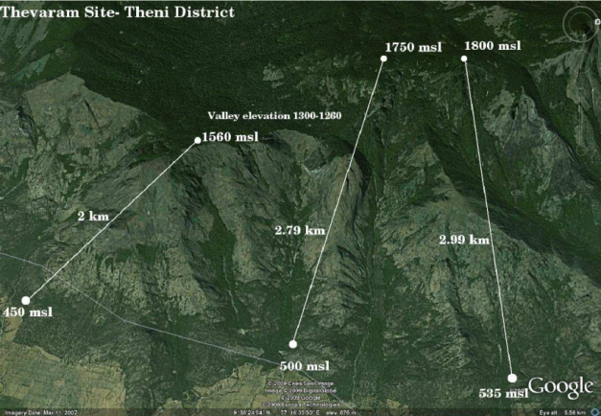
INO site at Kambam Valley
The tunnel starts at the mean sea level height of 450 meter and goes below the peak at 1560 meter.
Tunnel length of 2 km and vertical coverage of about 1200 meter.
The environment and Forest clearances will be obtained within 6 months.
Then, start to construct the INO detector.
From N. Mondal

Slide 7
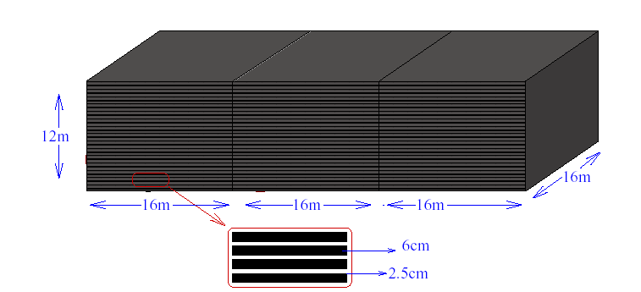
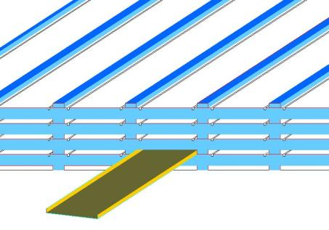
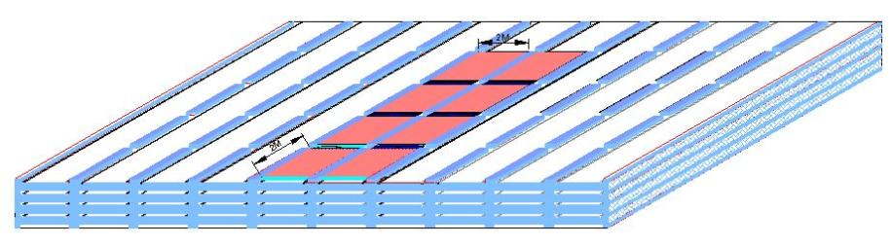
INO detector
From N. Mondal
  Use magnetised iron as target mass and RPC as active detector medium. Target mass of 17kton x 3 modules.
  Charge identification and good momentum resolution for the precise measurement of Δm²₃₁ and θ₂₃ using atmospheric neutrinos.
  It will take 5 years to start the operation of the first detector module.

Slide 8
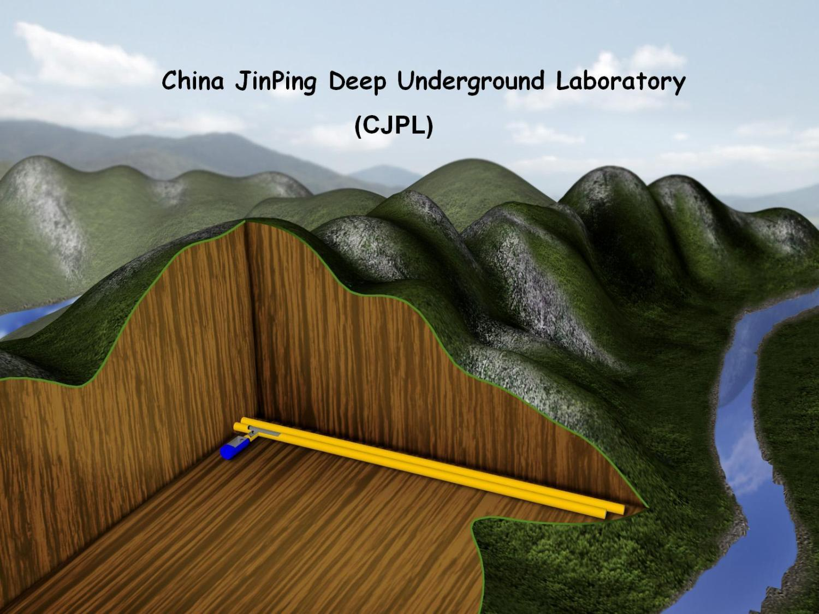
From Q. Yue

Slide 9
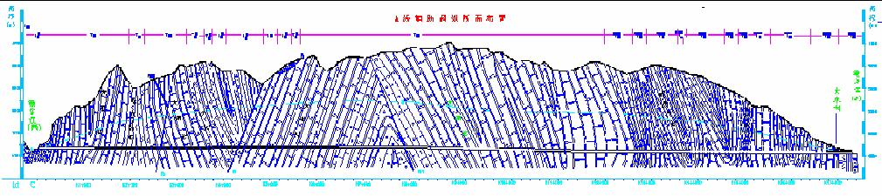
The basic conditions of CJPL
~2400m
~8000m
Peak：4193m
Maximum rock overburden: ~2400m
Length of Tunnel: 17.5km
Rock cover larger than 1500m:>70%
Two tunnels for transportation
From Q. Yue

Slide 10
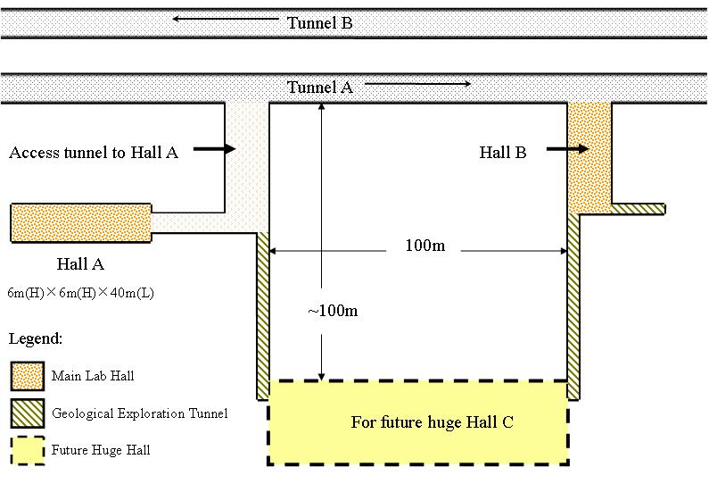
Phase-I: 6*6*40m Lab（RED Square）
The plan of CJPL construction
From Q. Yue

Slide 11
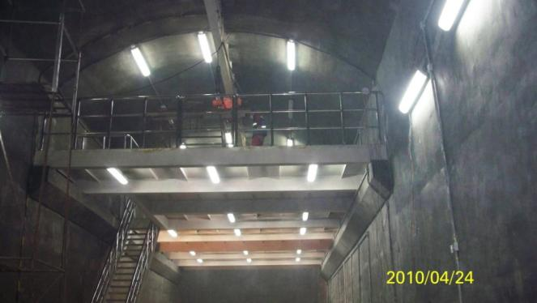
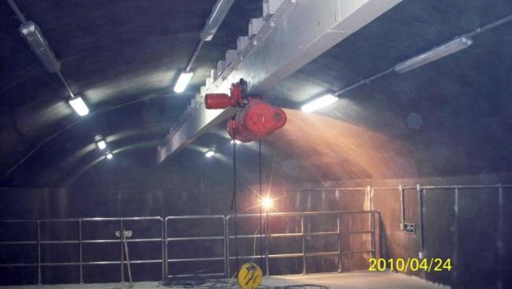
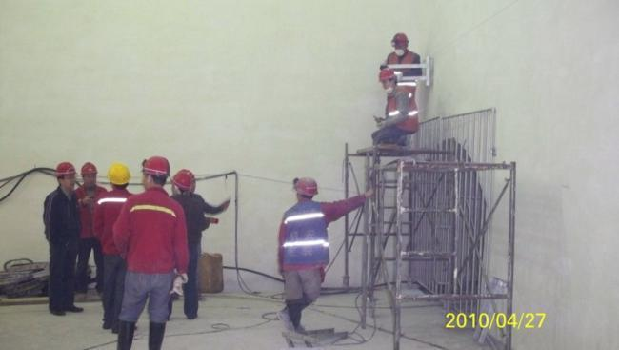
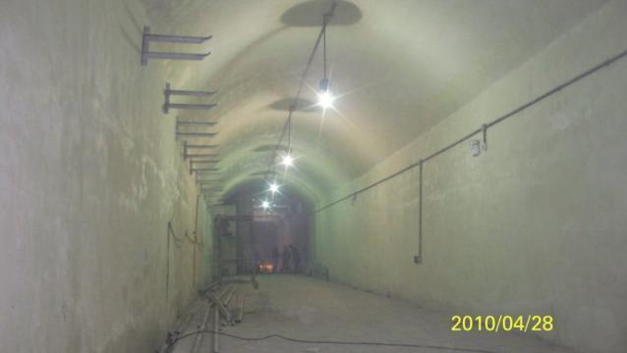
From Q. Yue

Slide 12
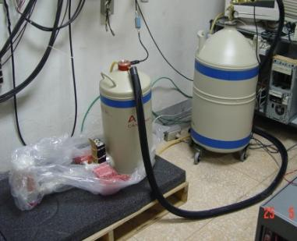
China Darkmatter EXperiment (CDEX)
20g ULEGe
Phase-I (2010.9-2011.3)
-- 20g UltraLowEnergy (ULE)-HPGe detector (220 eV threshold)
-- Shielding system construction
-- HPGe detector for radioactive measurement
-- Radon monitor system
Phase-II (2010.12-2011.12)
-- ULE-HPGe detector(~1500g)
Phase-III (2012-)
-- ULE-HPGe detector(~10kg scale)
From Q. Yue

Slide 13
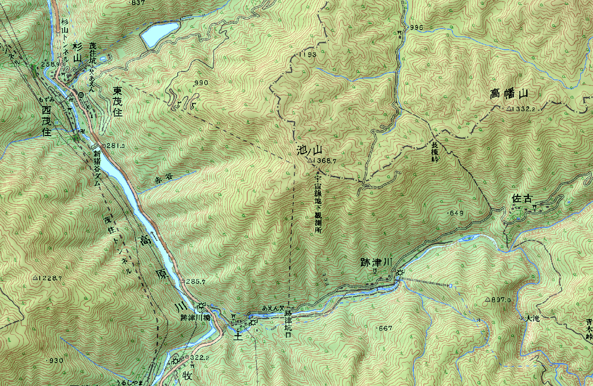
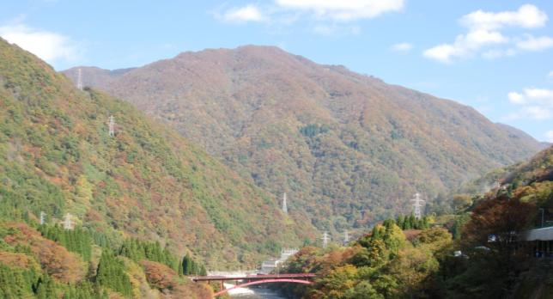
Kamioka observatory
Mine train tunnel 3 km
(used for power and network lines)
Mt. Ikeno-yama
(1369 m s.l.)
Surface buildings
(ICRR, Tohoku)
Access tunnel 1.7 km
Entrance (344 m s.l.)
1000m
tunnel

Slide 14
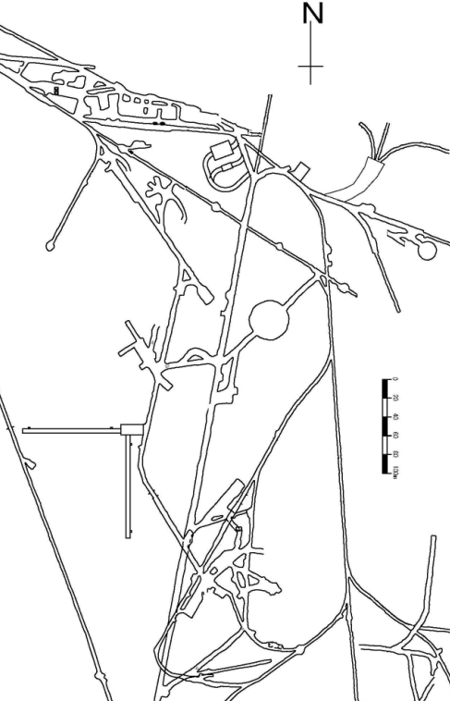
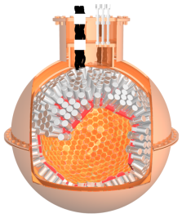
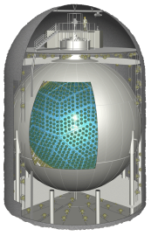
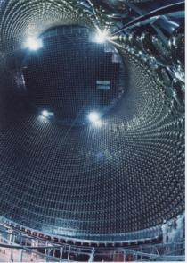
Kamioka underground map
Just under the top of Mt.Ikeno-yama
XMASS
Old mine office
KamLAND
LAB-1(IPMU)
C
D
LAB-E
LAB-A
CANDLES
LAB-B
Pure-water
Super-Kamiokande
Clean room
CLIO
１００ｍ
To entrance

Slide 15
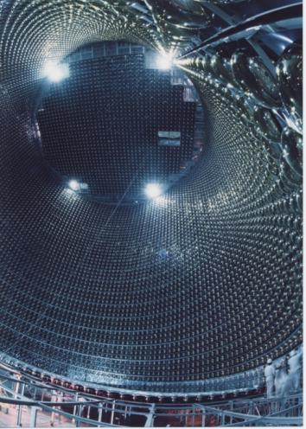
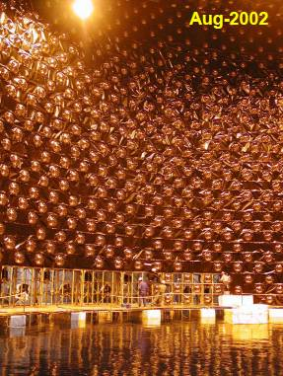
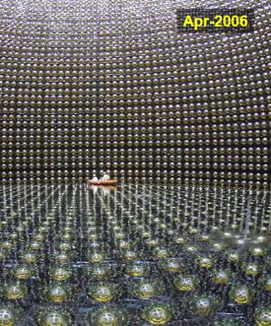
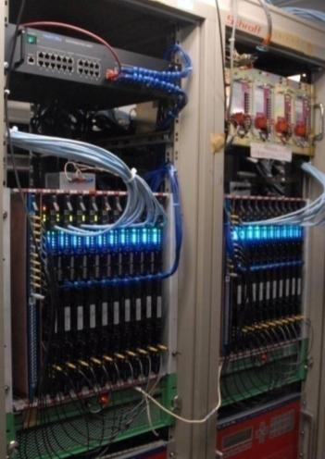
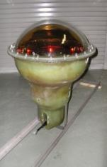
Super-Kamiokande
1996 | 1997 | 1998 | 1999 | 2000 | 2001 | 2002 | 2003 | 2004 | 2005 | 2006 | 2007 | 2008 | 2009 | 2010
SK-I
SK-II
SK-III
SK-IV
SK-I
Acrylic (front)
+ FRP (back)
SK-II
SK-III
SK-IV
11146 ID PMTs
(40% coverage)
5182 ID PMTs
(19% coverage)
11129 ID PMTs
(40% coverage)
Electronics
Upgrade
Energy
Threshold
(Kinetic energy)
~6.5 MeV
~4.5 MeV
~4.0 MeV
Current
<~3.5 MeV
Target
~4.5 MeV

Slide 16
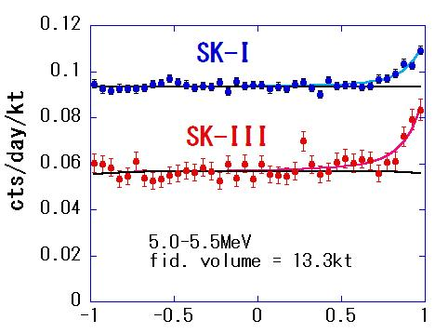
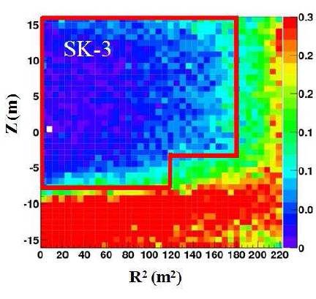
Lowering BG for solar ν in SK
Improvements after SK-III
Lowering background (~40% reduction)
-- Supply water through RO to reduce Ra
-- Control water flow to reduce convection
→Lower background in fiducial volume
(current level: ~0.4mBq/m³)
Data analysis, simulation
Improved direction reconstruction
(σ improved by 10%)
New cuts to reduce low energy BG
Implement position dependence of
water transparency
More precise modeling of the detector
cosθ_{sun}
Z (m)
Systematic error of the solar neutrino flux was reduced to 2.1% (2/3 of SK-I)
⁸B neutrino flux
SK-III : ( 2.32±0.04(stat.)±0.05(sys.) )×10⁶ cm⁻²s⁻¹
-> consistent with SK-I (2.38±0.02(stat.)±0.08(sys.) )×10⁶ cm⁻²s⁻¹
R² (m²)
Z
R
SK detector

Slide 17
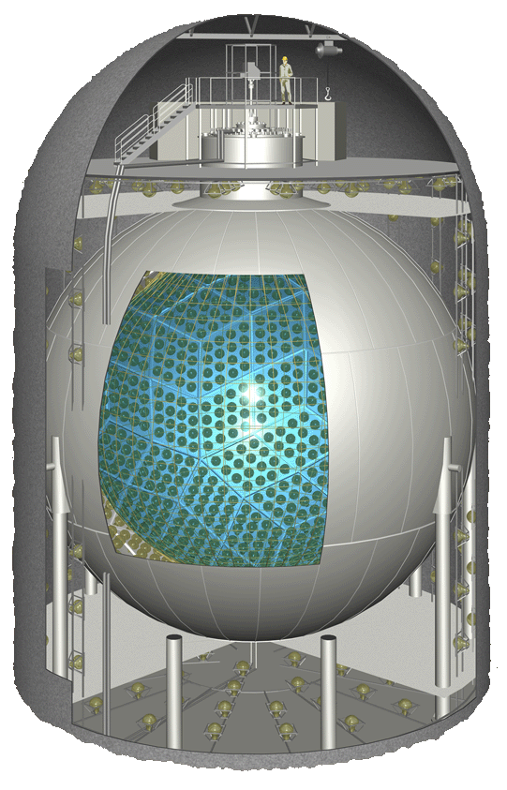
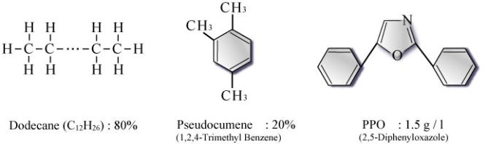
KamLAND Detector
( KAMioka Liquid Scintillator Anti-Neutrino Detector )
Glove box &
Calibration system
Inner Detector
Liquid Scintillator (1000 tons)
  Ultra-pure ; U/Th < 10⁻¹⁷ g/g
Electronics Hut
Access Chimney
Spherical stainless tank
(18 m diameter)
1.36 g/l
Liquid Scintillator
Plastic Balloon (13 m diameter)
Mineral Oil : Inner buffer
  ρ_{LS}/ρ_{MO} = 1.0004
PMTs
  1325 of 17-inch and 554 of 20-inch
  Photo-coverage : 34% → ~ 500 p.e./MeV
Outer Detector
Water Cherenkov detector ; muon veto
PMT
  225 of 20-inch
Inner Buffer
(mineral oil)
Plastic balloon
(13 m diameter)
Outer Water
→ S.Yoshida/G.Keefer’s talk
From S. Yoshida

Slide 18
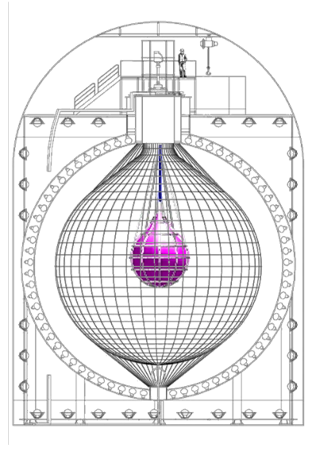
KamLAND-ZeN ( KamLAND Zero Neutrino ββ decay )
Milestone in KamLAND-ZeN Project
1st Phase
  Install mini-balloon into KamLAND
    ~ 25 μm thick Nylon film
  Dissolve ~400 kg of enriched ¹³⁶Xe gas
    ¹³⁶Xe enrichment ; 91.7 %
  Xe dissolved LS
    Decane(82.3 %) / PC(17.7 %) / PPO(2.7 g/l)
    3.0 wt% of Xe
  No further modification to the KamLAND detector
    → start data taking quickly
  Explore KKDC claimed region ; down to <m_{ν}> ~ 60 meV
Plan to Start data taking 2011/spring
¹³⁶Xe 400kg
mini-balloon (R ~ 1.7 m)
2nd Phase
  Dissolve ~1000 kg of enriched ¹³⁶Xe gas
  Increase light yield
    Brighter LS development (target; ~ +40%)
    Light concentrator installation (target; ~ +80%)
  Explore the inverted mass hierarchy region ; <m_{ν}> ~ 25 meV
(2015 ~)
From S. Yoshida

Slide 19
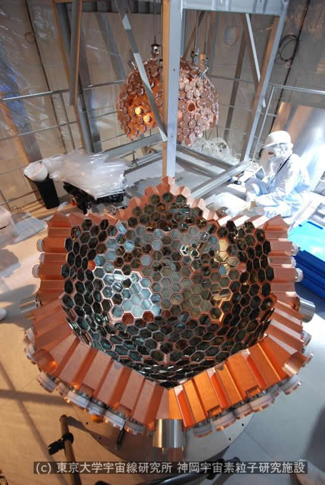
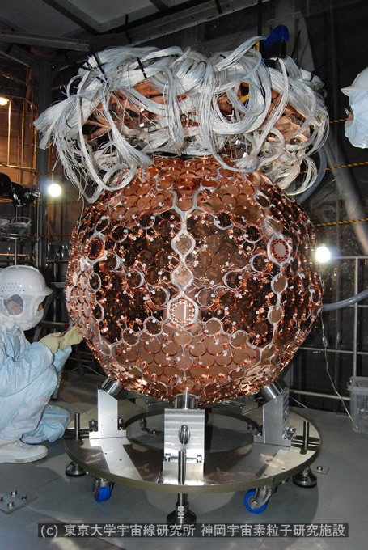
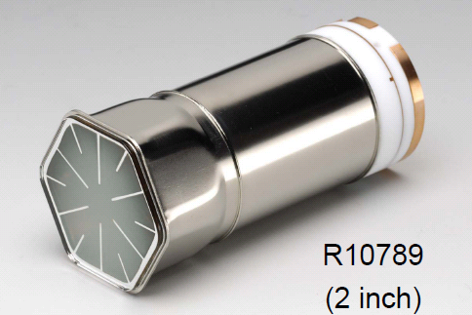
XMASS
Large scale multi-purpose low background detector using liq. Xe.
As the first phase, 800kg liq. Xe dark matter detector is under construction.
642 low BG PMTs
Construction will be finished by September this year.
→ A. Takeda’s talk

Slide 20
CANDLES III(U.G.)
⁴⁸Ca ββ decay experiment
CaF₂(pure)
  10³ cm³ × 96 crystals; 305 kg
  ⁴⁸Ca ; 350 g
Liquid scintillator
  two phase system
  Purification system
H₂O Buffer
  passive shield (larger tank)
PMTs
  17” PMT (×14) : R7250
  13” PMT (×56) : R8055
Construction almost finished.
Start measurement soon.
  <m_{ν}> ~ 100meV sensitivity now.
In future, using 3 ton enriched (2%) Ca,
  → <m_{ν}> ~ 30meV
→ I. Ogawa’s talk
From I. Ogawa

Slide 21
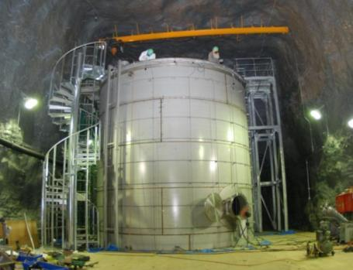
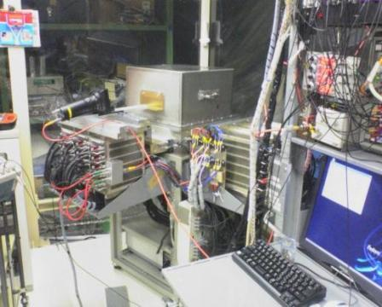
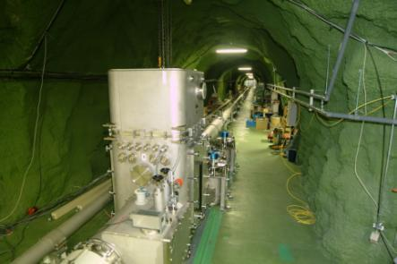
Other projects at Kamioka
LAB-1(IPMU)
EGADS: R&D for Gd-loaded SK (200 ton test tank)
ＸＭＡＳＳ
C
D
CANDLES
KamLAND
LAB-E
LAB-A
40cm
LAB-Ｂ
NEWAGE: R&D for direction-sensitive dark matter detector.
Micro TPC using CF₄ gas.
SK
Pure-water
Clean room
CLIO: Laser interferometers for gravitational wave prototype and earth science
Laser interferometers for gravitational wave prototype and earth science
１００ｍ

Slide 22

LCGT (Large Cryogenic Gravitational Telescope)
Underground site is “quiet” not only for radioactivity but also for seismic noise.
Equipment cost (98M$) was funded in this year.
Excavation and etc. cost(~50M$) is under discussion.
From M.Ohashi

Slide 23
LCGT: Large Cryogenic Gravitational Telescope
Existing tunnel
Mt. Ikeno-yama
(1369 m s.l.)
Existing tunnel
1st tunnel
(3km)
2nd tunnel
(3km)
New entrance for LCGT
From M.Ohashi

Slide 24



Hyper-Kamiokande
Tochibora mine, Kamioka
Height 40m
Super-K
50kton total
22kton fiducial
Length 250m
Height 54m
Hyper-K
1Mton total vol.
540kton fiducial vol.
Inner volume {D43m x L(5x50m)} x 2
PMT ~100,000 (20inch)
(Photo-coverage 20％）
Dia. 43m

Slide 25







Candidate site for Hyper-Kamiokande
Off-axis T2K beam

Slide 26


Site Study for Hyper-K
Safety factor analysis
rock mass
cavern
Boring the site is being prepared.
Initial state of stress in the rock mass (important for cavern design)

Slide 27
Conclusions
Asian underground facilities are reviewed.
Existing facilities: YangYang (Korea) and Kamioka (Japan).
Under construction facilities: JinPing(China) and INO (India).
All Asian facilities are horizontal tunnel access.
Fruitful scientific programs are running/prepared in those facilities.

