Slide 1
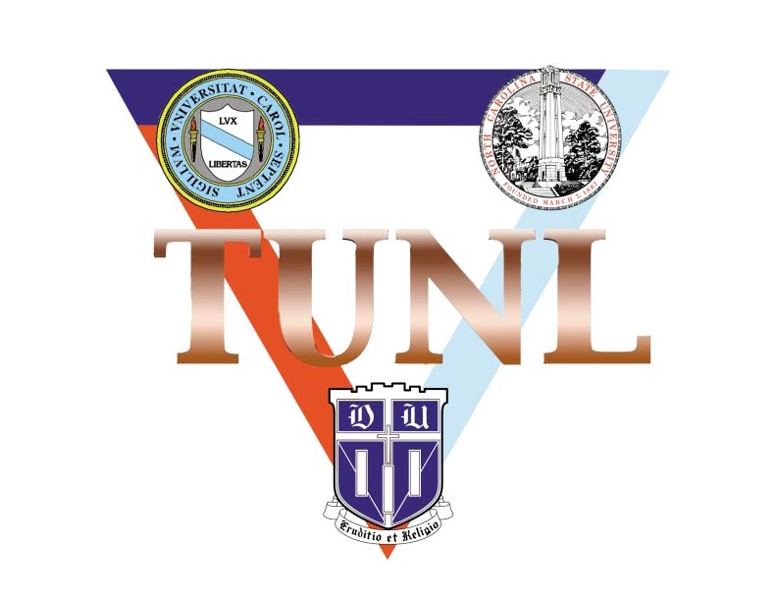
North American Underground Facilities
Reyco Henning
LRT 2010
Sudbury, ON

Slide 2
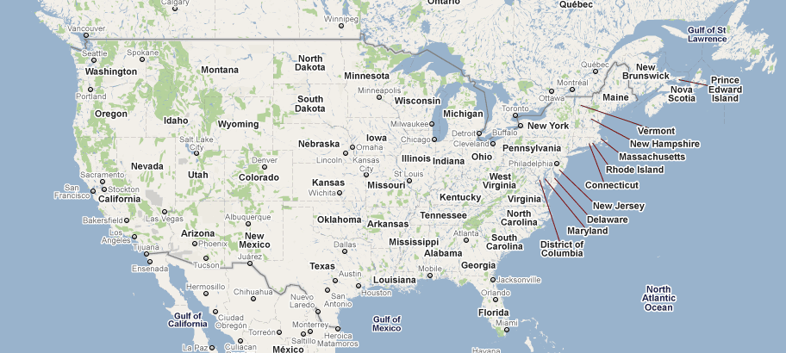
Major Existing North American Facilities
SOUDAN
PNNL
SNOLAB
SUL
(DUSEL)
Oroville
KURF
WIPP
Others

Slide 3
Different Depths
Shallow (< few hundred mwe)
Material Assay
Reduced Cosmogenic activation – electroforming and materials manufacture
Deep (few thousand)
Ultra-low background materials assay.
Physics Experiments

Slide 4
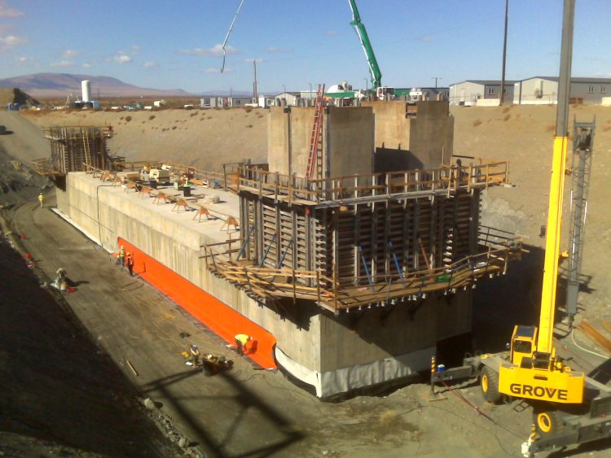
Pacific Northwest National Laboratory’s New Facility Richland, WA
Capabilities at 38 MWE
Clean fabrication and machining
Electroformed copper production and cleaning
Clean detector assembly Measurements Hall
Underground materials storage

Slide 5
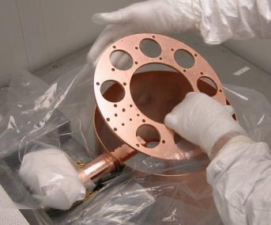
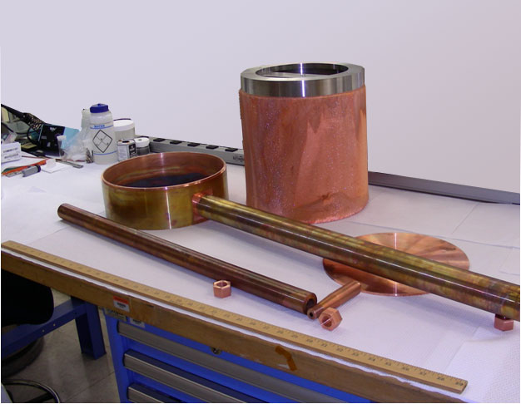
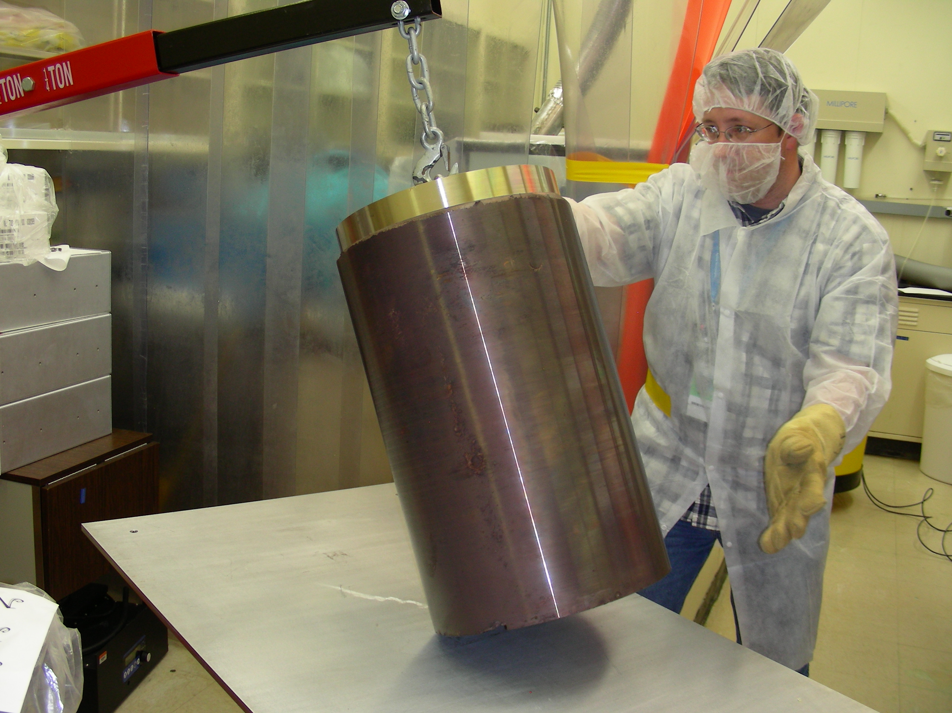
Electroformed Copper / Clean Fabrication
Fabrication of ultra-low-background materials for construction of next-generation experiments
Large parts produced with ultra-pure Cu
Notes:
PNNL is a world leader in atmospheric monitoring of ultra-trace and low-level radionuclides for detecting proliferation of weapons of mass destruction. The Radiological and Chemical Sciences group within the National Security Directorate has had the mission of radiation detection technology development and deployment for more than 50 years. Instruments incorporating PNNL radiation detection technology have been deployed in an array of “field” locations, including: outer space, deep undersea, within the core of both naval and civilian reactors, international border crossings, international test detection network sites, high altitude aircraft, nuclear accident sites such as Three Mile Island and Chernobyl, nuclear complex sites such as PNNL is deploying radiation portal monitors at U.S. ports of entry for the Department of Homeland Security to detect smuggling of WMD onto American soil.

Slide 6
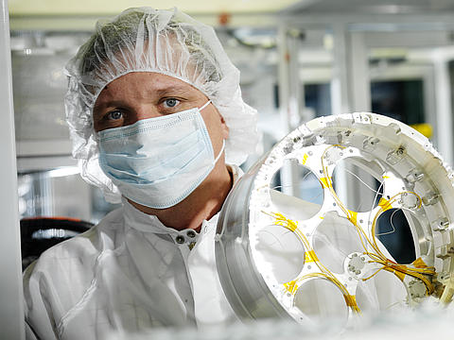
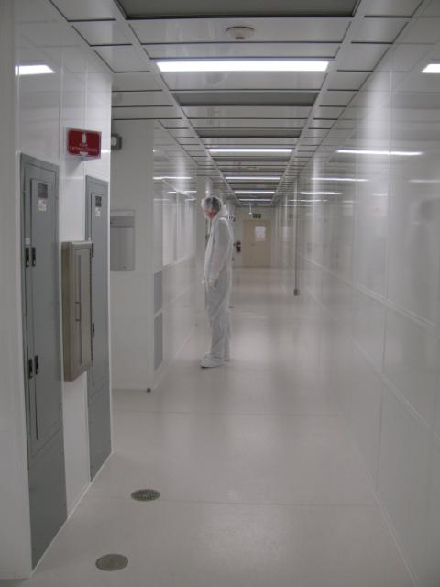
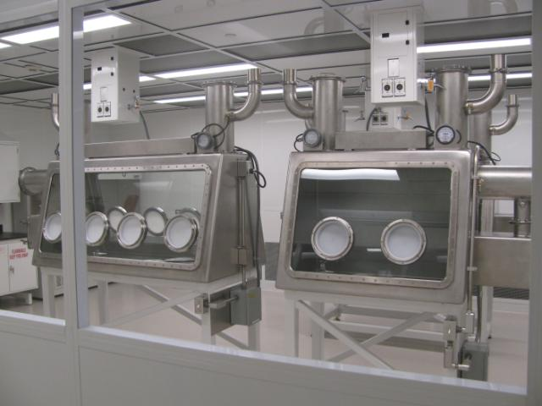
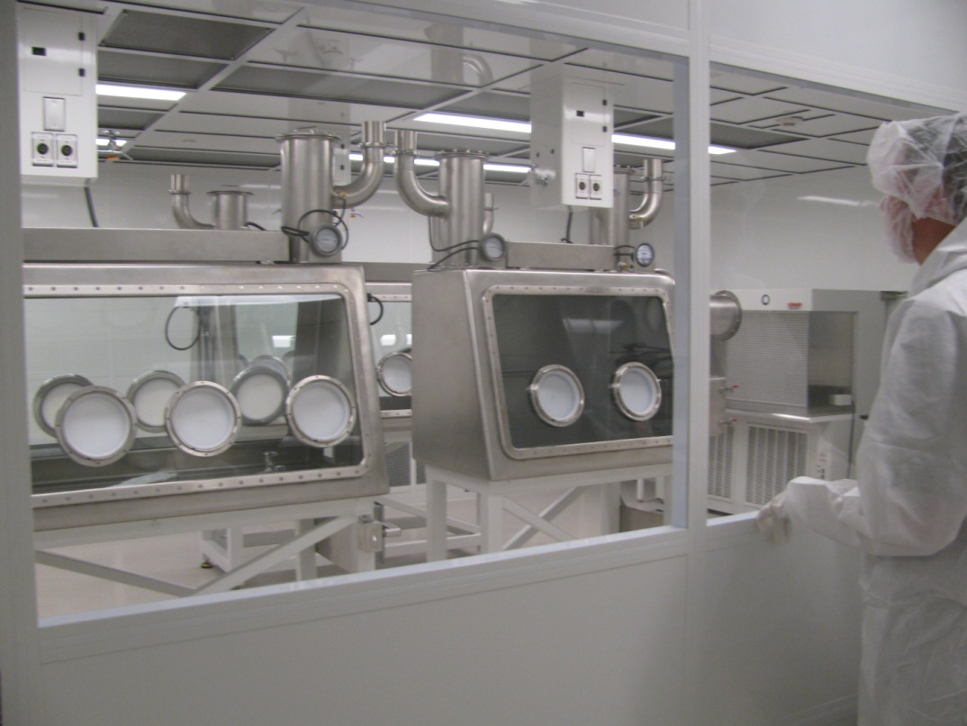
Detector Assembly / Measurements Hall
Detector arrays for science and security applications
MAJORANA DEMONSTRATOR and tonne-scale ⁷⁶Ge 0νββ Experiments
Nuclear fuel cycle and nuclear explosion monitoring low background systems for national security

Slide 7
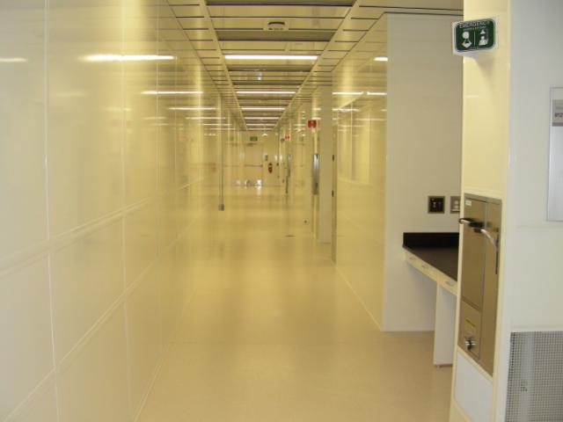
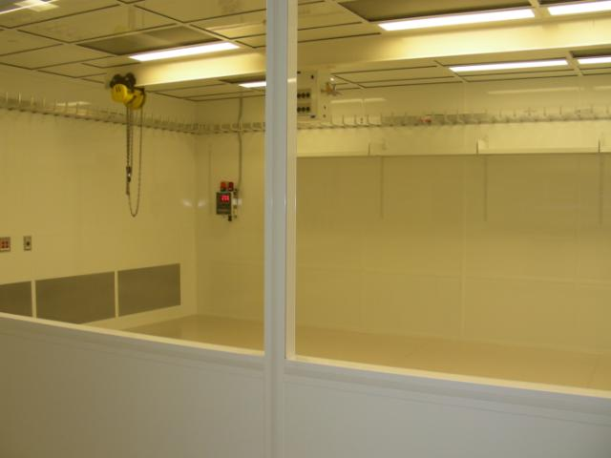
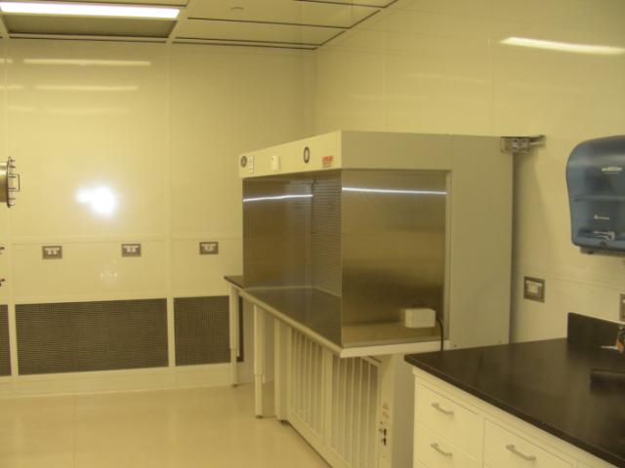
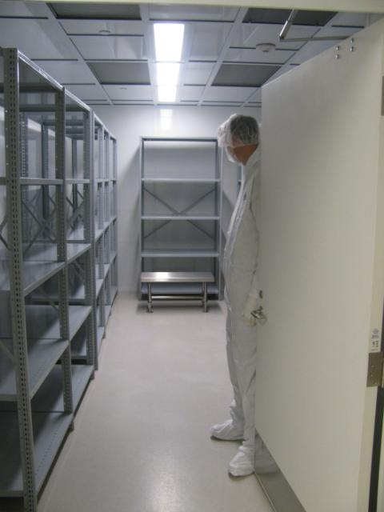
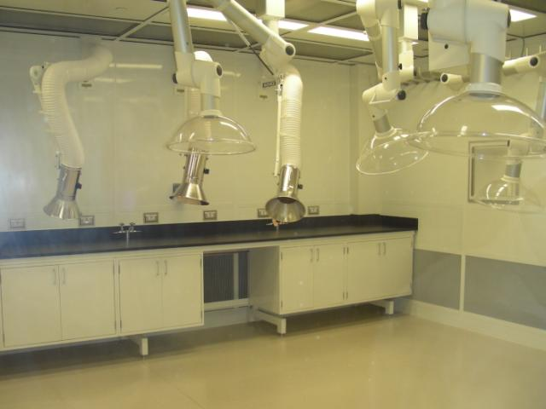

Slide 8
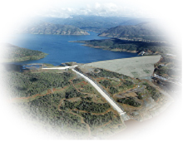
Oroville Dam Underground Facility
Oroville, CA
~180 mwe, site of the UCSB-LBL Ge 0νββ expt.
Low Background Counting.
Radon flushed counting chambers
85% P-Type HPGe/ULB detectors (~14 yr UG)
Sensitivity for ~kg Samples
~1 Day
~1 Week
Contaminant | LBL Surface Facility | Oroville Facility
²³⁸U and Daughters | 0.5 ppb (6 mBq/kg) | 50 ppt (0.6 mBq/kg)
²³²Th and Daughters | 2.0 ppb (8 mBq/kg) | 200 ppt (0.8 mBq/kg)
⁴⁰K | 1.0 ppm | 100 ppb
⁶⁰Co | 0.04 pCi/kg | 0.004 pCi/kg

Slide 9
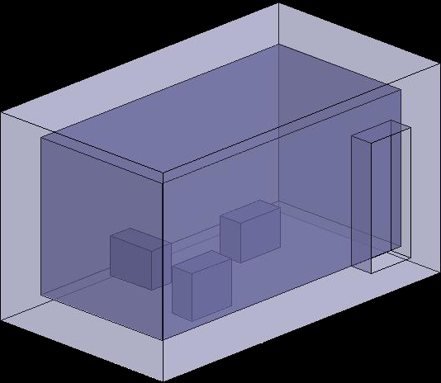
Onsite (Bldg.72) Surface Facility
Environmental Study
Waste Analysis
Neutron Action Analysis
Physics (pre-screening)
Features
Special 4π-shielded room with concrete walls made from ~500 tons of selected low-radioactivity serpentine rock (Mg₆Si₁₀(OH)₈) concrete (wall thickness ~ 4-6 ft)
115% N-type Low Background HPGe Detector, w/J-hook mount. Counting chamber has outer Pb and inner Cu (OFHC) shielding layers
Other HPGe, NaI, and BF3 couners
~1.5m Shield
NaI/BF₃
HPGe
115%
N-HPGe (ULB)

Slide 10
A database for the LBF
Developed by J. Loach, LBNL
Vast (since 1950’s) historical archive will be made public
Robust database built with CouchDB
Web interface with powerful search
Dedicated database for each customer
Separate and secure cloud storage
Identical, protected web interfaces
Software will be open-sourced
For use in the wider community

Slide 11
A database for the LBF

Slide 12
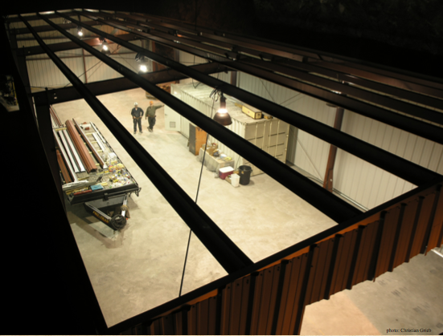
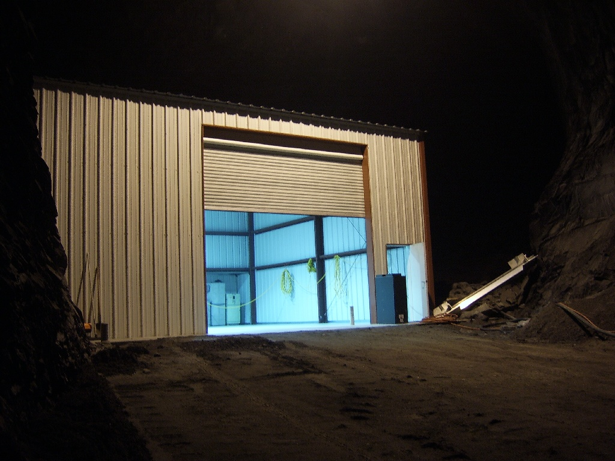
Kimballton Underground Research Facility (KURF) Ripplemead, VA
30 min drive from Virginia Tech
1450 mwe, 14 th level
Drive in access (even for bus!)
Power, mine water, ethernet, phone
Part-time staff
1-3 pCi/l Rn
Experiments:
LB Assay
MAJORANA Prototype (MALBEK)
Double-beta decay to Excited States
Future:
Mini-LENS, neutron detector

Slide 13
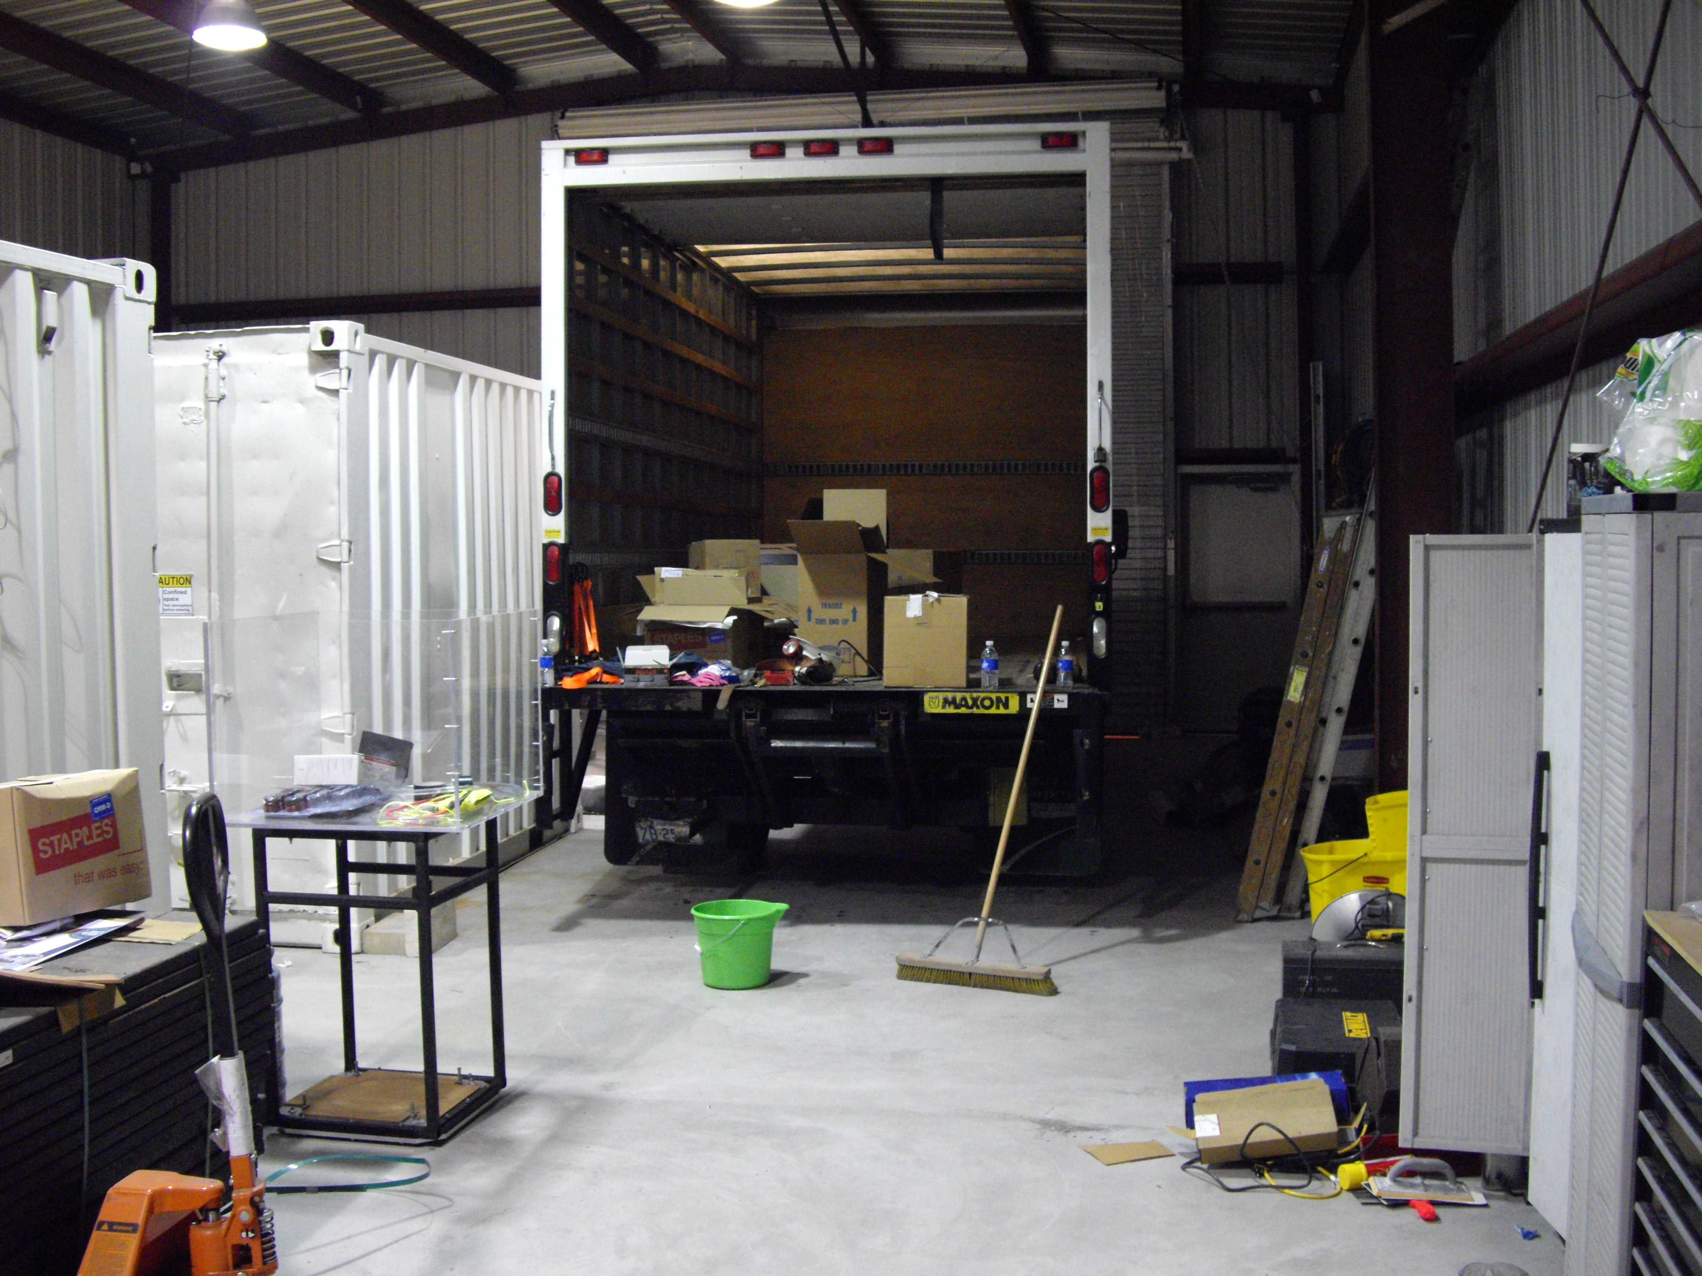

Slide 14
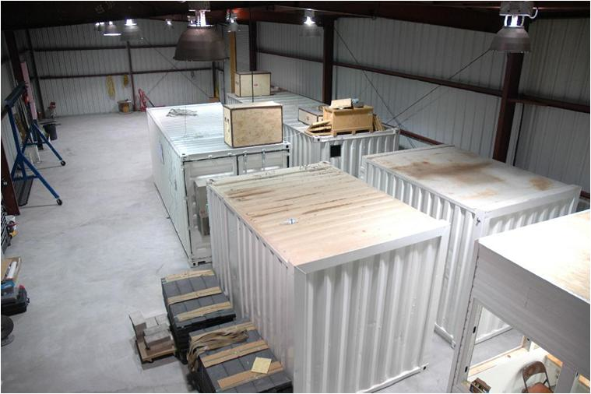
Current Status

Slide 15
Future

Slide 16
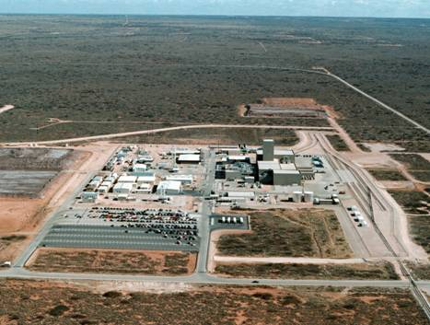
Location
Waste Isolation Pilot Plant (WIPP) Carslbad, NM
DOE Lab! ~1700mwe

Slide 19
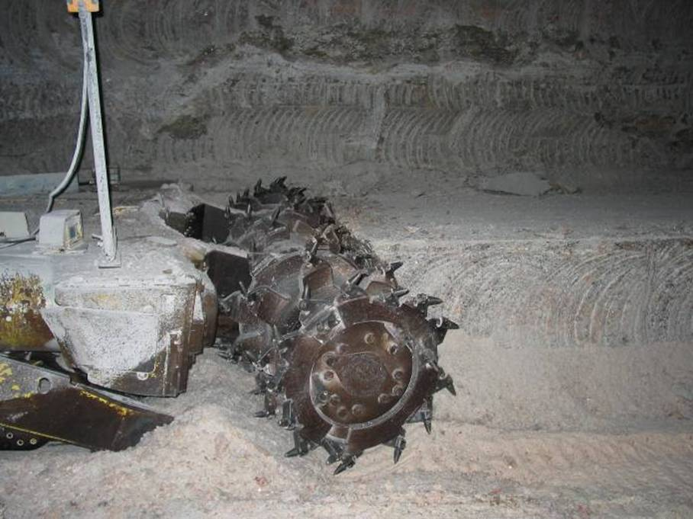

Slide 20
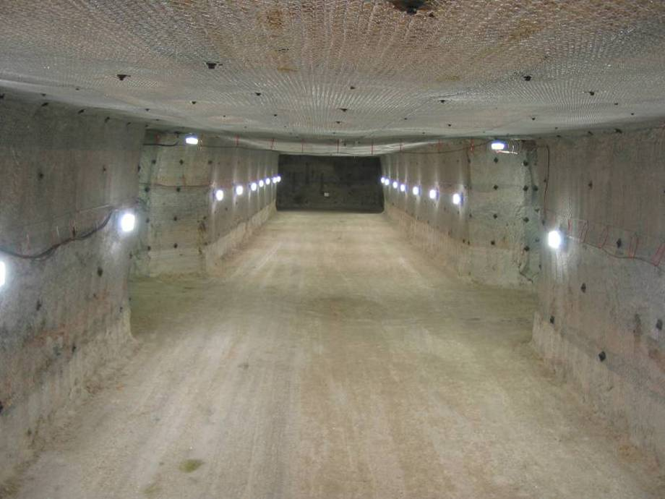

Slide 21
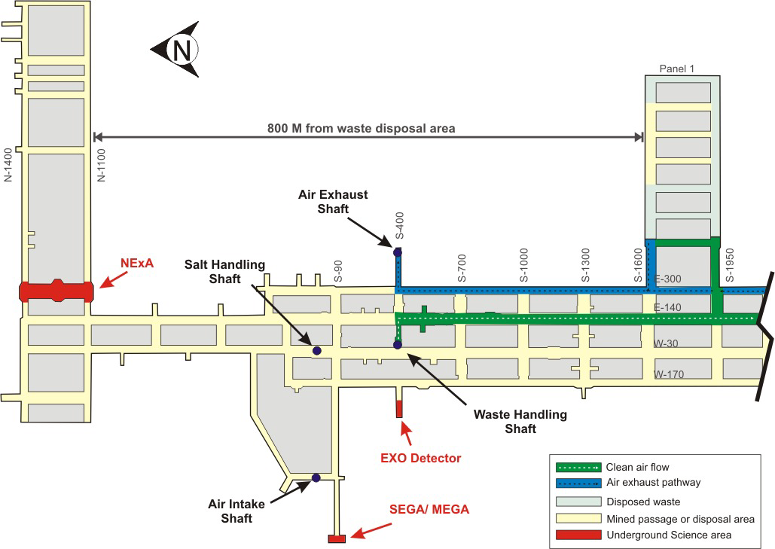
Current experimental areas at WIPP
potential experiment
location

Slide 22
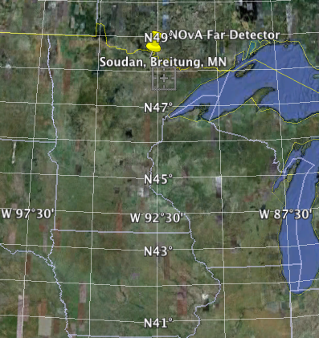
Soudan Underground Laboratory Breitung, MN
Depth: 713 m, 2090 mwe
Start of Physics: 1980
Experimental Halls:
• 13 m by 14 m by 70 m
• 15 m by 15 m by 90 m
Full-Time Staff: 9 people
Systems: Electrical Power, Telecommunications (Internet), HVAC, Cryogenics, Closed Loop Cooling
NuMI Neutrino Beam from Fermilab
Access Time from Surface: 3 min

Slide 23
Soudan Underground Laboratory
713 m deep = 2090 mwe
Operated by the University of Minnesota and leased from the Park Service. Located in an iron mine which is now a Minnesota State Park near Lake Vermilion
Experiments:
MINOS neutrino oscillation experiment, running since 2003, receiving beam from FNAL (NUMI beam)
CDMS-2 Experiment ended in 2009 and now running SuperCDMS at Soudan through 2015 – new detectors, same shield and icebox.
Copper Electroforming – Reeves and Sons, Inc funded by SBIR
SOLO – HPGe doing screening mostly for LUX, managed by Brown University
COGeNT dark matter search (University of Washington, PNNL)
Neutron Multiplicity Meter (UCSB, Case) studying cosmogenic neutrons
Soudan 2 Proton decay experiment (ended in 2001)
Calorimeter removed in 2005, but proportional tube veto remains in place
Muon Shielded Hall is the Soudan 2 proportional tubes lining a 35’ x 40’ x 100’ cavern, with a new user-configurable DAQ

Slide 24
HPGe Screening (SOLO)
Lift from Surface
MINOS
Cu Electroform
Fully lined with an active muon veto.
CoGeNT, Medtronics Cosmo-n Detector XIA alpha, BetaCage Gopher HPGe
CDMS Exp.
CDMS office
Shielded hall
Historic Mine Tour (rail cars)

Slide 25
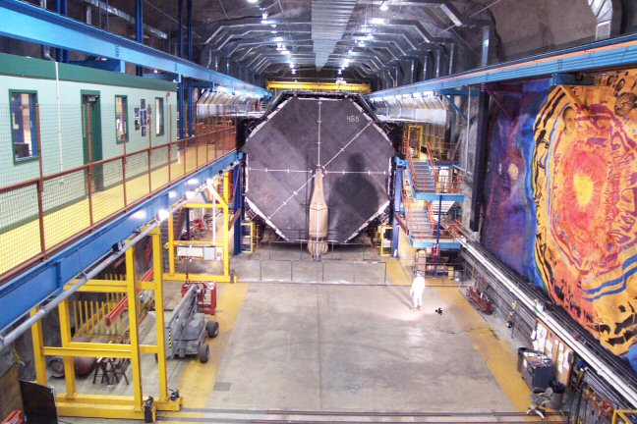
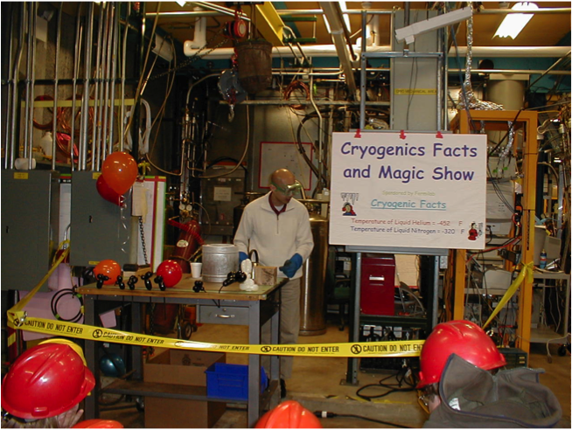
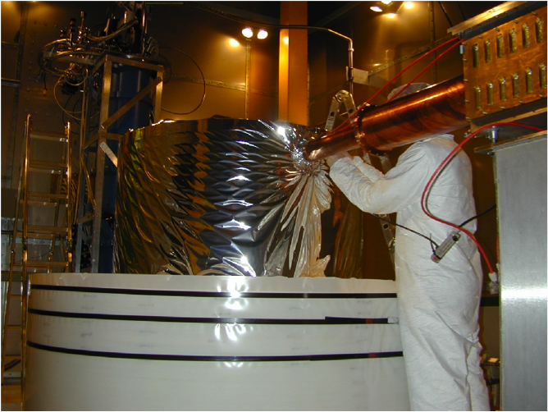
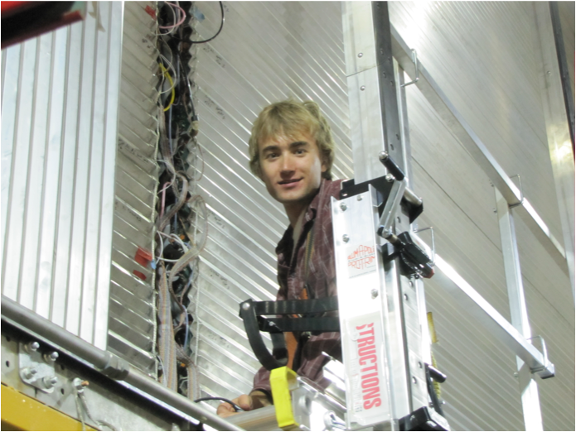
MINOS
Outreach
CDMS
Muon-shielded Hall

Slide 26
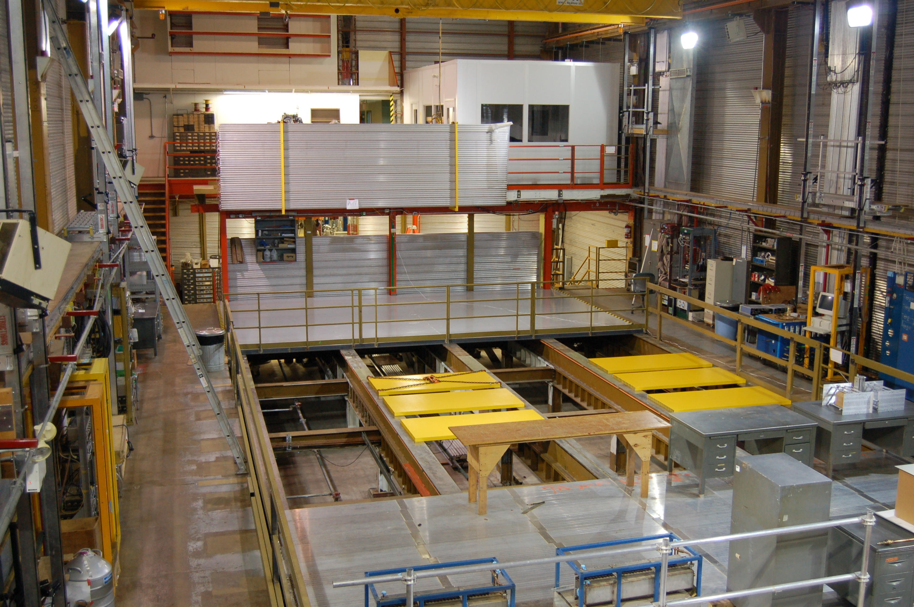
Muon-Shielded Experimental Hall (35’ x 40’ x 100’)
Picture before installation of the following experiments.
CDMS screenging HPGe
Beta Cage DUSEL R&D (Syracuse, Caltech)
Neutron Multiplicity Meter
GoGeNT
Medtronics soft memory errors
XIA Alpha counter tests

Slide 27
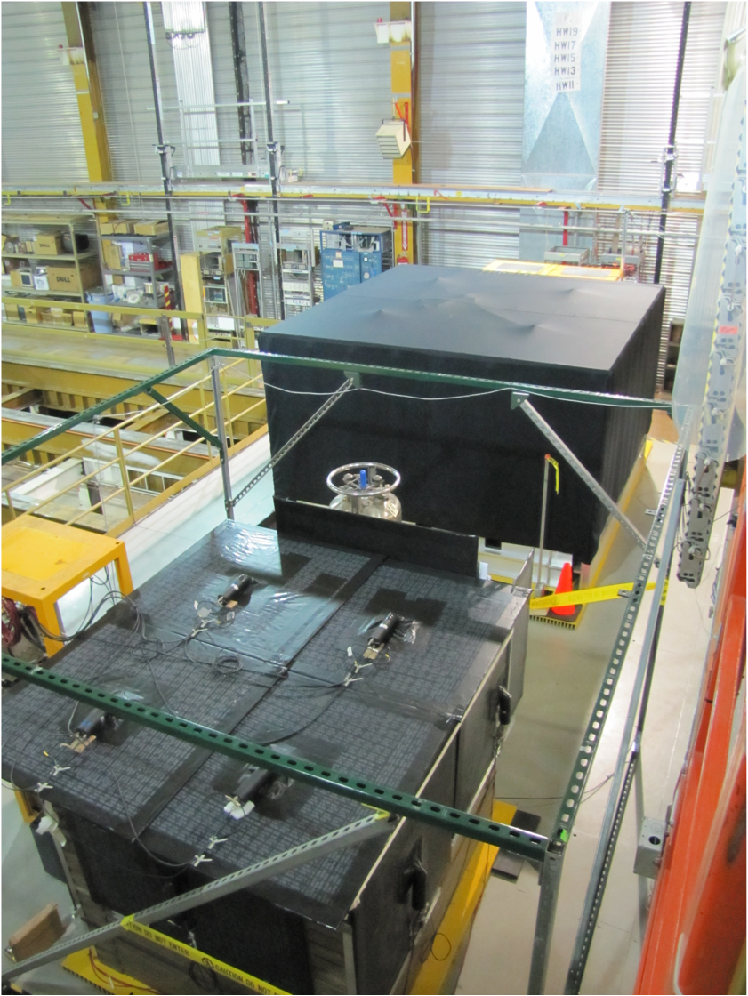
Neutron Multiplicity Meter
CoGeNT

Slide 28
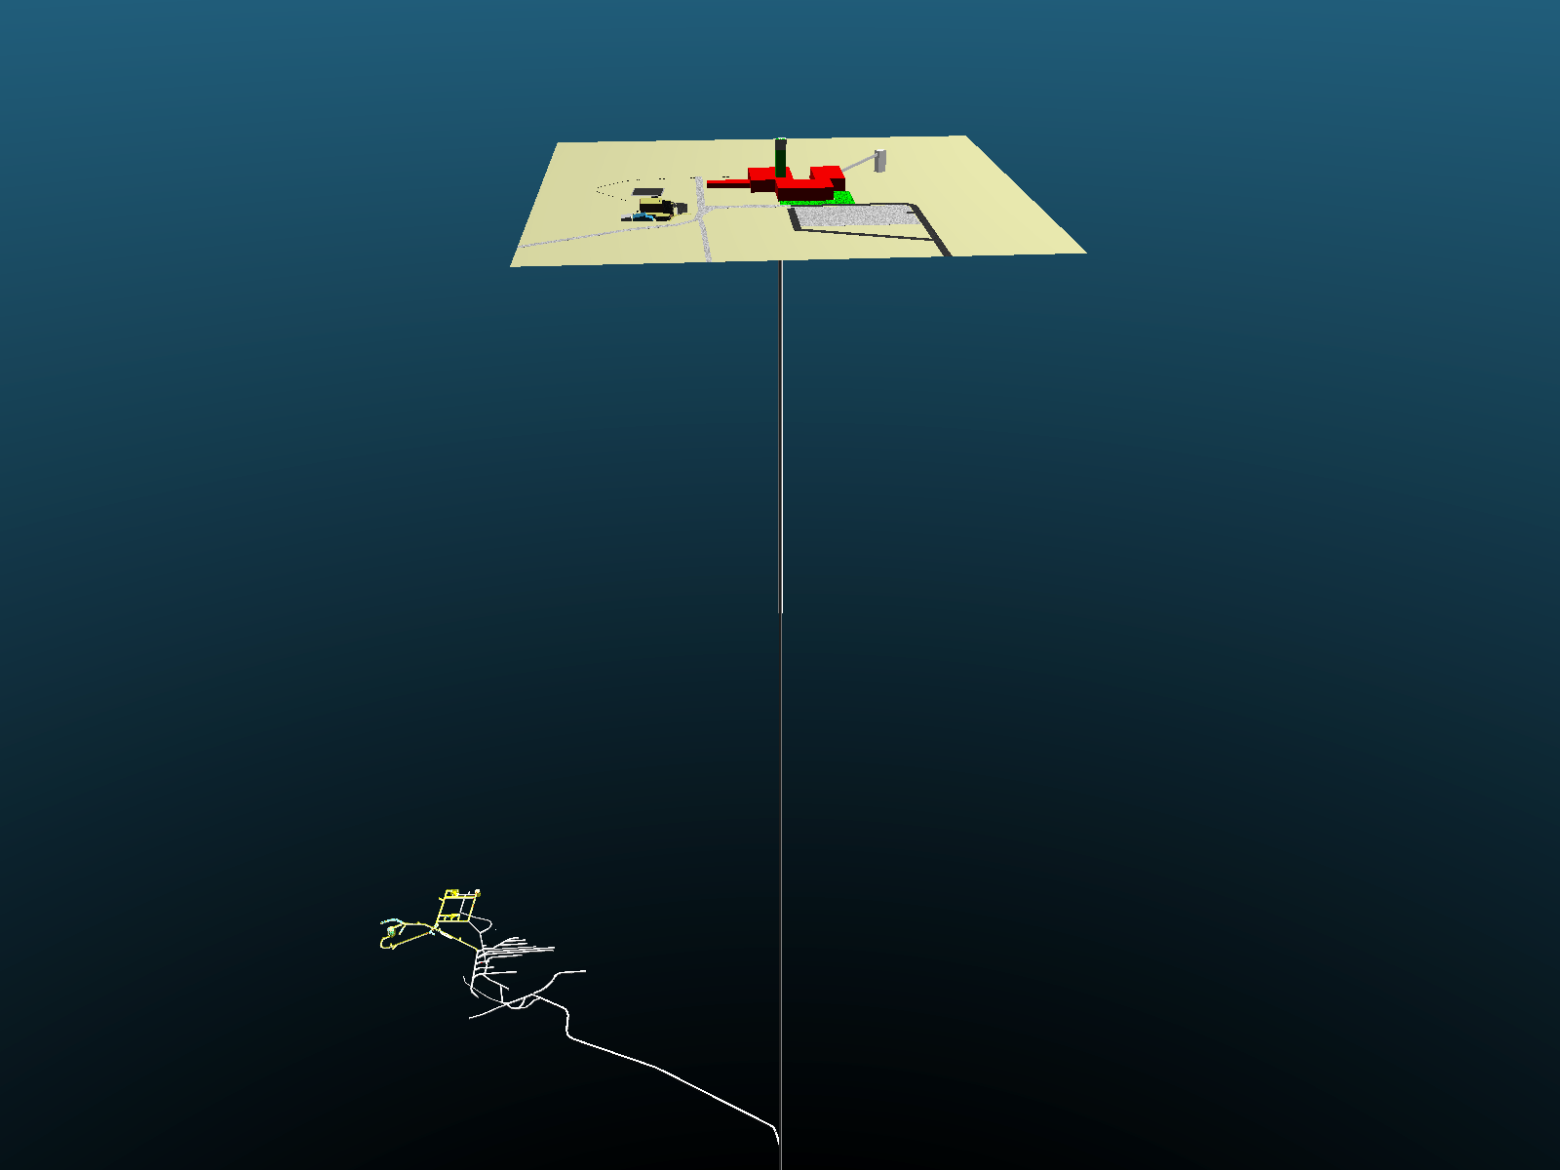
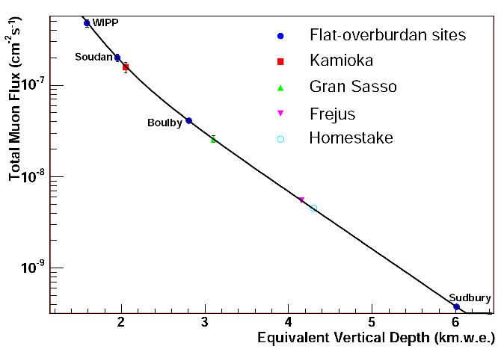
SNOLAB
Surface
Facility
2km
overburden
(6000mwe)‏
Underground
Laboratory
Muon Flux = 0.27/m²/day
MEI & HIME astro/ph 0512125

Slide 29
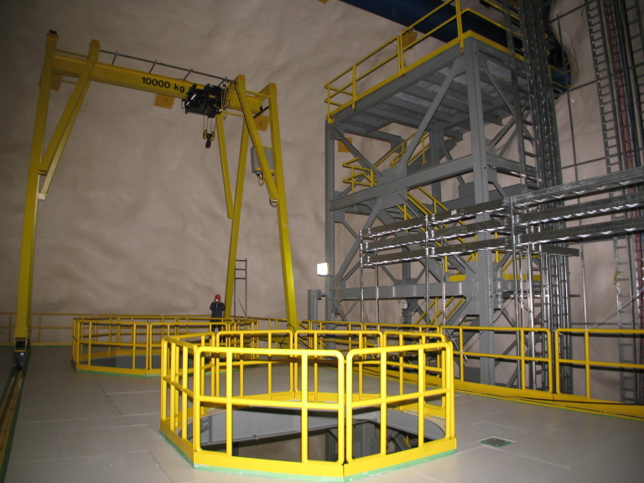
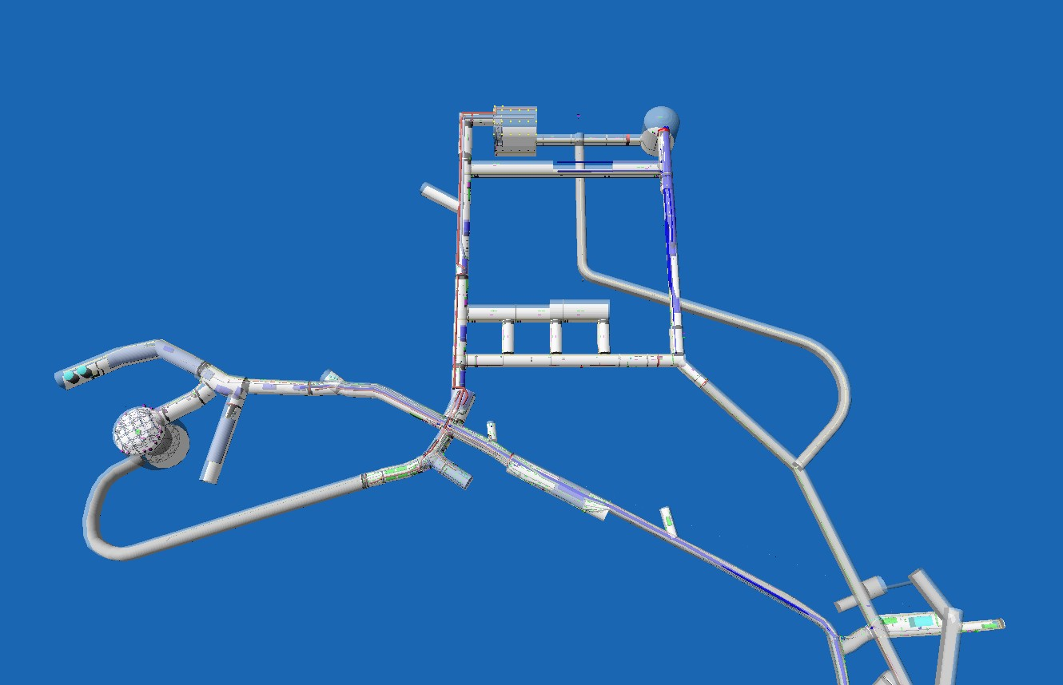
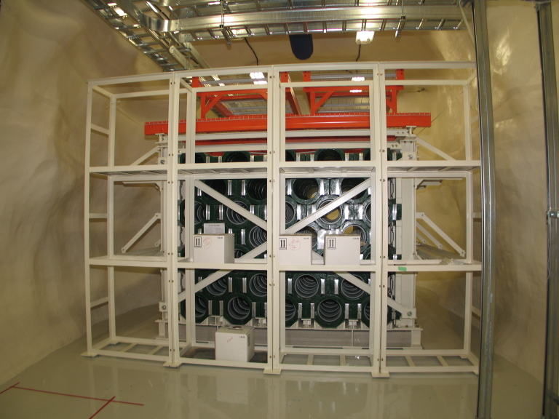
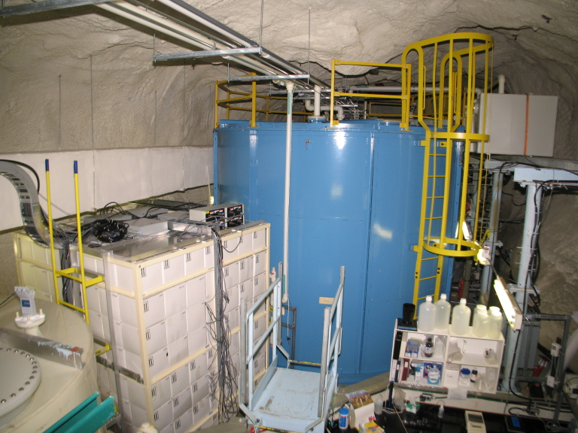
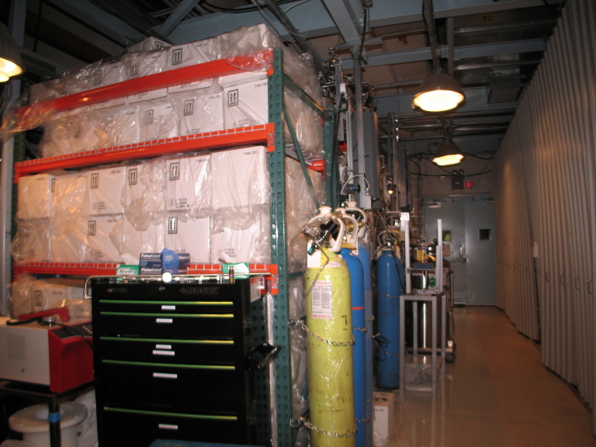
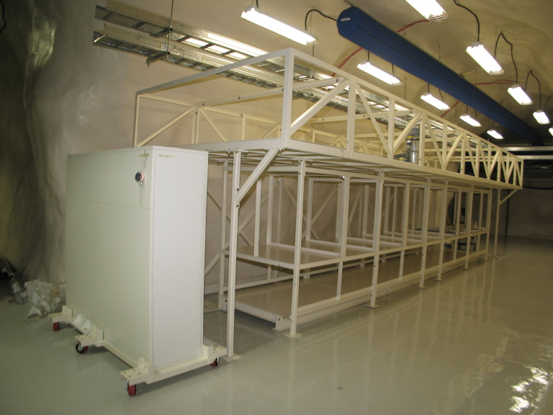
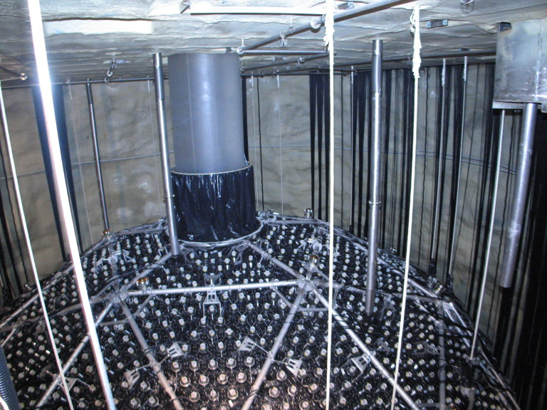
Now:DEAP-3600
MiniCLEAN
SNOLAB Experimental Program
Now: HALO
Now: HALO
Cube Hall
Cryopit
Now:
PICASSO-II
HALO
Stub
Utility
Drift
2011: COUPP 60kg
2010: COUPP-4kg
2011: SuperCDMS?
Now: DEAP-1
Ladder Labs
Now:
PICASSO-IIB
SNO
Cavern
South
Drift
Personnel facilities
Utility
Area
Now: SNO+

Slide 30
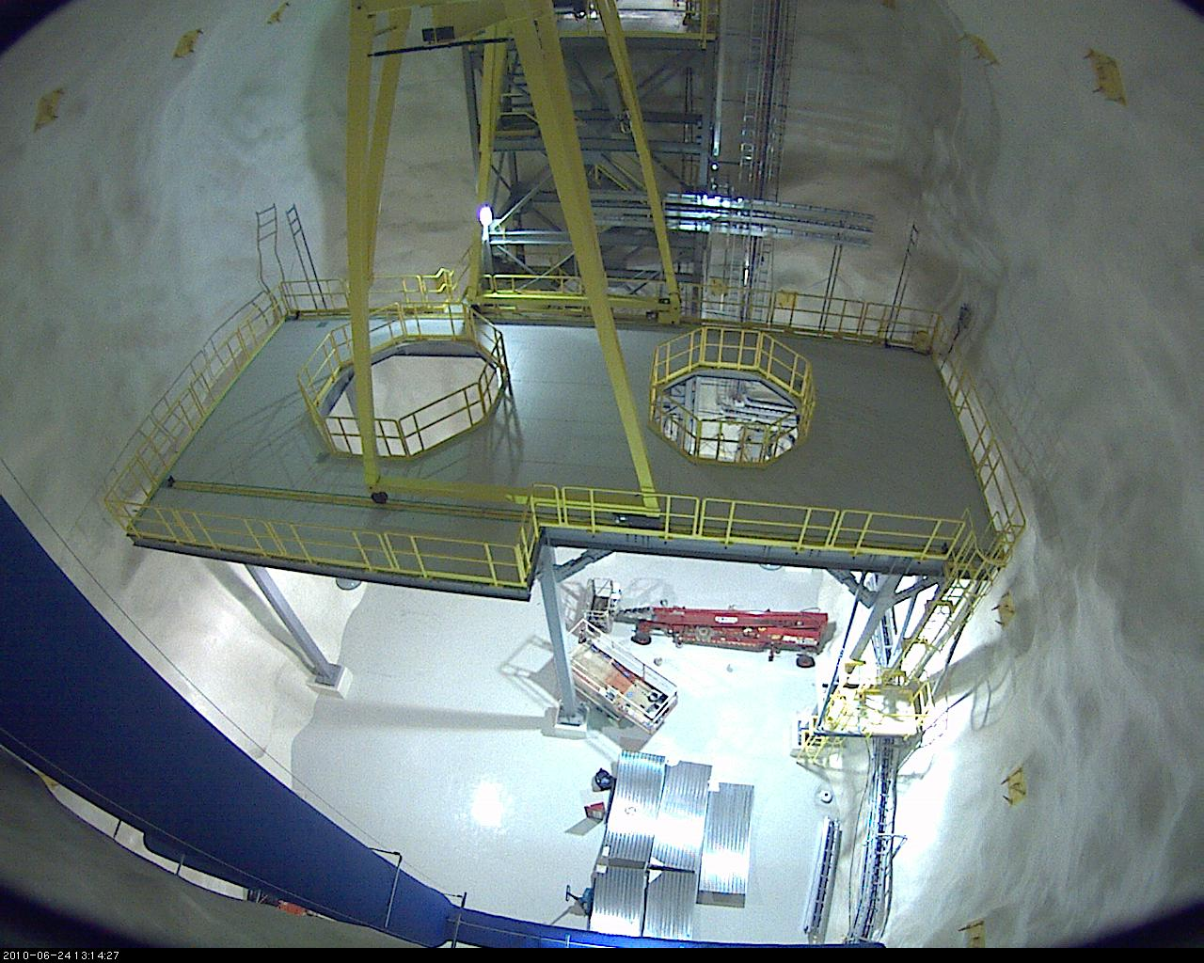
8 July 2010
Fraser Duncan, MiniCLEAN Review

Slide 31
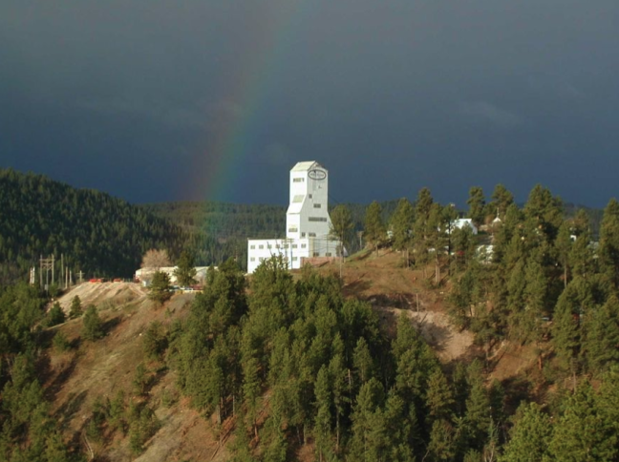
Sanford Underground Laboratory / DUSEL
See talk by G. Gilchrist

Slide 32
Conclusions
Many local facilities provide easy access and opportunities for local students and faculty.
Complementary to large underground facilities.
SNOLAB and DUSEL point to an exciting future for underground science in North America

Slide 33
Acknowledgements
LRT 2010 Organizers
Slides:
Fraser Duncan – SNOLAB
Jaret Heise – SUL/DUSEL
Prisca Cushman, Marvin Marshak (U. of Minnesota) – SOUDAN
Yuen-Dat Chan, Al Smith (Lawrence Berkeley National Laboratory) – Oroville
Eric Hoppe, Dick Kouzes, Jim Fast – PNNL
Steve Elliott (LANL), Norbert Rempe -- WIPP

Slide 34
Backups

Slide 35
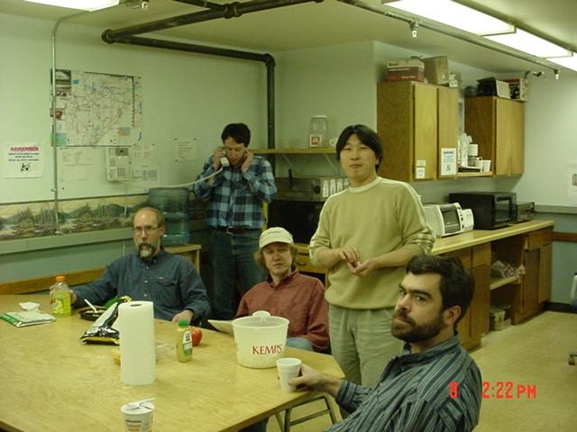
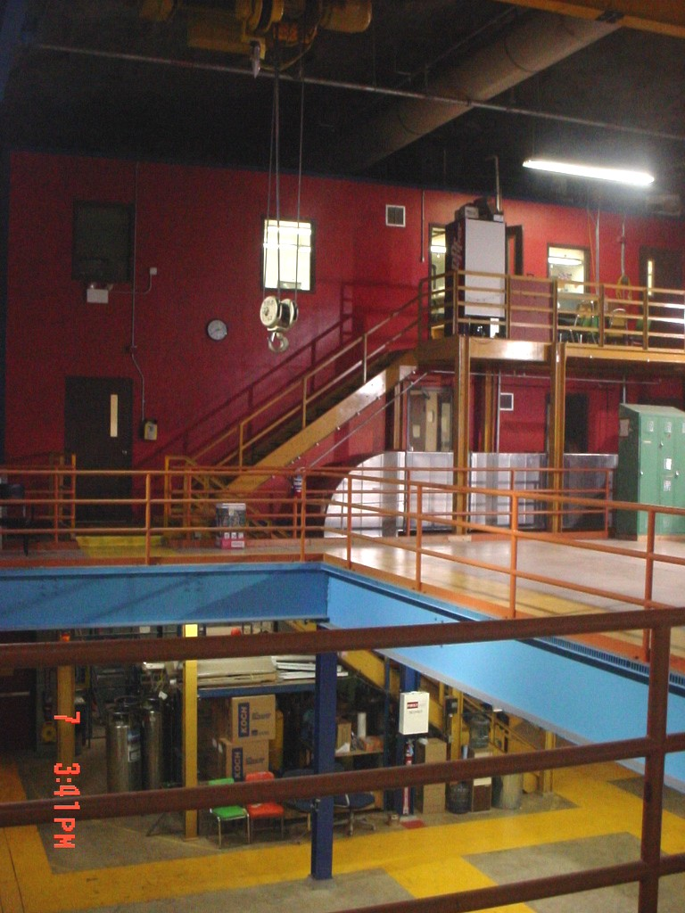
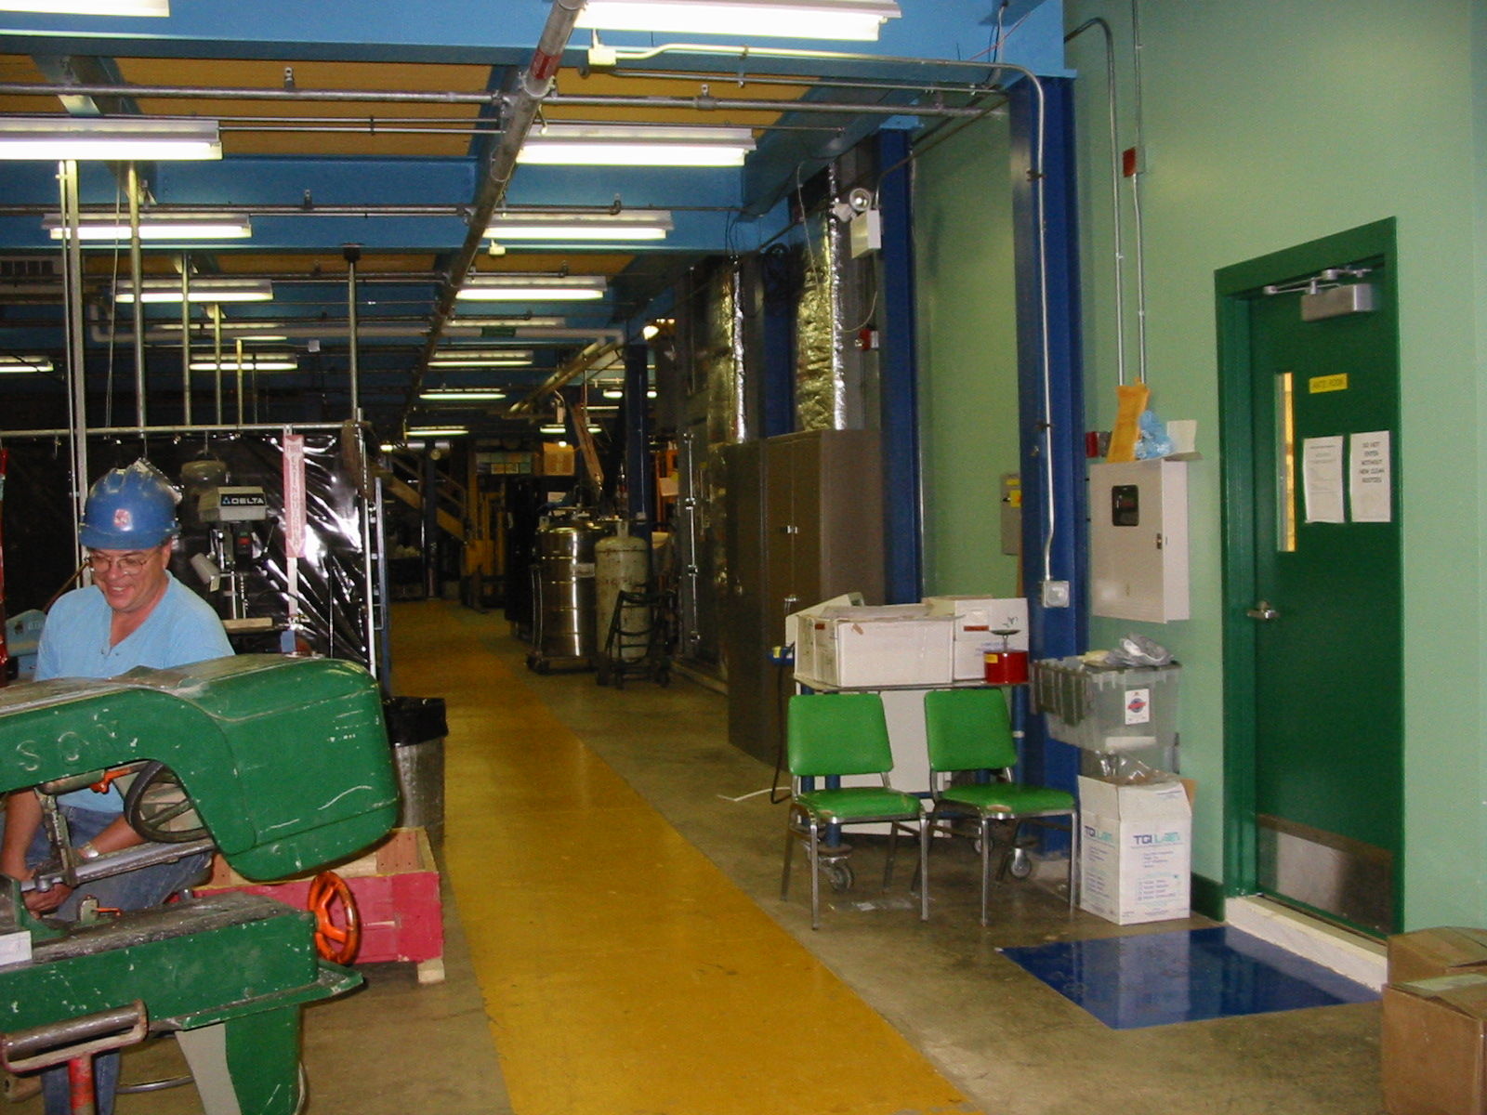
Detector Prep
RF room
Machine Shop

Slide 36
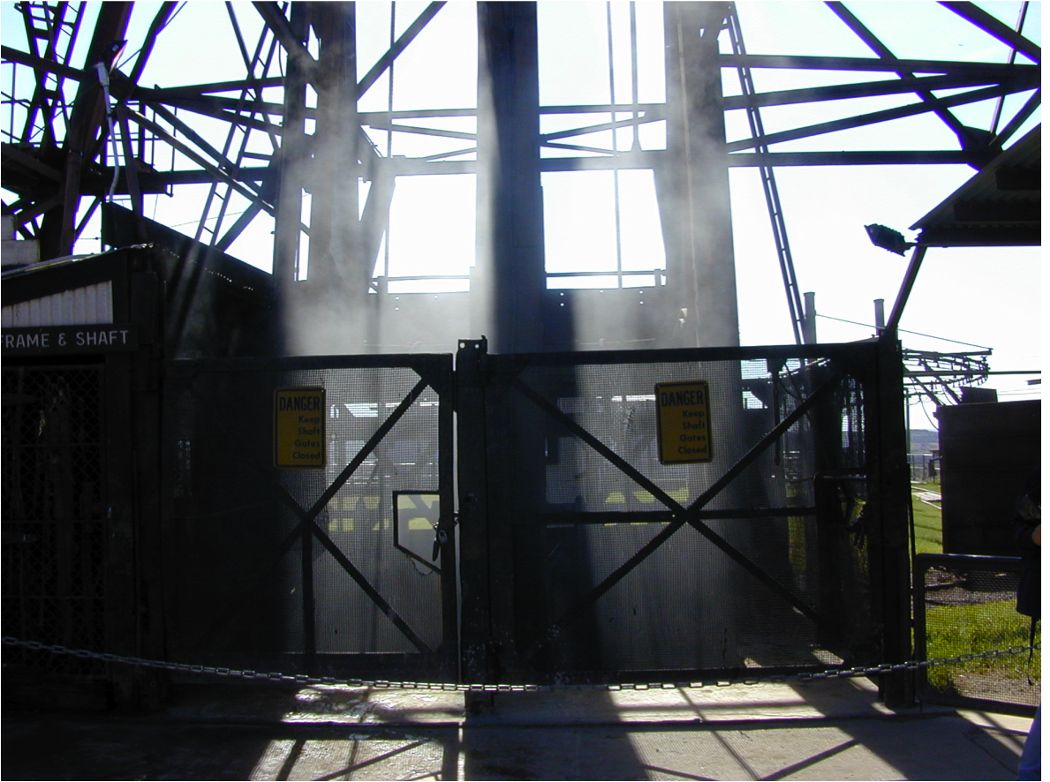

Slide 37
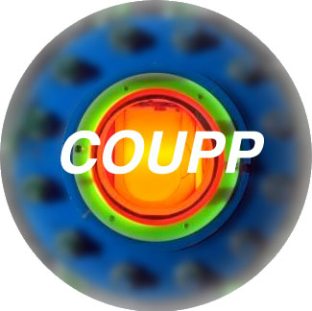
Recent Projects Supported by LBF
Contact:
ydchan@lbl.gov
arsmith@lbl.gov
COUPP

Slide 38
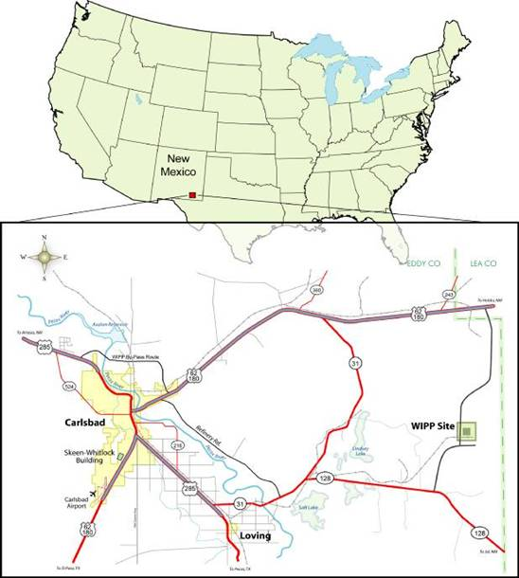

Slide 39
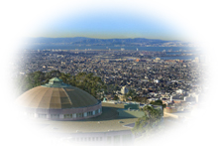
Low Background Facility at LBNL
History:
Established by A.R. Smith in the late 1950s for quantifying the stray radiation field of the newly operational Bevatron at LBL. Since the early 1980s, the LBF has become increasingly utilized to select low-activity construction materials for use in experiments searching for rare events, as in double beta-decay, dark matter, and neutrino interactions.
Location:
Underground Site
(Oroville, Ca)
Surface Site
(LBNL, Berkeley, Ca)
LRT2010

